Slide 1
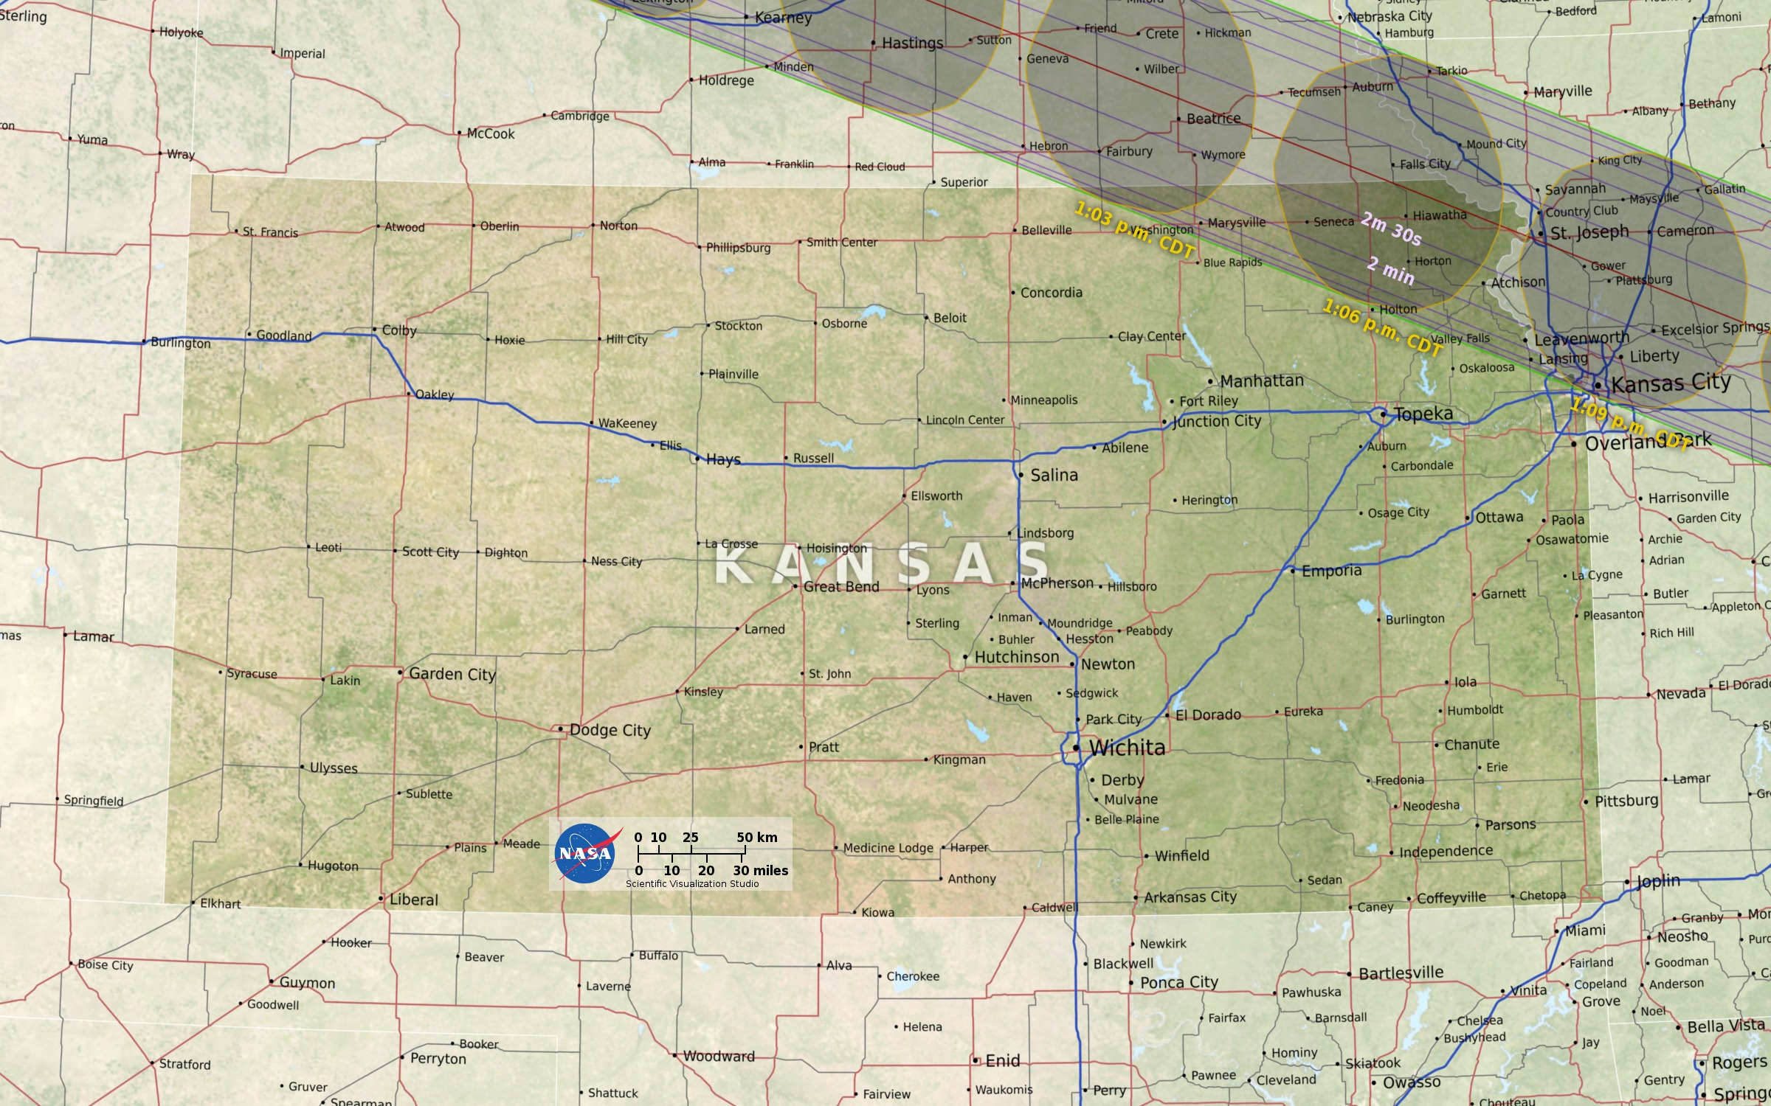
Notes:
2017 Total Solar Eclipse Path
The path of totality passes through 14 states during the total solar eclipse on August 21, 2017. The umbra is shown at 3-minute intervals, with times in the local time zone at the umbra center. The duration of totality is outlined in 30-second increments. Interstate highways are blue, other major roads are red, and secondary roads are gray.
For more information, please visit:
svs.gsfc.nasa.gov/4552

