Slide 1
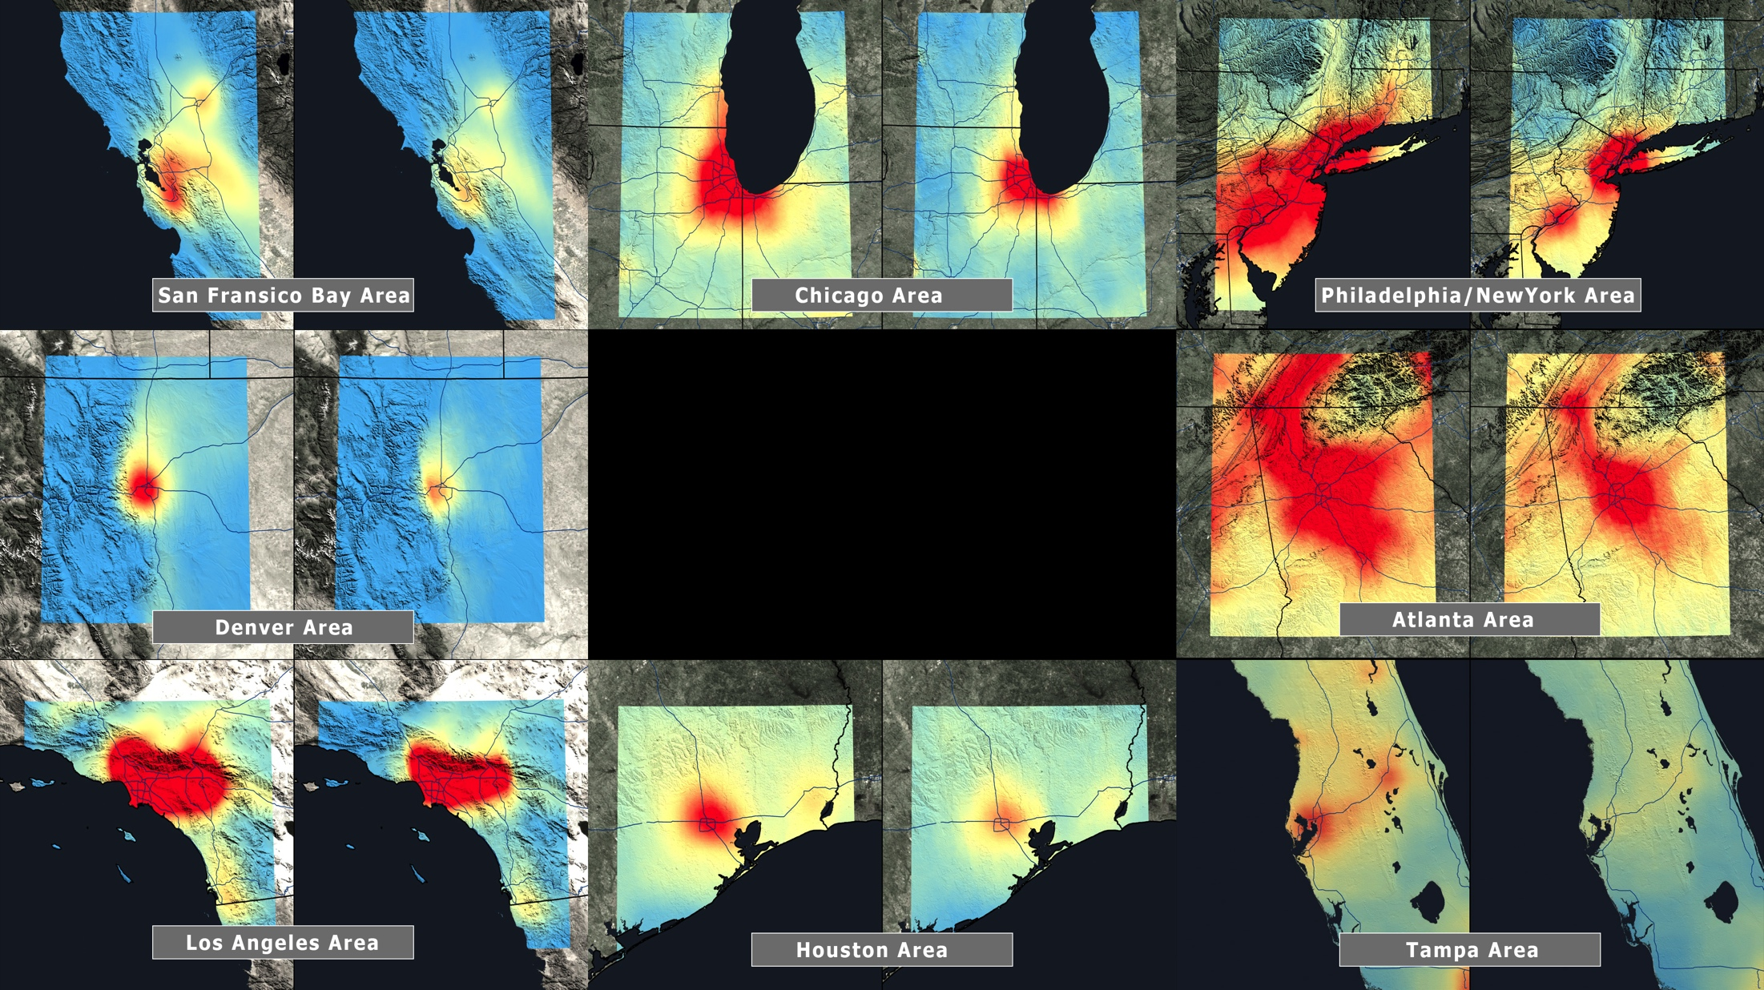
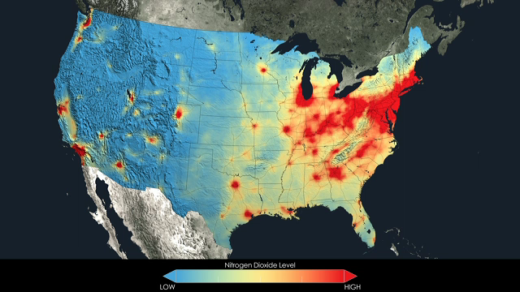
Notes:
U.S. Air Quality Improvement
Average yearly atmospheric nitrogen dioxide the U.S., 2005-2011.
Anyone living in the U.S. for the past decade may have noticed a change in the air. The change is apparent in NASA satellite images that demonstrate the country's reduction of air pollution, or more specifically, nitrogen dioxide.
Nitrogen dioxide can impact the respiratory system, and it also contributes to the formation of other pollutants including ground-level ozone and particulates. The gas is produced primarily during the combustion of gasoline in vehicle engines and coal in power plants. Air pollution has decreased even though population and the number of cars on the roads have increased. The shift is the result of regulations, technology improvements and economic changes, scientists say.
This visualization shows tropospheric column concentrations of nitrogen dioxide across the U.S. as detected by the Ozone Monitoring Instrument on NASA's Aura satellite, averaged yearly from 2005-2011.

