Slide 1
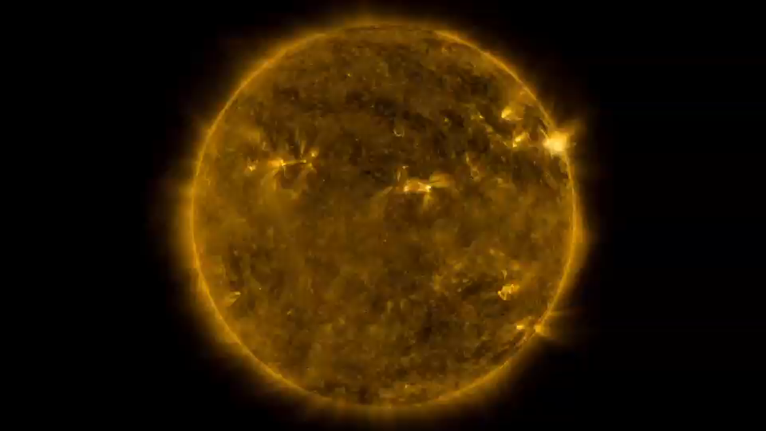
Notes:
As kids, we’re taught to not look directly into the sun. Now, a time-lapse video created from observations by NASA’s Solar Dynamics Observatory, or SDO, spacecraft provides an opportunity to catch up on what we’ve been missing. Since its launch in 2010, the spacecraft has captured images of the sun 24 hours a day in specific wavelengths of light that allow scientists to see solar material of different temperature as well as changes to the sun’s surface and atmosphere. The time-lapse video features more than 5,000 images taken by SDO over the last five years. The images are spaced eight hours apart, which is too infrequent to catch fast-moving bursts like solar flares, but allows a close look at solar activity taking place over longer timescales. Watch the video to see five years in the life of our sun.

