Slide 1
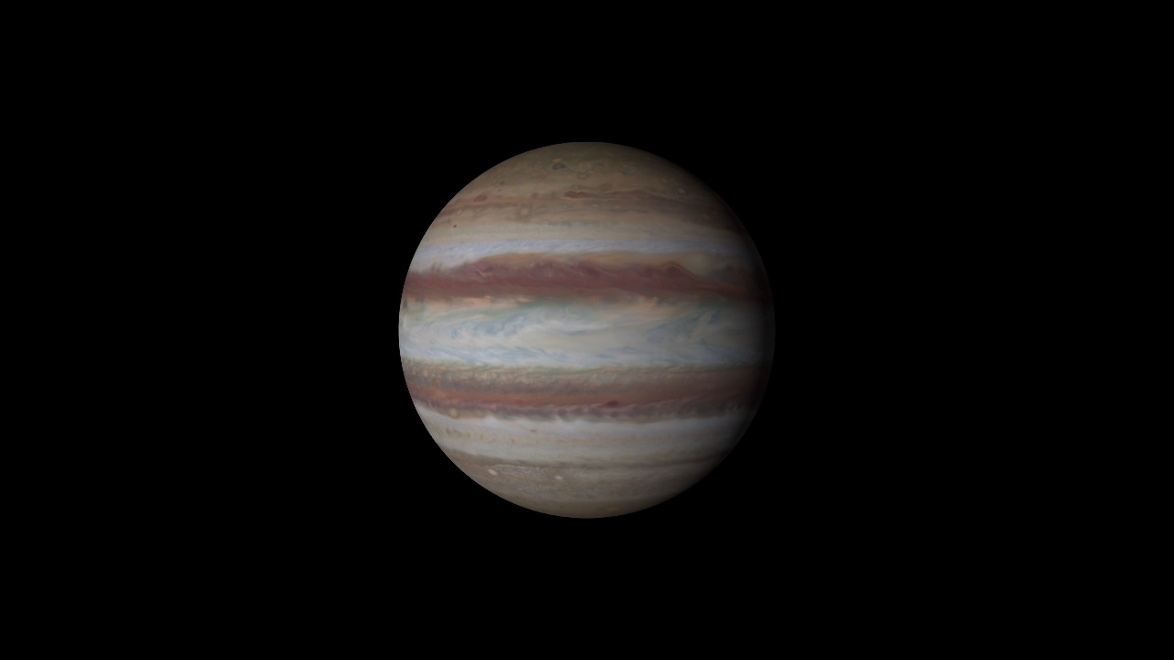
Notes:
Hubble Maps Jupiter
This new map of Jupiter was made from observations performed with NASA’s Hubble Space Telescope. It is the first product to come from a program to study the solar system’s outer planets – Jupiter, Uranus, Neptune and, later, Saturn – each year using Hubble. The observations are designed to capture a broad range of features, including winds, clouds, storms and atmospheric chemistry. These annual studies will help current and future scientists see how these giant worlds change over time.
Scientists at NASA’s Goddard Space Flight Center, the Jet Propulsion Laboratory, and the University of California at Berkeley produced two global maps of Jupiter from the observations, which were made using Hubble’s high-performance Wide Field Camera 3.
The two maps (the first of which is shown here) represent nearly back-to-back rotations of the planet, making it possible to determine the speeds of Jupiter’s winds. Already, the images have revealed a rare wave just north of the planet’s equator and a unique filament-like feature in the core of the Great Red Spot that had not been seen previously. In addition, the new images confirm that the Great Red Spot continues to shrink and become more circular, as it has been doing for years. The long axis of this characteristic storm is about 150 miles (240 kilometers) shorter now than it was in 2014. Recently, the storm had been shrinking at a faster-than-usual rate, but the latest change is consistent with the long-term trend.
For more information, visit:
http://svs.gsfc.nasa.gov/cgi-bin/details.cgi?aid=12021

