Slide 1

EXPANDING OUR VIEW
Notes:
1. Slide #1 – Onscreen before presentation begins and during introduction
These slides are available for you to customize for your presentation
In this notes pane area you will find key points that coordinate with each slide, as well as links to additional resources.
Image credit: NASA
Illustration
Here are some general resource sites:
Library of Roman visuals
https://outerspace.stsci.edu/display/SRO/Library+of+Roman+Visuals
Roman information for the science community
https://stsci.edu/roman
Roman Science Interest Group
https://roman.gsfc.nasa.gov/science/rsig.html
Roman information for the general public
https://www.stsci.edu/roman
Slide deck provided by Goddard Space Flight Center, aimed more at the science community
https://roman.gsfc.nasa.gov/science/workshop112021/presentations/Mon_Overview/roman_mission.pdf
Roman Partner institution information:
NASA Goddard Space Flight Center: https://roman.gsfc.nasa.gov/
NASA Jet Propulsion Laboratory NASA JPL: https://www.jpl.nasa.gov/missions/the-nancy-grace-roman-space-telescope
IPAC Caltech roman.ipac.caltech.edu
Formulation Science Working Group: https://roman.gsfc.nasa.gov/science/fswg/

Slide 2
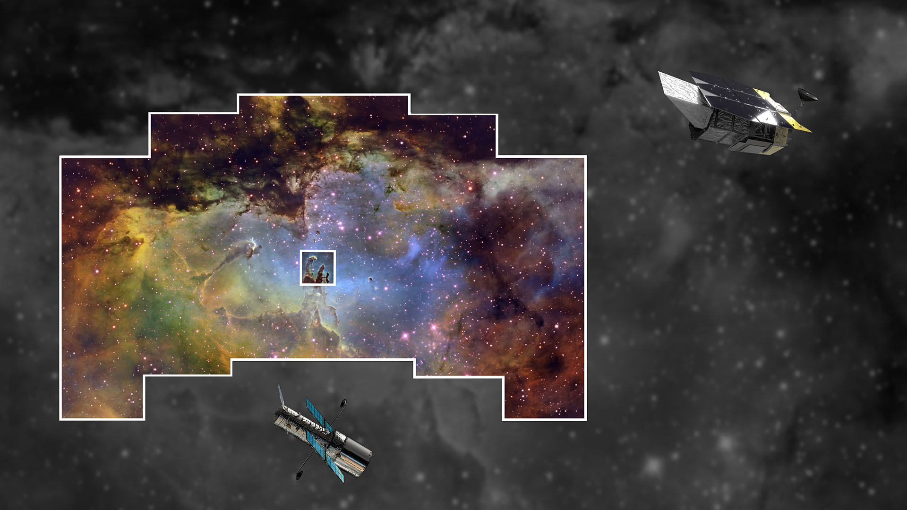
ROMAN
The Bigger
Picture
200x HUBBLE’S INFRARED VIEW
HUBBLE
Notes:
2. Roman FOV compared with familiar Hubble Space Telescope
Key points to discuss:
Compared to Hubble’s Wide Field Camera 3 (WFC3) infrared capability, Roman is 200x the field of view, with the same high-quality/high-resolution data.
Combined data quality and data volume will help us to see “bigger picture” of how the universe works.
No other space-based telescope has this FOV and same data quality
More in-depth messaging:
This image of the Eagle Nebula showcases both the Roman’s large field of view as well as its superb resolution. The field of view is compared with Hubble’s famous image of the three dust pillars, shown at the center. Each outlined area shows what the telescopes capture in a single pointing/shot. The rest of the image is taken from a ground-based telescope.
Roman will provide a very high quantity of high-quality data that could be what astronomers need to finally make progress on some cosmic mysteries that have been difficult to solve, i.e., dark energy and the nature of dark matter.
Hyperlinks for presentation, i.e., related videos or webpages:
Zoom out video from Eagle Nebula to the larger Carina Nebula: https://hubblesite.org/contents/media/videos/2020/41/1284-Video
Zoom out video from center of Abell 426 field to the fuller cluster field: https://hubblesite.org/contents/media/videos/2020/41/1285-Video
Video with interview and various perspectives: https://svs.gsfc.nasa.gov/13587
Image credits:
Wide view: Composite image of the National Science Foundation’s 0.9-meter telescope at Kitt Peak National Observatory (Credit: T.A. Rector (NRAO/AUI/NSF and NOIRLab/NSF/AURA) and B.A. Wolpa (NOIRLab/NSF/AURA), and an image by amateur astronomer Liam Murphy.
Center image: NASA, ESA, and the Hubble Heritage Team (STScI/AURA)
Image composition: by L. Hustak (STScI)
Optical Image Filters: F502N ([O III]), F657N (Hα + [N II]), F673N ([S II])
Additional background:
Old handout: https://www.stsci.edu/files/live/sites/www/files/home/roman/_documents/roman-expanding-our-view.pdf
STScI Newsletter: https://www.stsci.edu/files/live/sites/www/files/home/roman/_documents/Newsletter-v34-i02-WFIRST-Landscape-2020s.pdf
NASA News release: https://www.nasa.gov/feature/goddard/2020/a-tale-of-two-telescopes-wfirst-and-hubble

Slide 3
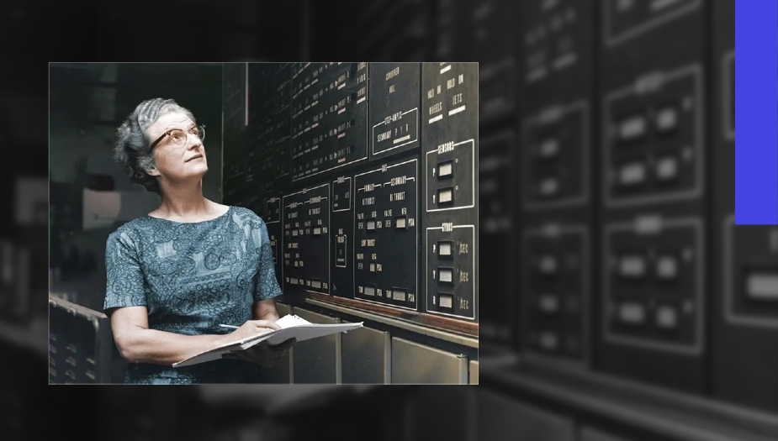
Nancy Grace
Roman
NASA’s First Chief of Astronomy
1925–2018
Notes:
3. The namesake: Nancy Grace Roman
The image on this slide shows Dr. Roman at work and provides an opportunity to discuss her contributions to science.
Key points to discuss:
NASA’s First Chief of Astronomy
Joined NASA in 1959 when the agency was only 6 months old
Championed space-based astronomy, which eventually led to the Roman Space Telescope
Nancy Grace Roman advanced space-based astronomy and general astrophysics knowledge, and the telescope bearing her name will take up that legacy by addressing big questions crucial to the future of the field.
More in-depth messaging:
Nancy Grace Roman was born in 1925 in Nashville, Tennessee and received her PhD from the University of Chicago in 1949. As a woman in astronomy, she experienced many obstacles in getting a permanent position as a working astronomer. She ultimately accepted a job at the new space agency–NASA–in 1959, just six months after NASA was formed.
Dr. Roman was the first female executive at NASA and the first Chief of Astronomy. She worked diligently to plan for a robust suite of satellites and rockets to be managed by NASA, including space-based observatories that could gain a better vantage point for observing the universe above the atmosphere that clouds our vision from the ground. Dr. Roman shepherded the Hubble Space Telescope through the political approval process in Congress. Without Dr. Roman, there very well may not have been a Hubble Space Telescope.
Hyperlinks for more information:
Article with quotes: https://solarsystem.nasa.gov/people/225/nancy-roman-1925-2018/
Press release on naming of telescope: https://www.nasa.gov/press-release/nasa-telescope-named-for-mother-of-hubble-nancy-grace-roman
Olivia Lupie's Roman Science Writer's Workshop presentation:
https://www.youtube.com/watch?v=KK9tIMJl13E
Produced video (6:20)
https://www.youtube.com/watch?v=m5fC3FIUngk&feature=youtu.be
2017 video interviews:
https://svs.gsfc.nasa.gov/12634
Short interview—article format:
https://women.nasa.gov/nancy-grace-roman-2/
Annual Review of Astronomy and Astrophysics—Her Memoir
https://www.annualreviews.org/doi/abs/10.1146/annurev-astro-091918-104446
Image credit: NASA

Slide 4
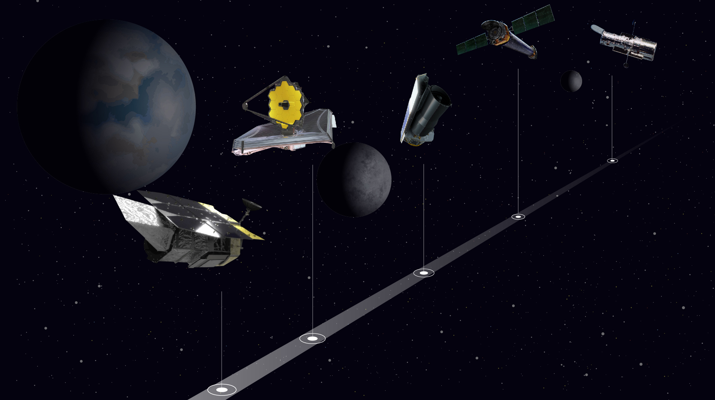
1990
HUBBLE
1999
CHANDRA
2003
SPITZER
2021
  WEBB
"Scientific research and engineering is a continuous series of solving puzzles."
by May 2027
ROMAN
-Nancy Grace Roman
Major US Space-based Missions
Notes:
4. History of major space-based missions resulting from Decadal Surveys – discoveries of one mission lead to the innovations in the next
Key points to discuss:
Every discovery in astronomy leads to new, exciting questions—and new exciting missions.
Example 1: Hubble and Spitzer’s infrared capabilities led to desire to see more infrared light at a high quality—JWST.
Example 2: Discovery of dark energy with Hubble led to Roman being named the top priority major space-based mission in 2010.
Every ten years the astronomy community evaluates the top priorities for future science and what missions can best address them—called the Decadal Review.
The 2020 Decadal Review report was delayed until June 2021 due to the coronavirus pandemic.
The process of building a mission from the initial idea to launch and operation can span an entire career—or more. Often completely new technology has to be developed and tested. This is why astronomers plan far ahead.
Nancy Grace Roman (person) was integral in this forward-thinking approach at NASA from the beginning.
Re: Roman launch date – The date being used in public communication is that launch will occur no later than May 2027, which is related to the mission’s budget as allocated by Congress. The *readiness* date that those working on the mission are working toward is October 2026.
Note for astronomers re: Roman launch date: The Roman team is working toward a “readiness” date of October 2026, but the official public language from NASA is that launch will be no later than May 2027, which aligns with the mission budget.
Hyperlinks for presentation, i.e., related videos or webpages:
American Astronomical Society site:
https://aas.org/advocacy/decadal-surveys
National Academies Astro2020:
https://www.nationalacademies.org/our-work/decadal-survey-on-astronomy-and-astrophysics-2020-astro2020
National Academies Astro2010:
https://nap.nationalacademies.org/catalog/12951/new-worlds-new-horizons-in-astronomy-and-astrophysics
Program (topical) panels: https://www.nationalacademies.org/our-work/decadal-survey-on-astronomy-and-astrophysics-2020-astro2020#sl-three-columns-eb3c7b22-c696-4135-9562-d4f519cc45fb
Image credit: NASA, J. Kang (STScI)

Slide 5
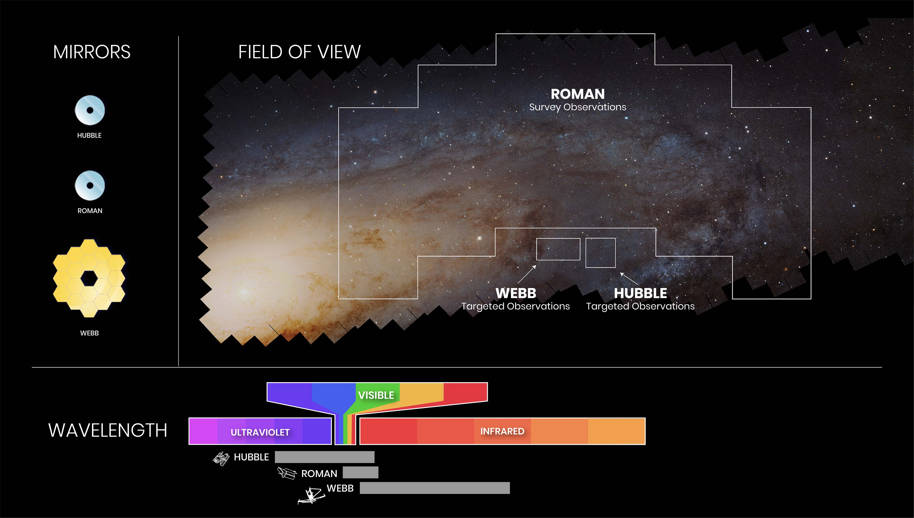
Notes:
5. Major missions comparison—Hubble, Webb, Roman
Key points to discuss:
This slide has examples of how missions are complimentary and work together.
As a survey telescope, Roman will take a broad view that can discover unique objects, and more focused telescopes like Hubble and Webb can follow-up to study in greater detail.
Even when missions are not in the sky at the same time, their archival data will always be able to be cross-referenced.
More in-depth messaging:
Areas where the telescopes overlap on wavelength sensitivity allow them to support and follow-up on each other’s observations. Roman takes the broad view, encompassing a lot of data and information, while telescopes like Hubble and Webb can take a more focused view on specific objects.
Most astrophysics missions have scientific value far beyond the years they actively observe and collect data. All data collected by these (and many other) missions are archived in the Mikulski Archive for Space Telescopes (MAST), and are available for future astronomers to reference and compare/contrast with new observations. So, observations taken by Roman in 2030 could be compared with Hubble’s observations from 1995, and new discoveries could be made using both the new and archived data.
Hubble and Roman mirrors are the same size, but Roman’s weighs less because of advances in technology since Hubble was engineered. Roman has a faster focal ratio f/7.8, or shorter local length, compared to Hubble’s f/24.
Hyperlinks for presentation, i.e., related videos or webpages:
Harry Ferguson Slides from Roman Science Writer’s Workshop:
https://www.stsci.edu/files/live/sites/www/files/home/events/event-assets/2020/_documents/2020-workshop-science-writers-roman-presentation-ferguson.pdf
and his talk: https://cloudproject.hosted.panopto.com/Panopto/Pages/Viewer.aspx?id=ecf77c76-d4fa-4028-9db0-ac4c01055d18
Image credit: A. James (STScI)

Slide 6
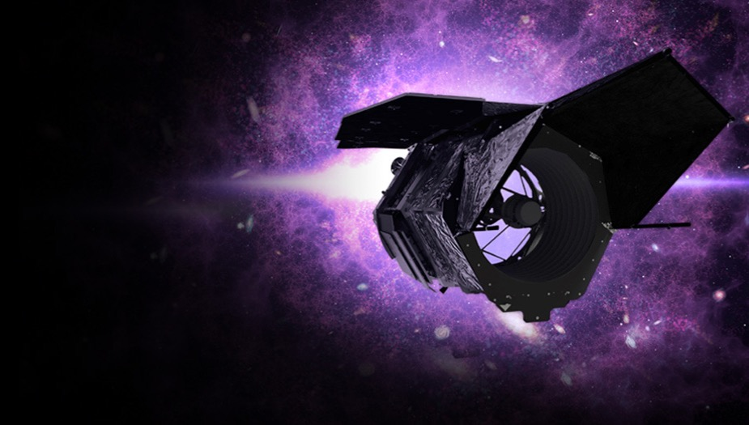
Roman Facts & Figures
300-megapixel camera
1 advanced coronagraph
5-year primary mission
930,000 miles (1.5 million km) from Earth
410 lbs (186 kilograms) primary mirror
Notes:
6. Facts & Figures list
This slide can spark as much or as little discussion as the presenter and audience like; options for in-depth discussion include:
Why it is important to be above the atmosphere (launch) and shielded from the heat of the Sun (location at L2)
https://www.nasa.gov/content/discoveries-why-a-space-telescope
What are the Lagrange Points, specifically L2?
Webb and other telescopes are also at L2
https://solarsystem.nasa.gov/faq/88/what-are-lagrange-points/
https://www.space.com/30302-lagrange-points.html
https://map.gsfc.nasa.gov/ContentMedia/lagrange.pdf
The primary, or minimum, duration science mission that Roman is designed to fulfill is five years. Fuel to keep Roman stable at L2 determines the length of the mission after that. The five years will begin at the launch date, which is planned to be no later than May 2027 (official language). The Roman team is aiming for the “readiness” date of October 2026.
Telescopes use a mirror to gather light and create an image, just like still film cameras did before everyone started using digital cameras on their phones.
https://www.nasa.gov/feature/goddard/2020/primary-mirror-for-nasas-roman-space-telescope-completed
Two instruments on Roman are discussed in the next few slides.
One (1) terabyte = 1,024 GB, or 200,000 5-minute songs; 310,000 pictures; or 500 hours of movies. Via https://www.howtogeek.com/353116/how-big-are-gigabytes-terabytes-and-petabytes/
Around 2007, consumer hard drives reached a capacity of 1 TeraByte. Now, hard disk drives (HDDs) are measured in Terabytes e.g., a typical internal HDD may hold 2 Terabytes of data whereas some servers and high-end workstations that contain multiple hard drives may have a total storage capacity of over 10 Terabytes. https://www.geeksforgeeks.org/understanding-file-sizes-bytes-kb-mb-gb-tb-pb-eb-zb-yb/
All Roman data will be immediately available to the astronomical community. More on Big Data slide - #29.
Image credit: NASA
Links to more background info:
https://roman.gsfc.nasa.gov/science/Roman_Reference_Information.html
Jennifer Wiseman and Julie McEnery's STScI Public Lecture:
https://youtu.be/QIHxdXxGDsc

Slide 7
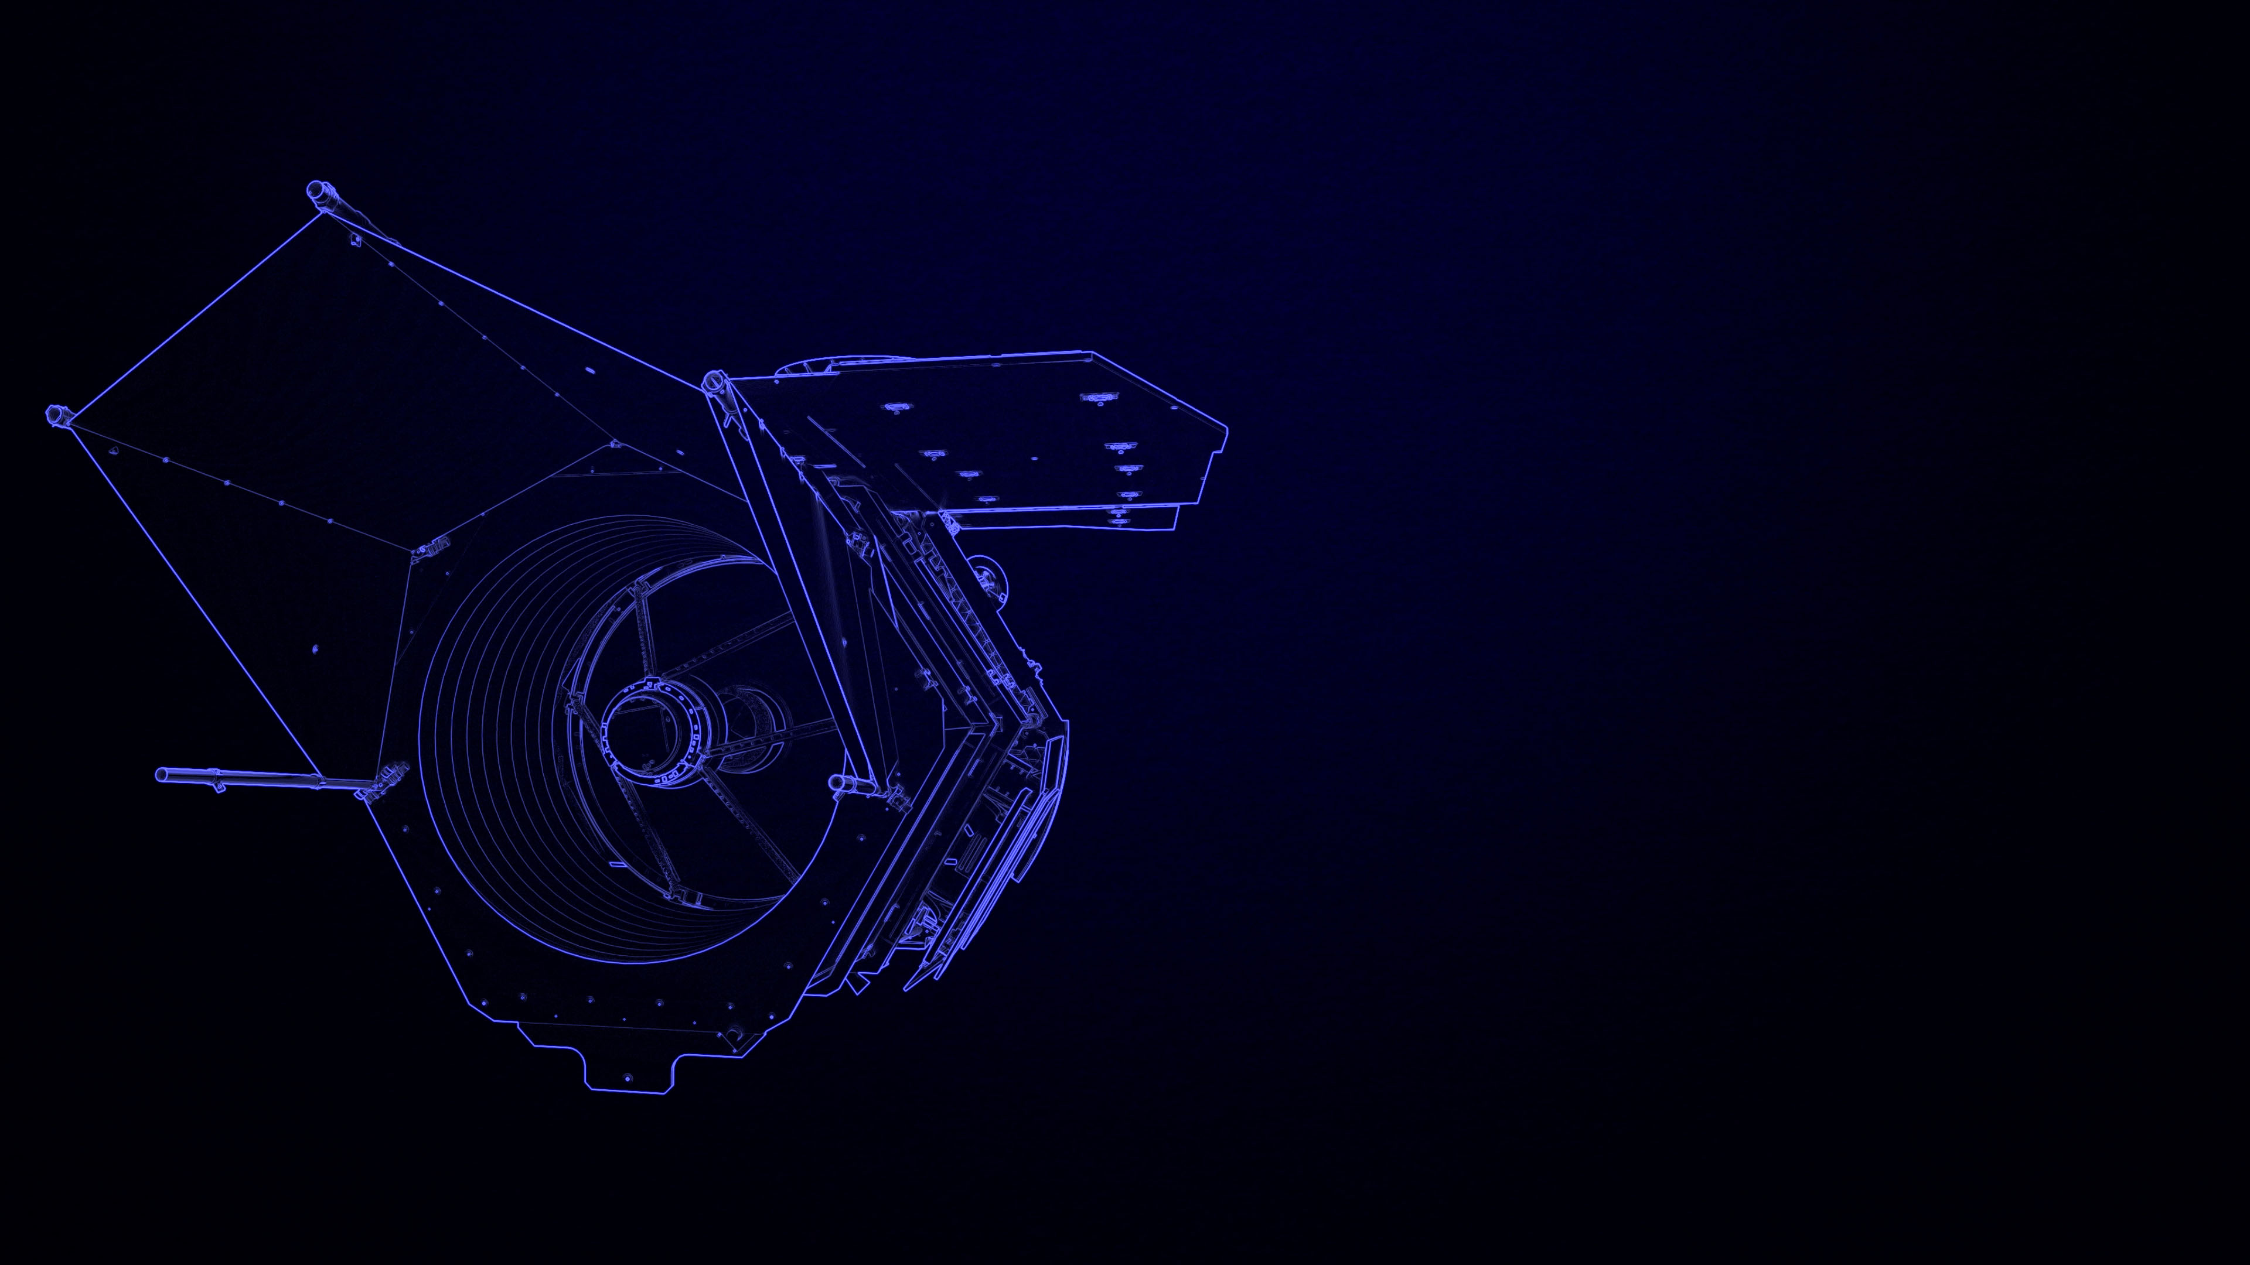
Roman Instruments
Wide Field Instrument
Coronagraph Instrument
Notes:
7. Introducing Roman’s instruments
Key points to discuss:
Roman has one science instrument (WFI) and one technology demonstration instrument (coronagraph).
Contrast with Hubble: targeted, detailed observations vs. a survey.
Roman combines Hubble-quality imaging with the breadth of a mission like the Sloan Digital Sky Survey
Hubble has four science instruments
More in-depth messaging:
Distinction between a science instrument and tech demonstration instrument:
The coronagraph instrument will be the first high-performance coronagraph system in space capable of direct imaging of exoplanet systems. It will inform future potential NASA missions aimed at imaging and characterizing faint Earth-like planets orbiting nearby stars.
Image credit: NASA, GSFC
Illustration
Links to more background info:
https://www.jpl.nasa.gov/missions/the-nancy-grace-roman-space-telescope
https://roman.gsfc.nasa.gov/observatory.html
https://www.stsci.edu/roman/observatory
https://svs.gsfc.nasa.gov/13295

Slide 8
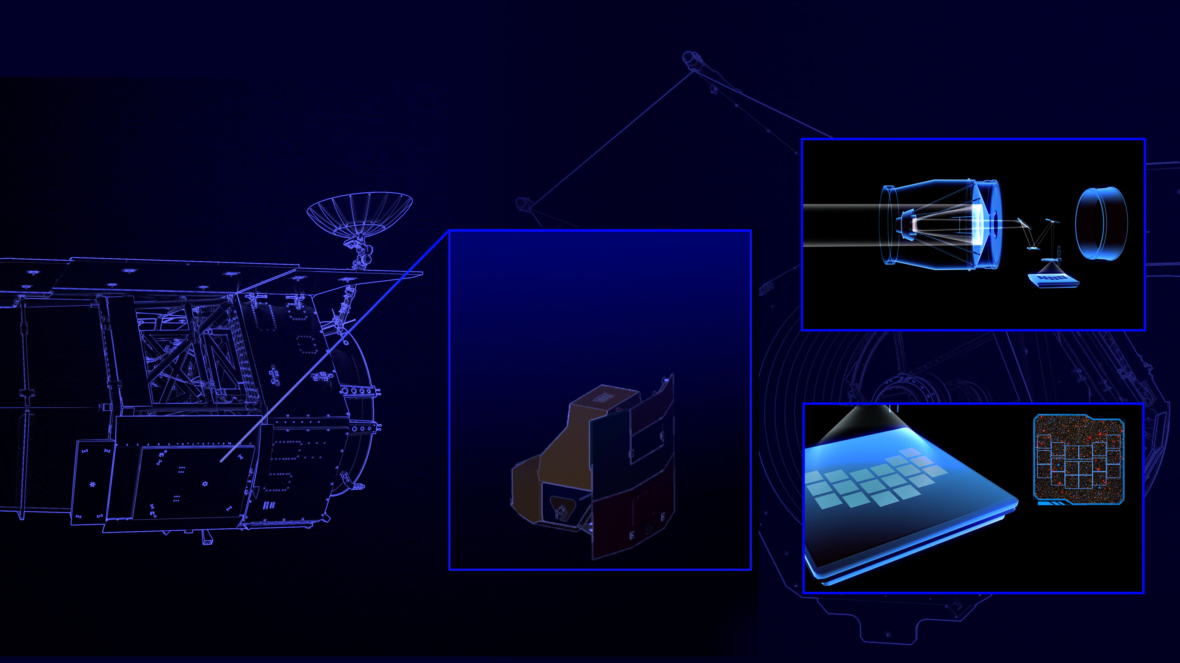
WIDE FIELD INSTRUMENT
Survey-style observations
18 near-infrared light detectors
300-megapixel camera
200x Hubble’s infrared field of view
2 spectroscopic capabilities
Notes:
8. The Wide Field Instrument
Key points to discuss:
Primary science instrument
Imaging and spectroscopy
8 imaging filters span 0.48–2.3 μm
Two slitless spectroscopic modes, spanning 0.75–1.93 µm
18 near-IR detectors each with 4096 x 4096 pixels
~100 x the field of view of Hubble’s ACS instrument, but it has ~200 x the field of view of Hubble’s WFC3/IR instrument
More in-depth messaging:
The Wide Field Instrument is Roman’s primary science instrument. It is a camera made of 18 individual detectors and provides a field of view about 100 times that of Hubble’s Advanced Camera for Surveys, and about 200 times that of its Wide Field Camera 3. Roman’s Wide Field Instrument, or WFI, also has two spectroscopic modes via a grism and a prism.
Hyperlinks for presentation, i.e., related videos or webpages:
https://www.stsci.edu/roman/observatory
https://roman.gsfc.nasa.gov/science/Roman_Reference_Information.html
https://svs.gsfc.nasa.gov/13235 (Video of light through telescope and falling onto WFI detectors)
Julie McEnery's Roman Science Writer's Workshop presentation:
https://youtu.be/KK9tIMJl13E?t=1020
Image credit: NASA Illustration

Slide 9
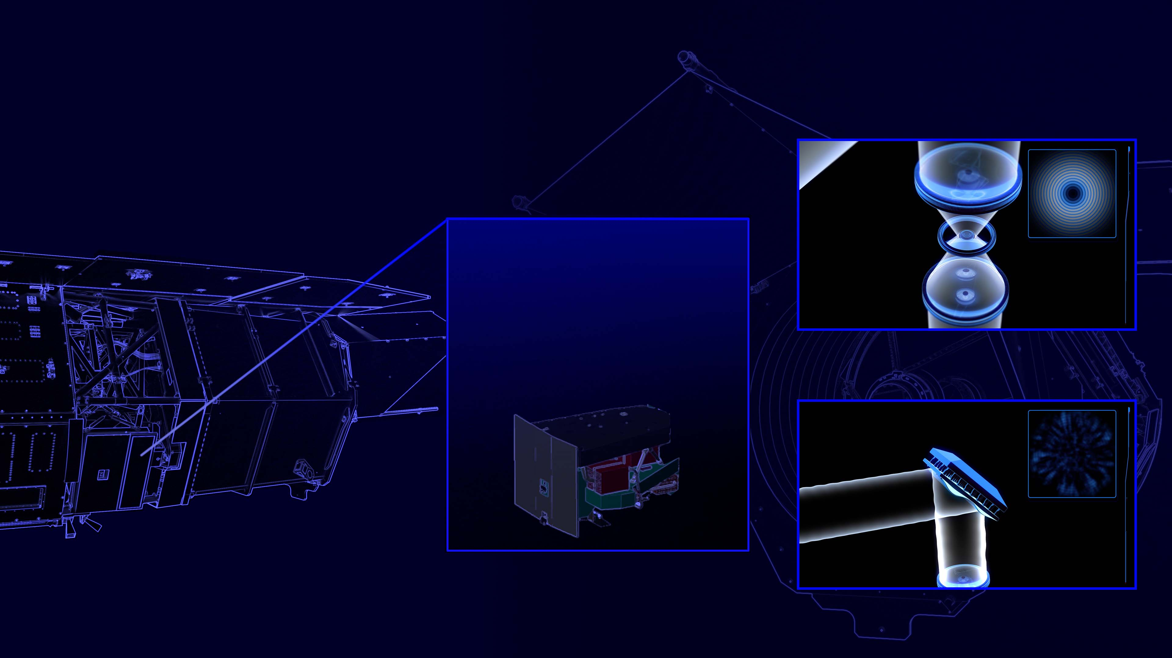
CORONAGRAPH INSTRUMENT
Technology demonstration
First-of-its-kind design in space
Direct detection of faint exoplanets
Notes:
9. The Coronagraph Instrument
Key points to discuss:
First coronagraph with this advanced tech onboard a space-based observatory. NOT the first coronagraph in space.
Purpose is to test and drive forward technology for detecting and studying Earth-like planets. The Roman coronagraph is a necessary stepping-stone to enabling future space-based telescope technology to directly image potentially habitable, Earth-like planets
Two functions:
-Direct detection of faint exoplanets in visible light
-Spectroscopy of exoplanet atmospheres
If the demonstration proves successful, the coronagraph may then be available to scientists for use as a science instrument
More in-depth messaging:
Tech specs:
operating at 0.4–1.0 μm
Detection limit: 10⁻⁹ contrast (post-processing)
Numerically optimized, precision-fabricated coronagraph masks
Large-format deformable mirrors for high-order wavefront control with thousands of pistons
Electron-multiplying CCD detectors for low-flux photon counting
The goal of the coronagraph instrument is to test light suppression techniques to get a contrast ratio of 2 x 10⁻⁸ or 1 part in 100 million. This is a stepping stone to what will be needed for future coronagraphs planned for directly imaging Earth-sized exoplanets at Earth-Sun distances from their parent stars. That contrast ratio will need to get to >10¹⁰.
The contrast ratio for Roman is predicted to be 100 million to one, which will help to improve/spur technology to reach contrast ratio of 10 billion to one (or 100 times better) after Roman's demonstration.
Hyperlinks for presentation, i.e., related videos or webpages:
Coronagraph video: https://svs.gsfc.nasa.gov/13325
Jason Rhodes Roman Science Writer's Workshop presentation: https://youtu.be/KK9tIMJl13E?t=1506
Image credit: NASA Illustration
Links to more background info:
https://roman.gsfc.nasa.gov/exoplanets_direct_imaging.html
Jason Rhodes Roman Science Writers Talk and slides:
https://www.stsci.edu/files/live/sites/www/files/home/events/event-assets/2020/_documents/2020-workshop-science-writers-roman-presentation-rhodes.pdf
https://cloudproject.hosted.panopto.com/Panopto/Pages/Viewer.aspx?id=ecf77c76-d4fa-4028-9db0-ac4c01055d18

Slide 10
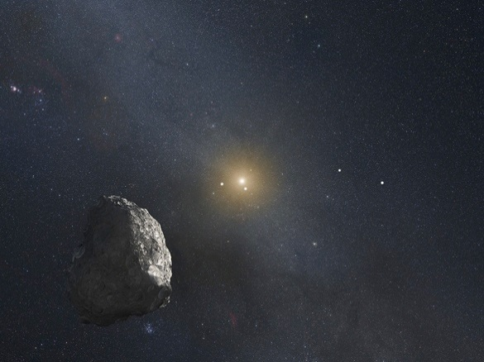
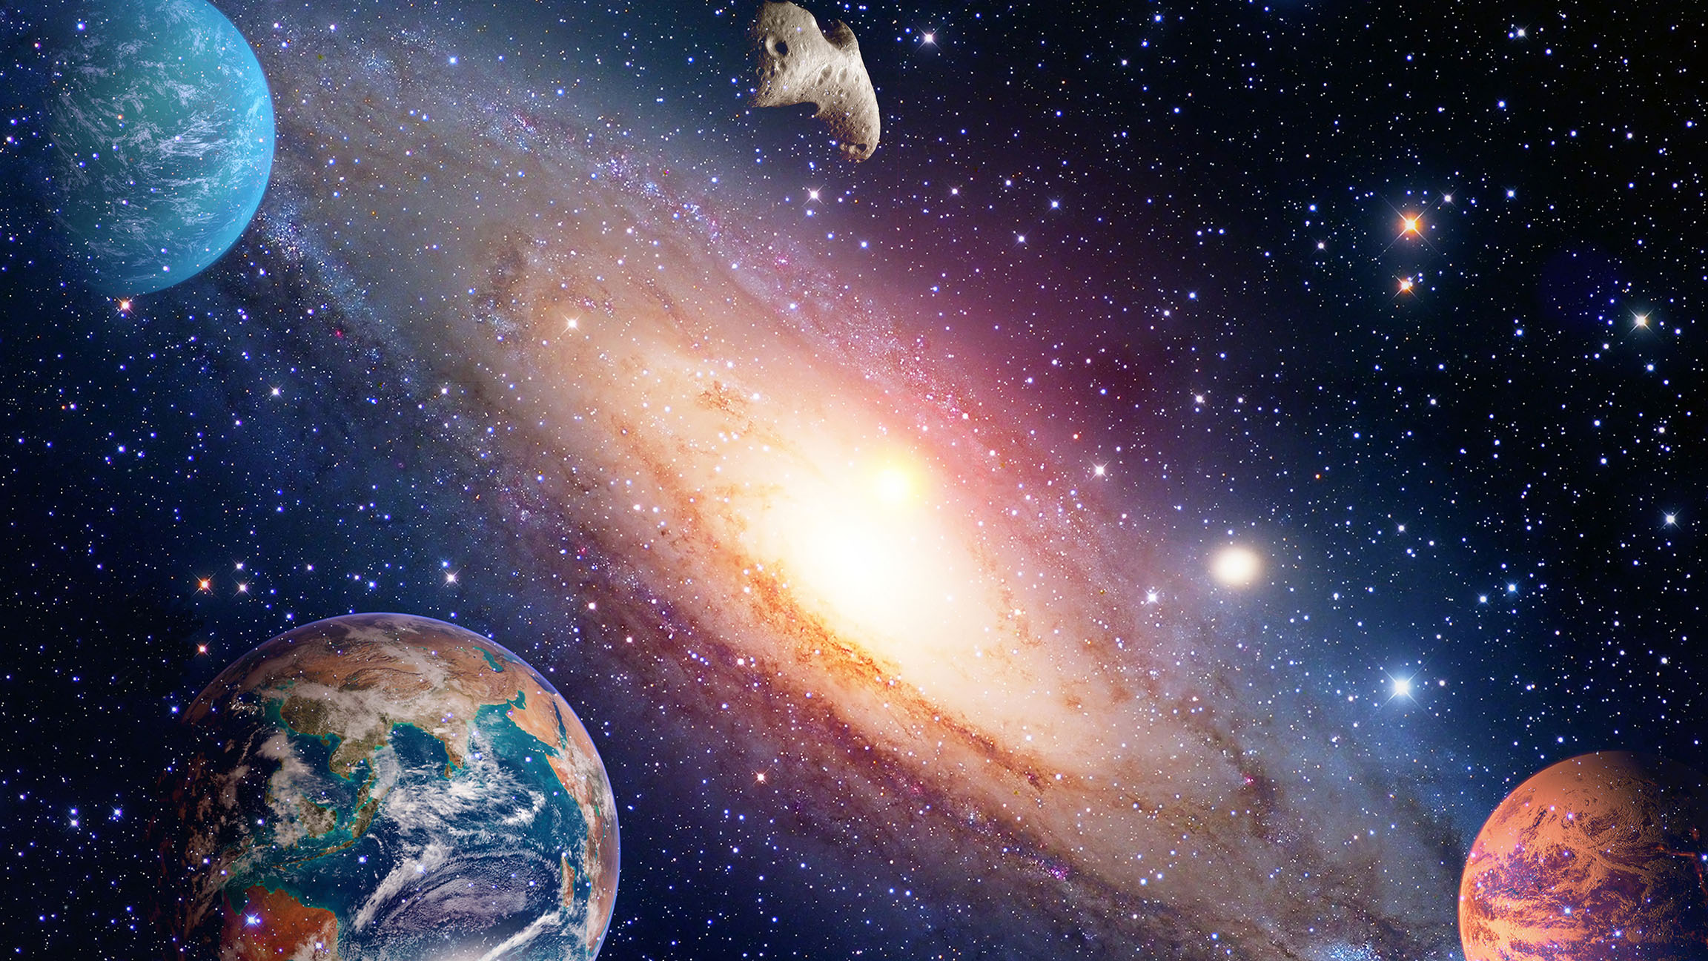
artists conception
Pluto & New Horizons Mission
SCIENCE
WITH
ROMAN
Notes:
10. Start of science section
Key points to discuss:
More than anything, a space telescope like Roman is a scientific tool
Both how Roman collects and distributes data is designed to move science forward in innovative ways.
Roman is a survey mission, meaning it looks broadly, rather than focusing on a selected target. So it’s all about volume: planets by the thousands, stars by the billions, galaxies by the millions.
Roman will explore the current hot topics of astronomy like dark energy, as well as age-old questions about how life on Earth began, and if it exists elsewhere in the universe.
More in-depth messaging:
All the factors about Roman that have already been discussed—its huge field of view and huge amount of high-quality data, its advanced coronographic technology—are designed for making scientific breakthroughs and answering big scientific questions. Some of these questions arose after discoveries by other missions like Hubble, Kepler, Spitzer, and TESS, but others are as old as stargazing itself: How did we get here? How does the universe work? Is Earth the only home to life?
Background info:
https://www.stsci.edu/roman/surveys-and-programs
https://www.stsci.edu/roman/about/science-themes
https://www.stsci.edu/contents/newsletters/2020-volume-37-issue-01/community-science-with-the-nancy-grace-roman-space-telescope
https://www.stsci.edu/contents/newsletters/2019-volume-36-issue-03/wfirst-a-new-era-in-high-precision-astrometry
https://roman.gsfc.nasa.gov/science.html
Image credit: NASA
Illustration
Roman will explore the full range of the cosmos, from our own solar system, to the stars in our home galaxy the Milky Way, to other galaxies, to the distant, early universe.

Slide 11
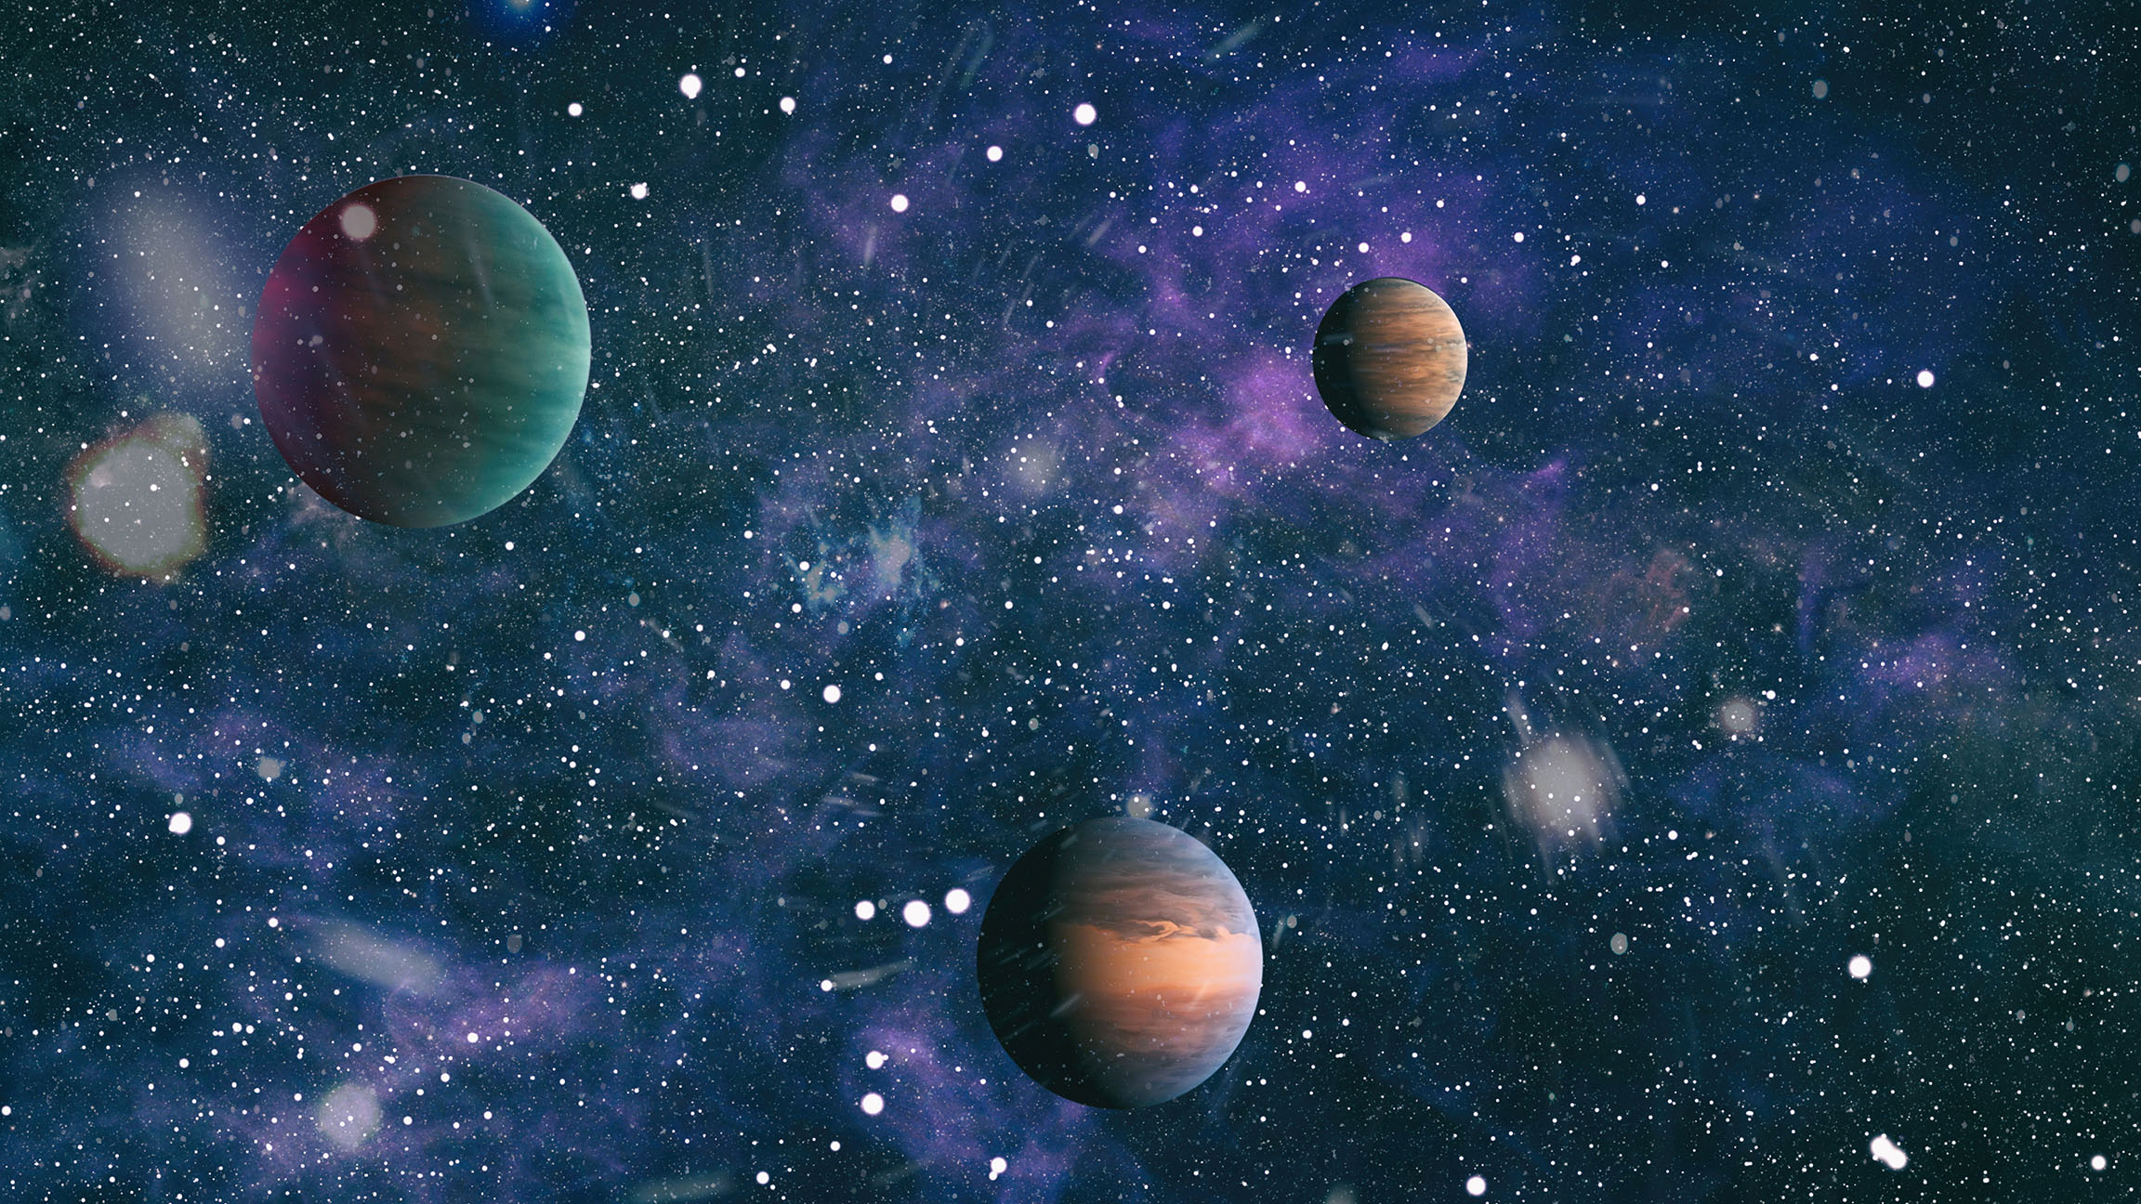
Planets
by the thousands
Notes:
11. Roman Science—Planets by the thousands-intro
Key points in this section
Roman will:
Use new methods to discover thousands of new exoplanets in our galaxy
Learn more about the planets in our own solar system
More in-depth messaging:
Astronomers distinguish between planets in our solar system that orbit the Sun and exoplanets, that orbit other stars. Roman will study both our solar system and exoplanets, using novel techniques.
Specific related hyperlinks on next slides
Image credit: NASA
Illustration

Slide 12
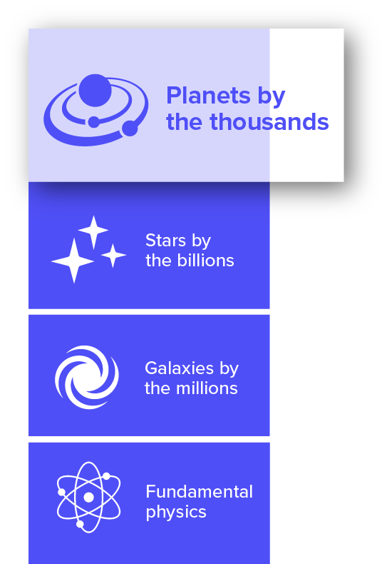
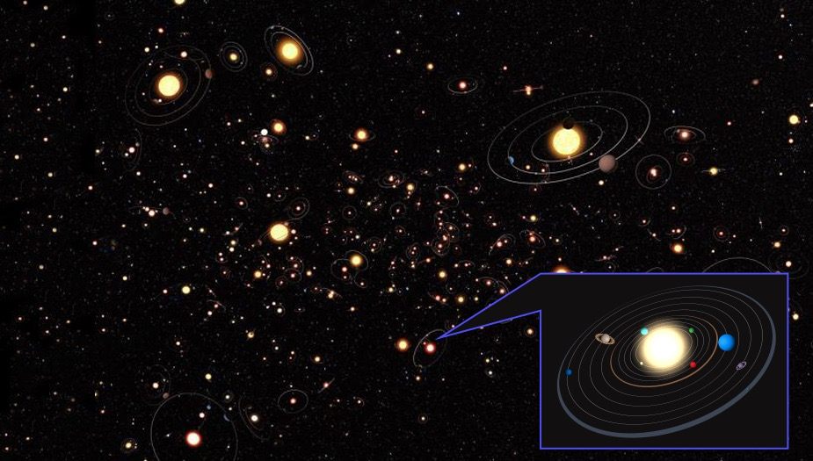
The full spectrum of
EXOPLANET DIVERSITY
Notes:
12. Planets by the thousands—exoplanets & microlensing
Key points to discuss:
There are many planets waiting to be discovered.
Many exoplanets found so far are gas giants; Roman will discover how common smaller, rocky planets like Earth are, and how common or unusual our own solar system is compared with the rest of the galaxy.
Roman will use the technique of micro-lensing to find new planets, especially smaller, rocky planets. Microlensing finds planets by detecting how they warp light from a star far beyond them, in the distance.
More in-depth messaging:
The first planets outside the Solar System—exoplanets—were discovered in the 1990s. Since then more than four thousand exoplanets have been confirmed, and scientists now estimate that most stars have at least one planet orbiting them. This means there are countless other solar systems waiting to be discovered.
About 100 exoplanets have been discovered using the technique of microlensing with ground-based telescopes. Microlensing studies the way planets between a distant star and the telescope will distort the light from the distant star, and by studying the distorted light, astronomers can determine a planet’s properties, like size and mass.
Roman will take this technique into space and use it to build up discoveries of small, rocky exoplanets that are harder to detect using other methods, including exoplanets that do not have a parent star—so-called “rogue exoplanets.”
Via the same lensing technique, Roman’s microlensing survey will also provide a wealth of discoveries of other celestial objects. These include small solar system objects and isolated black holes. The implementation of Roman’s microlensing survey will also enable thousands of exoplanets to be discovered via the transit technique.
Combined with results from other planet-detecting missions like Kepler and TESS, plus those in the future, Roman will provide a much fuller census of exoplanets, and a better understanding of how unique—or not—our home planet and solar system are in the universe.
Additional info:
https://roman.gsfc.nasa.gov/exoplanets.html
https://roman.gsfc.nasa.gov/exoplanets_microlensing.html
https://ui.adsabs.harvard.edu/abs/2019MNRAS.490.1581B/abstract
https://ui.adsabs.harvard.edu/abs/2018AJ....156..289B/abstract
Exoplanet Biosignatures: Observational Prospects:
https://ui.adsabs.harvard.edu/abs/2018AsBio..18..739F/abstract
https://exoplanetarchive.ipac.caltech.edu/
Microlensing video:
https://roman.ipac.caltech.edu/movies/calcada/eso_ulens_planetary_lightcurve_label.mp4
https://svs.gsfc.nasa.gov/13697
NASA’s Roman Mission Predicted to Find 100,000 Transiting Planets:
https://www.nasa.gov/feature/goddard/2021/nasa-s-roman-mission-predicted-to-find-thousands-of-transiting-planets
How NASA’s Roman Space Telescope Will Uncover Lonesome Black Holes
https://www.nasa.gov/feature/goddard/2021/how-nasa-s-roman-space-telescope-will-uncover-lonesome-black-holes
Image credit: ESO, M. Kornmesser
Illustration
This artistic rendering illustrates the diversity of planets around a diversity of stars

Slide 13
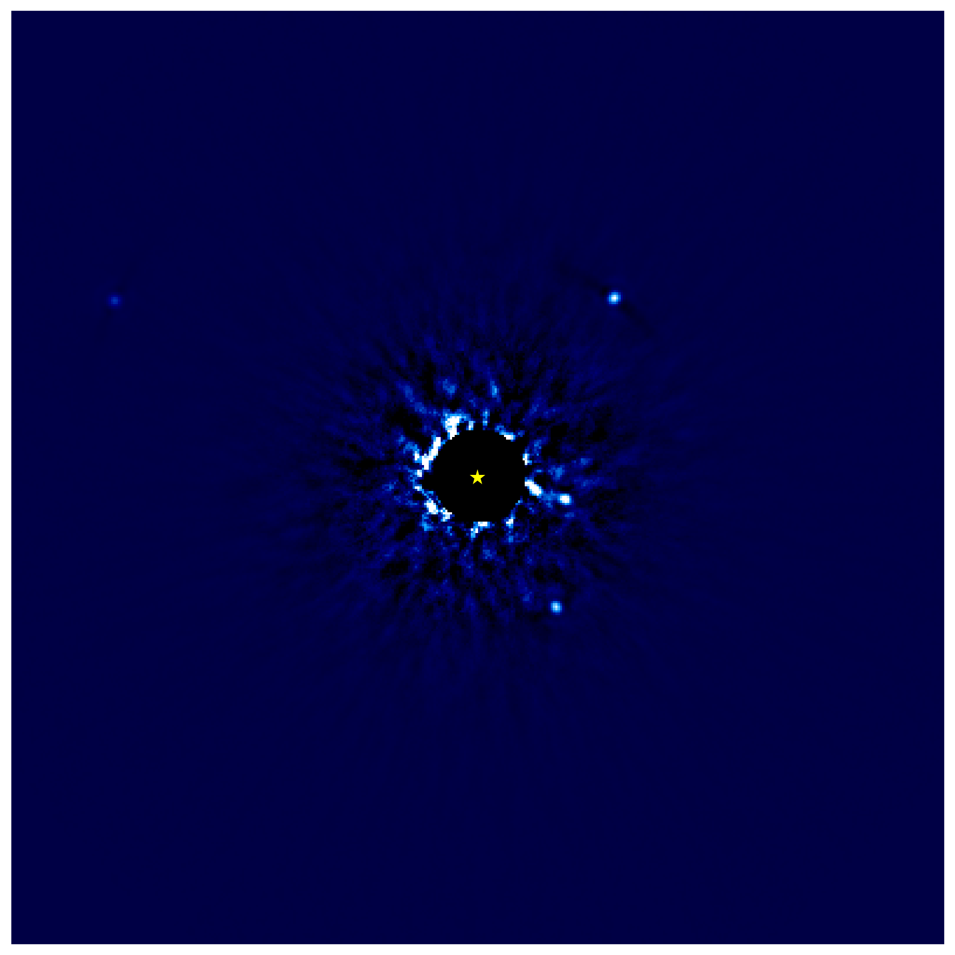
Advancing planet-detection
technology
Notes:
13. Planets by the thousands—exoplanets & the coronagraph
Key points to discuss:
Roman will demonstrate the function of new coronagraph technology.
Only a handful of exoplanets have been imaged to date from the ground and with the Hubble Space Telescope. We have obtained spectra on an even smaller number. All of them are gas giants more massive than Jupiter.
Roman provides the first opportunity to directly image and characterize Jupiter analogs. These are Jupiter-sized planets in Jupiter-like orbits around Sun-like stars.
Goal for future coronagraphs: direct images of Earth-sized planets around Sun-like stars. Roman is the necessary stepping-stone to the technology for future missions.
More in-depth messaging:
The coronagraph image shown here demonstrates how this type of instrument works—the star at the center of the image is blocked out, so that the light from the planets around it can be detected; it is not unlike holding up your hand to block out the Sun so you can see something in front of you more clearly.
This image was taken from the ground. Roman will be observing from above the atmosphere, where it will have a much sharper view.
Roman’s demonstration of advanced coronagraph technology is an important step toward finding and imaging Earth-like planets.
Hyperlinks for presentation, i.e., related videos or webpages:
Coronagraph video: https://svs.gsfc.nasa.gov/13325
Image credit: Jason Wang (Caltech)/Christian Marois (NRC Herzberg)
Near-infrared telescope image: Keck
This near-IR, ground-based image from the Keck Telescope was created using a coronagraph to block out the young star at the center. Even with some stray starlight entering the telescope, researchers were able detect four Jupiter-mass objects orbiting around the young star.
This image was taken from the ground. Roman will be observing from above Earth’s atmosphere, where it will have a much sharper view. In addition, Roman’s “inner working angle” will be smaller than current ground-based telescopes—i.e., we can image closer to the star itself to look for planets that are orbiting more closely to its host star.
Links to more background info:
https://roman.gsfc.nasa.gov/exoplanets_direct_imaging.html
https://www.ipac.caltech.edu/news/nasa-s-roman-mission-could-snap-first-image-of-a-jupiter-like-world
JPL Roman Coronagraph website, with “Reference Information Slides” at the bottom of the page: https://www.jpl.nasa.gov/missions/the-nancy-grace-roman-space-telescope
https://roman.ipac.caltech.edu
https://roman.ipac.caltech.edu/sims/Param_db.html
https://ui.adsabs.harvard.edu/abs/2016PASP..128b5003R/abstract
https://ui.adsabs.harvard.edu/abs/2019AJ....157..132L/abstract
IPAC Exoplanet Slides – https://roman.ipac.caltech.edu/Introductory_Slides.html

Slide 14
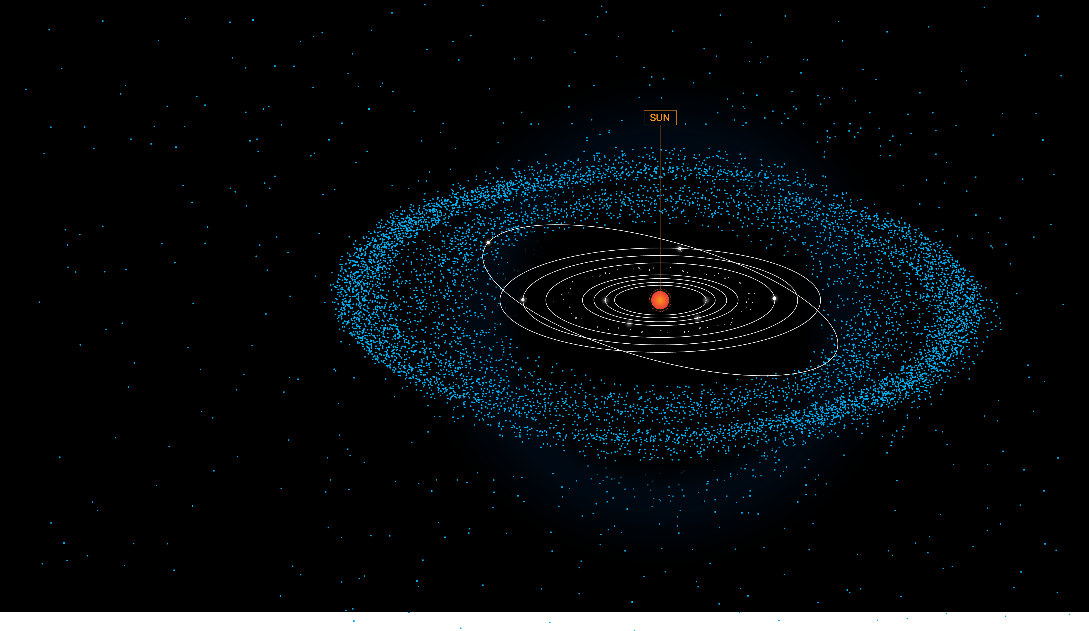
Our cosmic neighborhood
Notes:
14. Planets by the thousands—the Solar System
Key points to discuss:
As Roman looks into distant space, it will also be capturing a lot of information about the Solar System in the foreground.
Roman will provide a wealth of data both on known Solar System objects—i.e., the eight planets, dwarf planets, moons and asteroids—plus new, previously unknown small, faint objects.
In-depth messaging:
Roman's sensitivity, large field of view, and repeated survey observations will enable discoveries of faint objects in the Solar System that have previously gone unseen. As Roman looks through the Solar System into deep space, the telescope will collect a wealth of data that can shed light on its history and development over time.
Image credit: NASA, J. Kang (STScI)
Illustration
Links to more background info:
Solar System science with Roman: https://ui.adsabs.harvard.edu/abs/2018JATIS...4c4003H/abstract

Slide 15
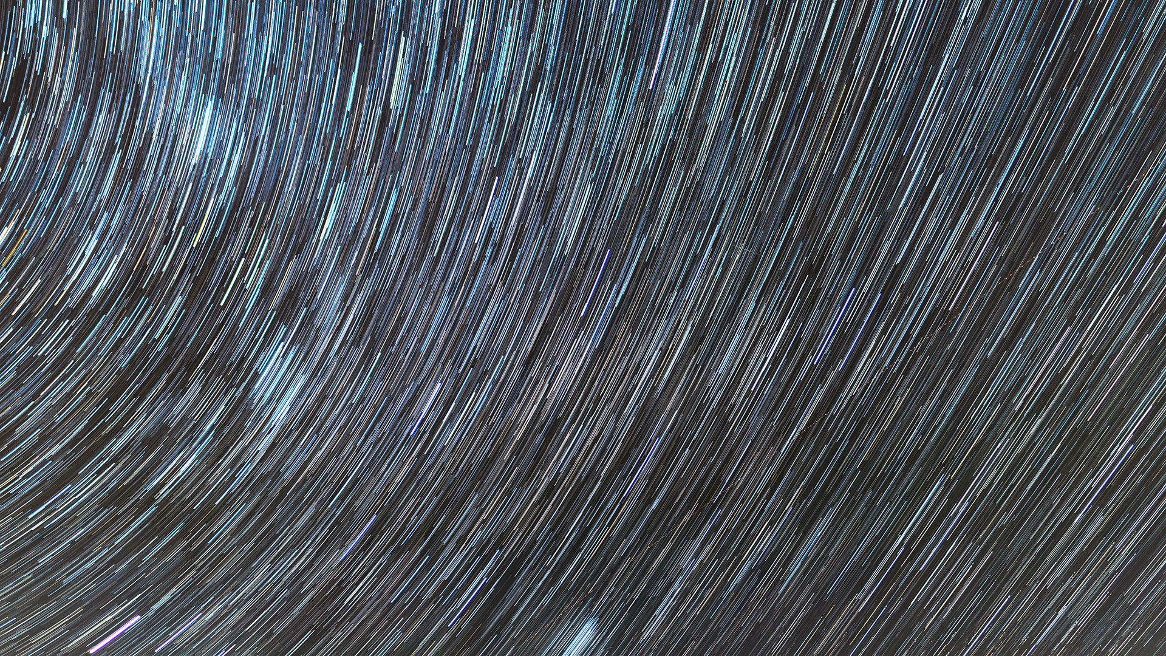
Stars
by the billions
Notes:
15. Roman Science—Stars by the billions-intro
Astronomy began with stargazing, but there is still so much we don’t know about how stars form, how they affect one another in dense star-forming regions, and the role they play in the development of galaxies over time.
A combination of three things makes Roman’s study of stars special:
Roman will detect near-infrared light, which passes through cloudy nebulae to reveal stars hidden in visible light.
Roman’s high resolution will provide unprecedentedly clear views.
Roman’s huge field of view will collect a census of stars that will provide new insight into their still-mysterious formation and processes.
Image credit: Zolt Levay | Monument Valley Navajo Tribal Park, Arizona ǀ 2016
Image info:
The fall night sky along the Colorado-Arizona border. The star trails are an artifact of Earth’s rotation: this photograph is a composite of 59 exposures of 20 seconds each.
Exposure Date: October 4, 2016
Camera: Nikon D800
Lens: Nikon 20 mm; f/1.8
Exposure: 20 sec; ISO 3200; composite of 59 exposures

Slide 16
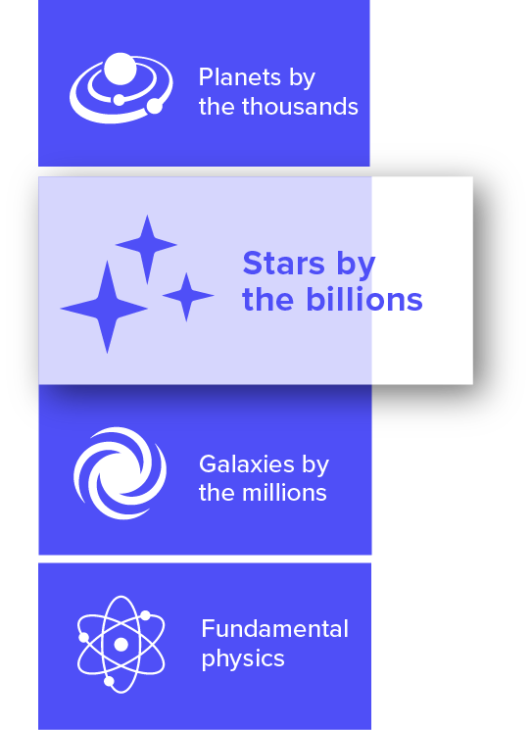
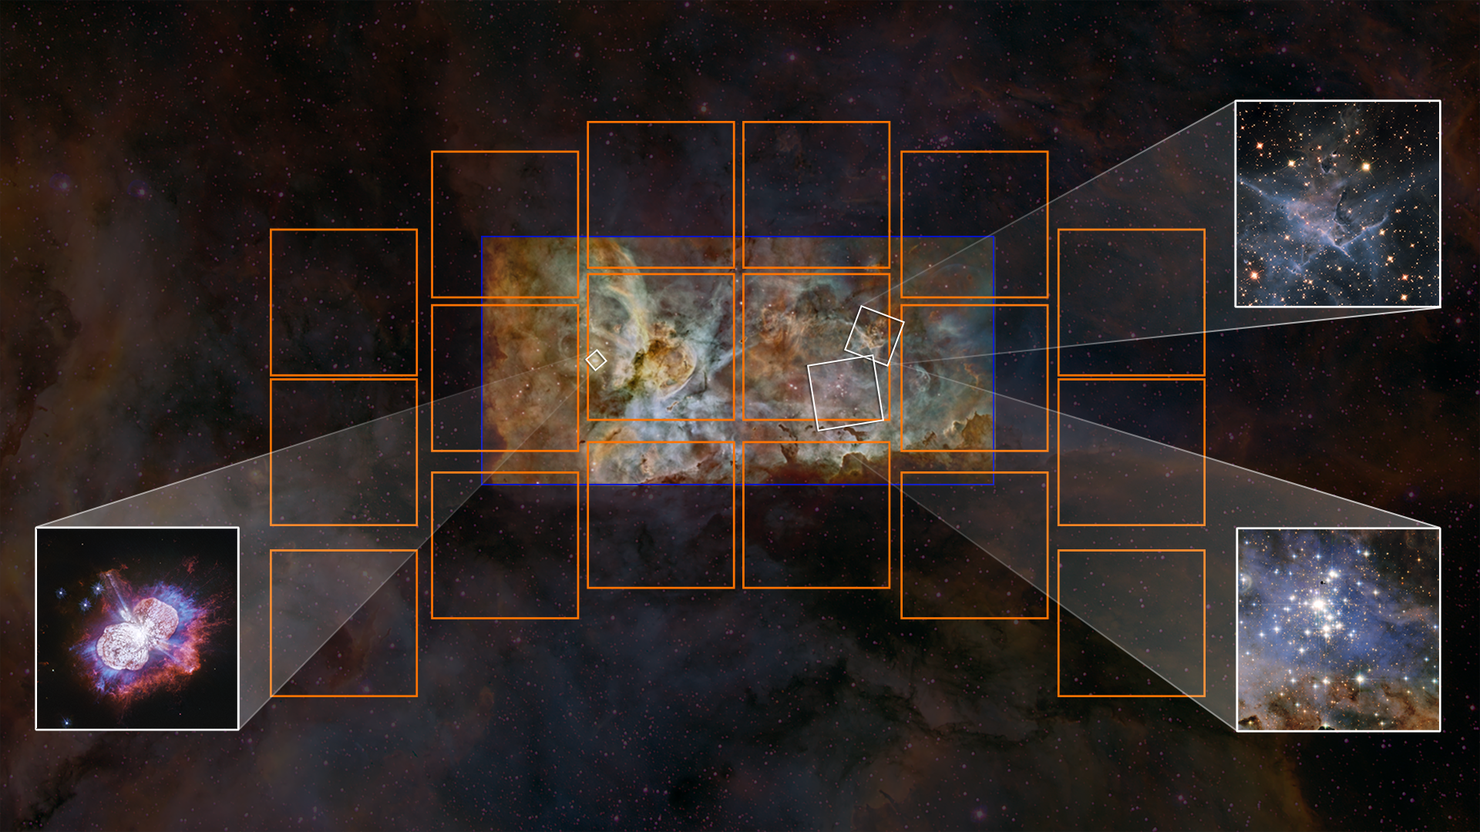
The Stellar Lifecycle in a Snapshot
Stellar birth
Stellar death
New star clusters
Notes:
16. Roman Science—Stars by the billions—stellar lifecycle
Key points to discuss:
Example image on slide: the star-forming region in the Carina Nebula, captured by Hubble and a ground-based telescope.
Busy “star-forming” regions display all the stages of the stellar lifecycle, if you take a broad enough view. So-called stellar “death” seeds new star formation.
Roman’s large field of view will allow for viewing various stages of the stellar lifecycle in one environment, including:
Young protostars blasting out jets
Star clusters
Clouds of gas and dust
Stellar “death”—when it has expended all its fuel. For massive stars, this is a supernova
In-depth messaging:
Stars are engines of creation, fusing elements that go on to make up the rest of the universe, including elements like carbon, oxygen, and nitrogen that are essential for life on Earth. This is why discovering the secrets of star formation and development are important to understanding overall big questions about the universe and life as we know it.
With Roman's near-infrared capabilities, Roman can “see through” some of the obscuring dust to study forming stars embedded inside.
With the large expansive view, Roman can study how star formation in one region can affect star formation in other areas of the same nebula—it could limit it or encourage it.
With Hubble-like resolution, imaging over time can find time-variable features, like protostellar jets moving outwards from young stars.
Hyperlinks for presentation, i.e., related videos or webpages:
Video - Webb: The Birth of Stars: https://www.youtube.com/watch?v=R1NiYe4xb6A
Hubble’s “Pillars of Creation” in visible and near-infrared light: https://webbtelescope.org/contents/media/images/4178-Image
Image credit:
Background image: Nathan Smith, University of Minnesota/NOIRLab/NOAO/AURA/NSF
Mosaic: Hubble Image: NASA, ESA, N. Smith (University of California, Berkeley), and The Hubble Heritage Team (STScI/AURA); CTIO Image: N. Smith (University of Arizona) and NOAO/AURA/NSF
Mystic Mt.: NASA, ESA, and M. Livio and the Hubble 20th Anniversary Team (STScI)
Eta Carina: NASA, ESA, N. Smith (University of Arizona), and J. Morse (BoldlyGo Institute)
Trumpler 14: NASA, ESA, and J. Maíz Apellániz (Institute of Astrophysics of Andalusia, Spain); acknowledgment: N. Smith (University of Arizona)
Composition: A. Pagan (STScI)
The Carina Nebula is an example of a star-forming region with many stages of the stellar lifecycle captured by Hubble. However, there is no guarantee that Roman will be studying this same area.
Links to more background info:
https://science.nasa.gov/astrophysics/focus-areas/how-do-stars-form-and-evolve
Public-friendly: https://webbtelescope.org/webb-science/the-star-lifecycle

Slide 17
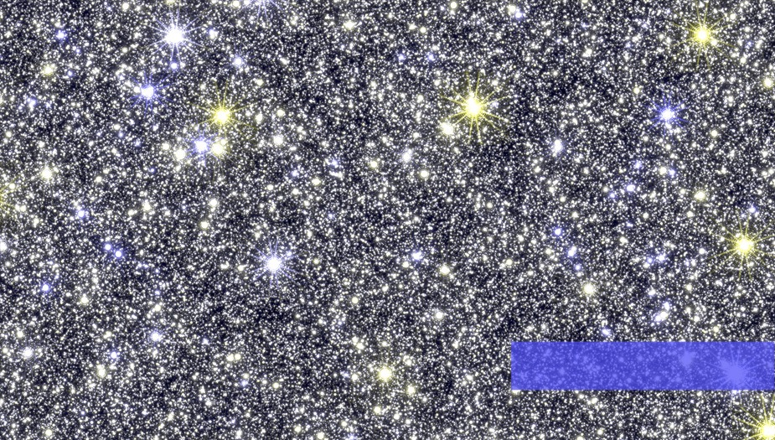
The crowded core
of the Milky Way galaxy
Notes:
17. Roman Science—Stars by the billions—core of the Milky Way
Key points to discuss:
Roman will see large swaths of stars deep inside the dusty regions of the Milky Way center.
Roman will pinpoint precise locations for over 200 million stars in the bulge, allowing for study of their movement over time and with that, the history of the Milky Way’s star-formation history.
More in-depth messaging:
This image is 1/140th a Roman field of view. There are so many stars at the center of our galaxy that in other telescopes’ views they may blur together, but Roman will see them with high clarity, distinguishing stars in the center bulge from those in the surrounding disk. Tracking the precise positions and colors of individual stars over time will provide insight on the star-formation processes in the Milky Way bulge, bar, and disk.
Hyperlinks for presentation, i.e., related videos or webpages:
Simulated Image Credit: Matthew T. Penny (Ohio State University)
Links to more background info:
Published article: https://iopscience.iop.org/article/10.3847/1538-4365/aafb69/pdf
Penny, M. T., 2019, ApJS, 241, 3P

Slide 18
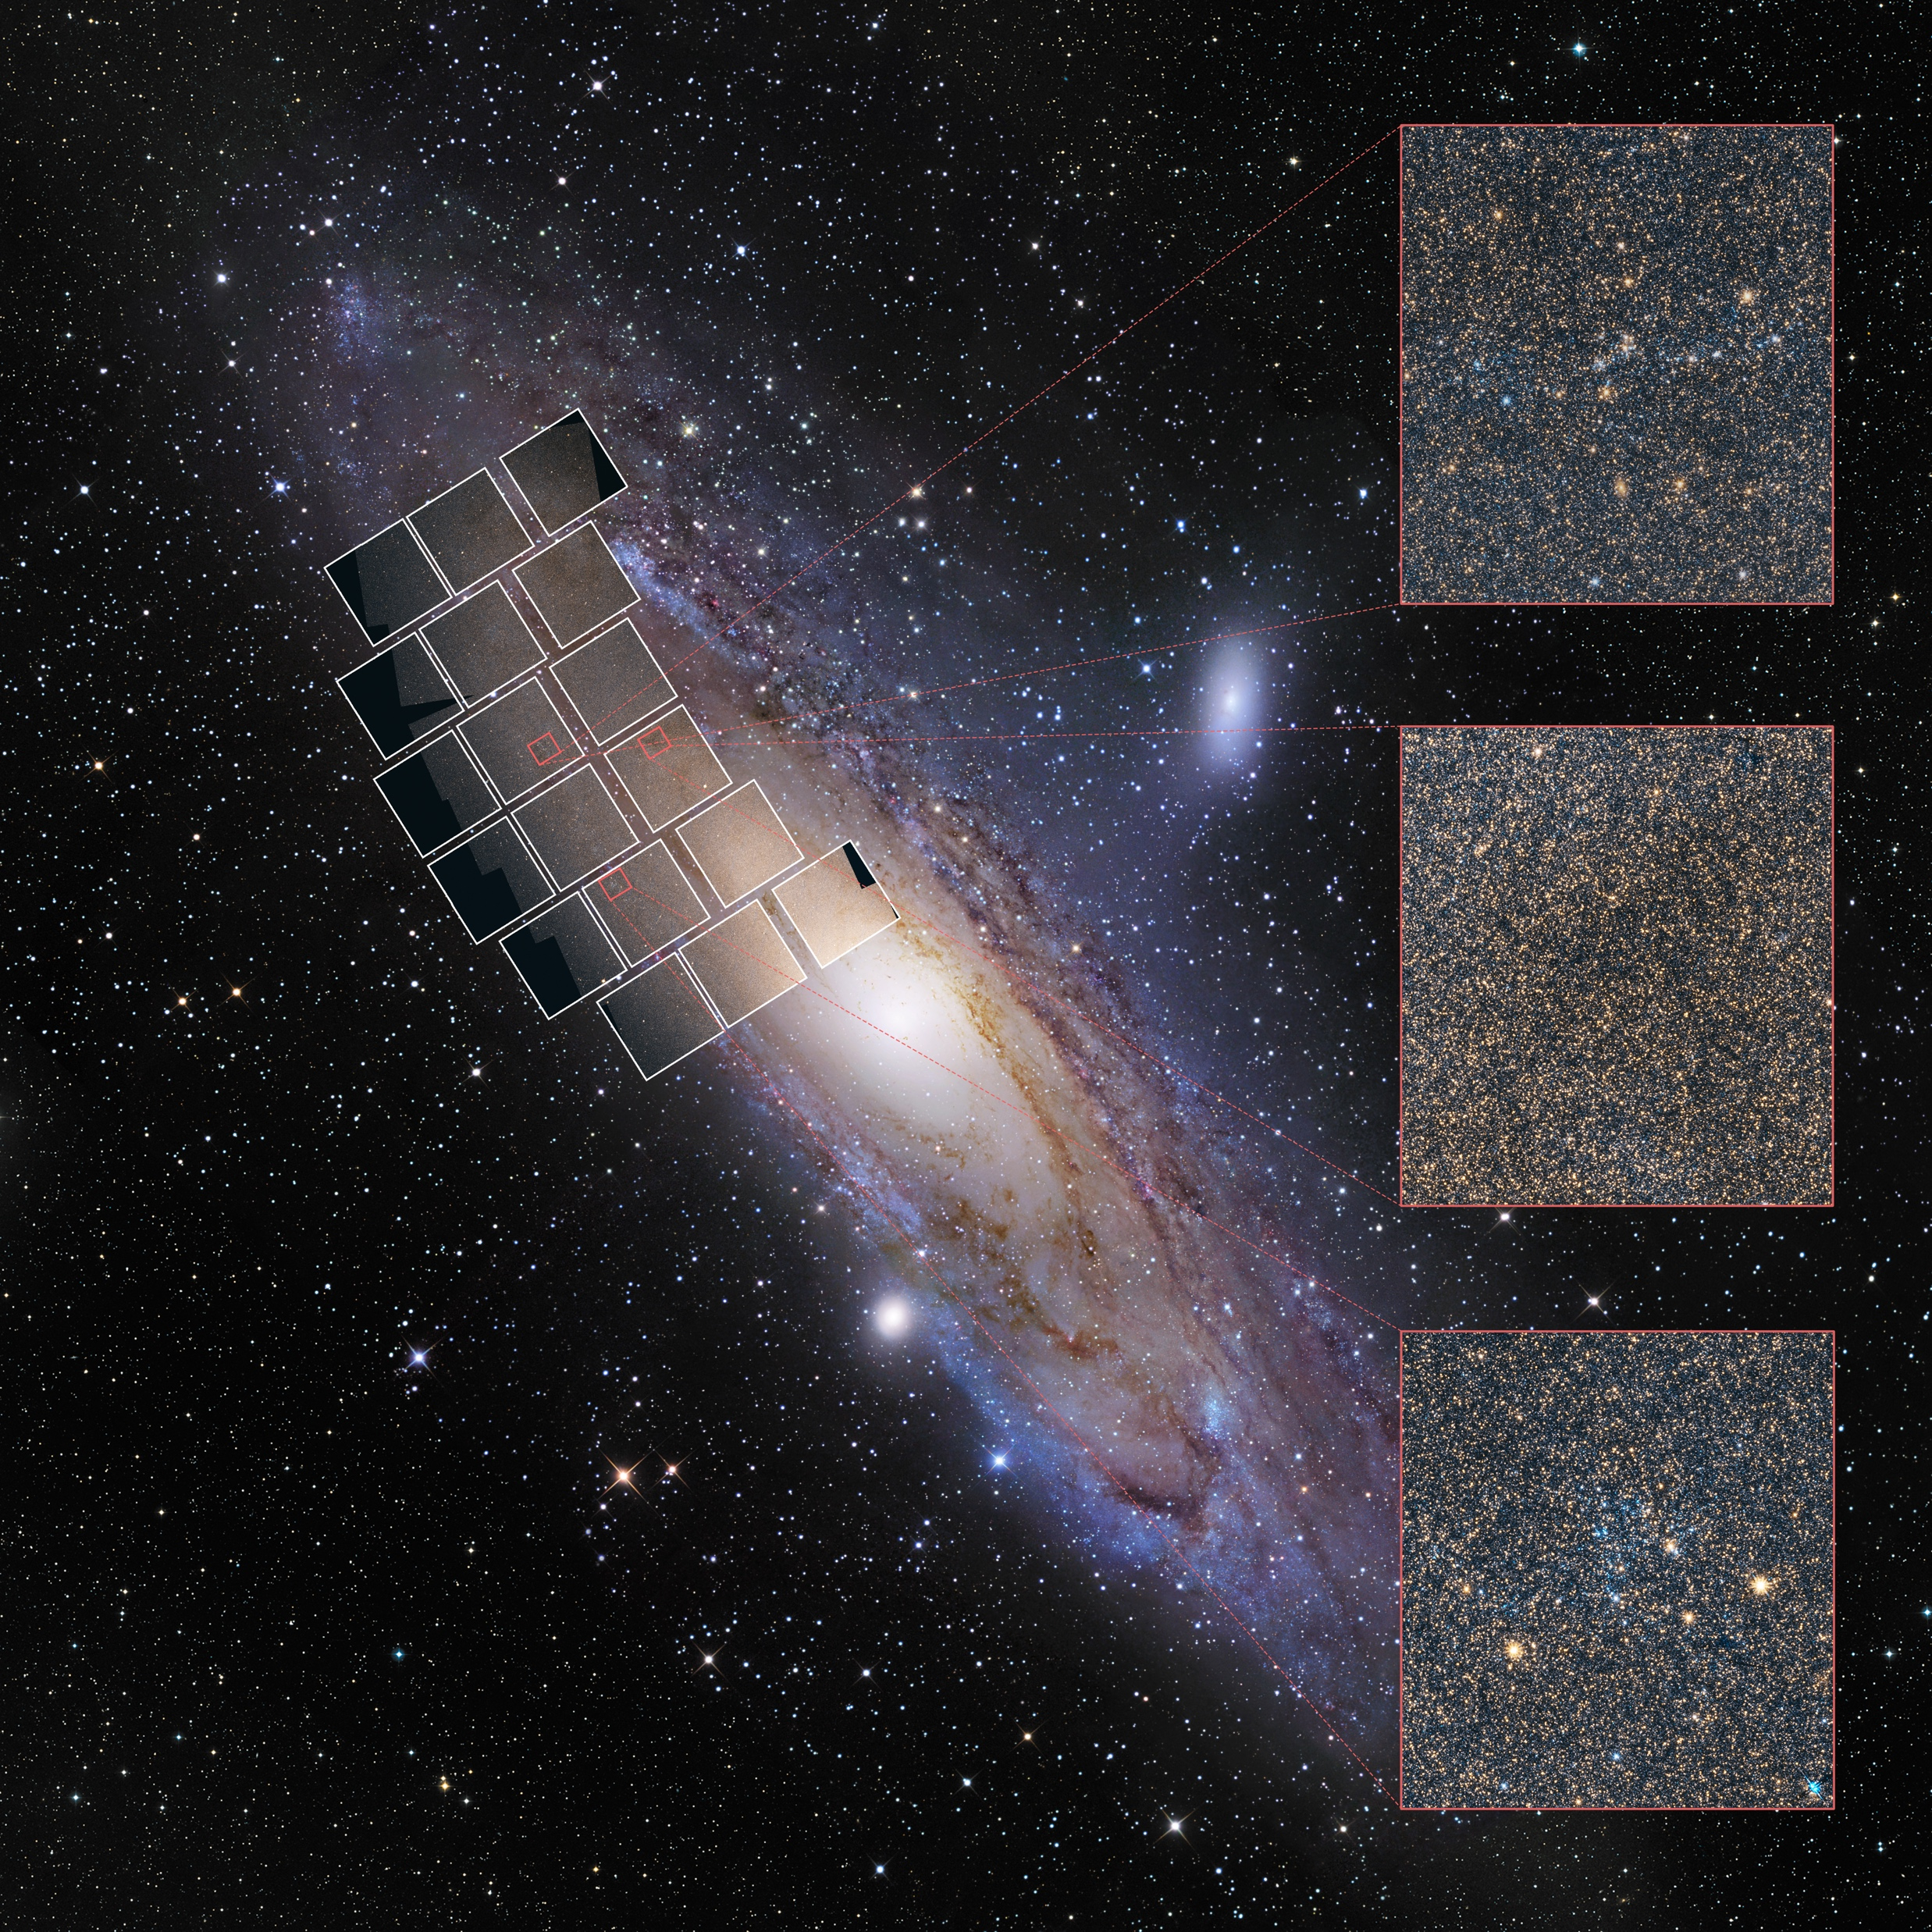
star cluster and
background galaxy
Roman field of view
dust cloud
young star cluster
Notes:
18. Roman Science—Stars by the billions—stars in nearby galaxies
Key points to discuss:
The galaxy shown on this slide is our Milky Way galaxy’s closest large-galaxy neighbor—the Andromeda galaxy.
Roman’s combination of high resolution and large field of view = sharp new view of nearby galaxies.
Rather than a blur of light, astronomers will be able to count the individual stars of nearby galaxies, like grains of sand on a beach.
Understanding of individual stars and regions of stars in a galaxy provides a better understanding of the entire galaxy—how is it similar to our Milky Way galaxy, and how is it different?
More in-depth messaging:
Galaxies are huge cities of stars, and nearby galaxies are an opportunity to study how stars interact and behave on this large scale. What is the relationship of individual stars to the whole?
Stars are individual puzzle pieces that make up the whole picture of a galaxy. We need to have each puzzle piece, understand everything about it (its edges, placement, size, etc.), and then we can step back when all the pieces are together to understand how the whole picture came to be.
Hyperlinks for presentation, i.e., related videos or webpages:
PHAT Simulated image with annotation: https://hubblesite.org/contents/media/images/2020/02/4610-Image
PHAT fly-through video: https://svs.gsfc.nasa.gov/13497
Image credit:
Background image: Digitized Sky Survey and R. Gendler
Roman simulation images: NASA, STScI, and B. F. Williams (University of Washington)
Image composition: J. DePasquale (STScI)
Links to more background info:
https://roman.gsfc.nasa.gov/large_area_near_infrared_surveys.html
PHAT press release: https://hubblesite.org/contents/news-releases/2020/news-2020-02

Slide 19
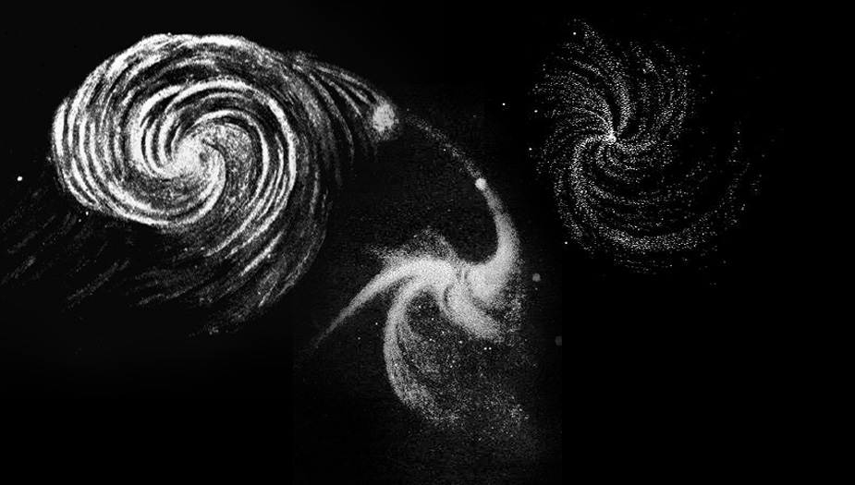
Galaxies
by the millions
Notes:
19. Roman Science—Galaxies by the millions-intro
Key points to discuss:
By building up a library of galaxies over space and time, scientists can study patterns in the history of galaxy development over time—formation, mergers, and growth.
The volume of galaxy data will also allow scientists to study the history of the universe and the mysterious phenomena of dark energy as it expanded the space between galaxies.
New insight on the dynamics of individual galaxies.
Image credit: William Parsons, the Third Earl of Rosse (public domain)
Illustration
19th century sketches of galaxies by the Earl of Rosse; From left to right: Whirlpool Galaxy (M51), the Triangulum Galaxy (M33), and M99
Additional background:
https://science.nasa.gov/astrophysics/focus-areas/what-are-galaxies
https://hubblesite.org/science/galaxies
About the slide image: http://www.messier.seds.org/more/m-rosse.html

Slide 20
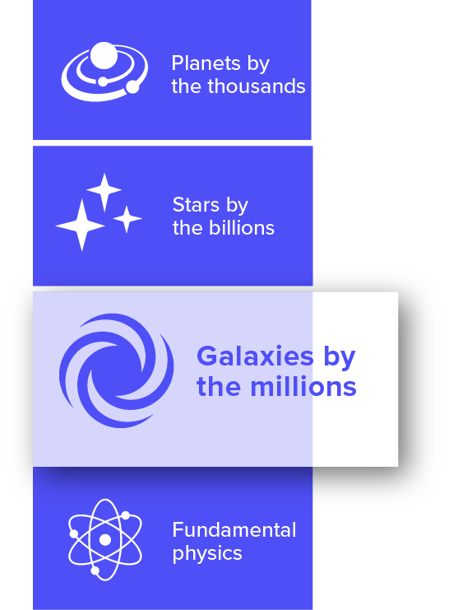
Hubble’s view of Rubin's galaxy
Possible extent of Rubin's halo
The Local Universe
Roman's Field of View
Notes:
20. Roman Science—Galaxies by the millions—nearby galaxies
Key points to discuss:
Roman’s large field of view will enable astronomers to map out nearby galaxies and their surrounding environment.
Roman data will provide details on these galaxies’ gas, dust, and stars, particularly in the extended outer halo, which is too faint or too large a region for some telescopes to image.
Roman will provide insight into how neighboring galaxies interact with each other.
More in-depth/narrative messaging:
By using Roman to survey the entire surrounding environment of nearby galaxies in different colors with accurate positions, astronomers can look at individual stars and satellite galaxies in the galaxy halos (outskirts) to understand the merger history that created the galaxy seen today.
Simulated Roman Space Telescope Image of the PHAT image of the Andromeda galaxy:
https://hubblesite.org/contents/media/images/2020/02/4608-Image
Image info
The slide image features galaxy UGC 2885 (nicknamed Rubin's Galaxy after astronomer Vera Rubin). Hubble's view is inset, and the Roman field of view is shown with the grid of squares. Roman will capture the entire halo of galaxies like Rubin in a single pointing; the size of the galaxy’s halo is estimated and shown here as the purple circle.
Credits:
Hubble image: NASA, ESA, and B. Holwerda (University of Louisville)
Background image: Digitized Sky Survey
Image Composition: J. DePasquale (STScI)
Additional background:
https://hubblesite.org/contents/news-releases/2020/news-2020-01
https://hubblesite.org/contents/news-releases/2015/news-2015-02.html
https://hubblesite.org/contents/media/images/2015/02/3480-Image.html

Slide 21
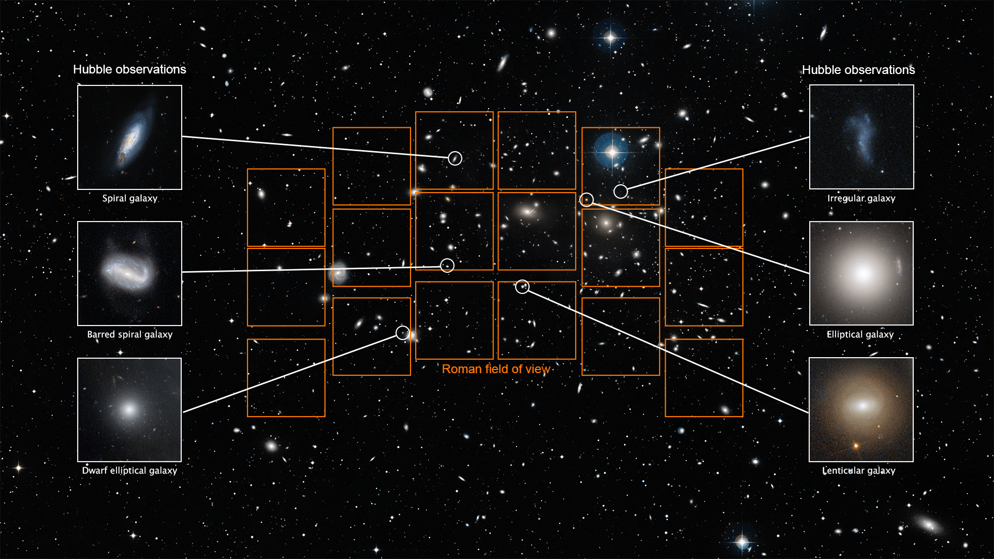
Galactic Diversity
Notes:
21. Roman Science—Galaxies by the millions—diversity
Key points to discuss:
Data on so many galaxies will be collected, it will provide insight into their diversity and evolution over cosmic time.
How do galaxies work? Roman will also provide new insight into galaxies’:
Structure
Star formation rates
Dust content/budget
Central supermassive black hole activity
Intra-galaxy feedback processes
More in-depth messaging:
Roman will find a diversity of galaxies at different stages of their evolution—galaxies in small groups and in large clusters, merging galaxies, and newborn galaxies. By capturing both volume and detail, Roman will greatly advance knowledge about galaxies and their variety of forms, and also their evolution over the history of the universe.
Hyperlinks for presentation, i.e., related videos or webpages:
Video—zoom out from Hubble field of view to Roman field of view:
https://hubblesite.org/contents/media/videos/2020/41/1285-Video (labeled) https://hubblesite.org/contents/media/videos/2020/41/1283-Video (unlabeled)
Image credits:
Background Image: Digitized Sky Survey
Galaxy Images: NASA, ESA, M. Sun (University of Alabama), W. Cramer and J. Kenney (Yale University), J. Mack (STScI), and J. Madrid (Australian Telescope National Facility) and Hubble Heritage Team (STScI/AURA).
Image Composition: A. Pagan (STScI)
Links to more background info:
January 2021 news release on Roman Ultra Deep Field: https://hubblesite.org/contents/news-releases/2021/news-2021-003
September 2021 news release on understanding galaxy evolution with Roman: https://hubblesite.org/contents/news-releases/2021/news-2021-048
Rachel Somerville's Science Writer's Workshop presentation: https://youtu.be/KK9tIMJl13E?t=2498

Slide 22
The Early Universe
Hubble Ultra Deep Field
Hubble Survey Area
Roman field of view
Notes:
22. Roman Science—Galaxies by the millions—early universe
Key points to discuss:
Roman will observe galaxies back to when the universe was just a few hundred million years old, substantially increasing our sample from this very distant past (universe is currently 13.8 billion years old).
Roman will capture up to a million galaxies in one shot; that’s 100x more area than the Hubble Ultra Deep Field, with the same depth and quality. An observation like this will include thousands of galaxies in the very distant universe (while now we have just a handful of these most distant galaxies).
Will enable better estimates of how quickly star formation was occurring in young galaxies of different masses, which affects how quickly heavier elements were formed in the early universe.
Hyperlinks for presentation, i.e. related videos or webpages:
Video “Echoes of the Universe's Creation”: https://www.youtube.com/watch?v=Y8W9T6ahwSU
Video—Hubble Ultra Deep Field 3-D fly-through: https://hubblesite.org/contents/media/videos/2004/28/445-Video.html
Image credit:
See this page for full data description and credits: https://hubblesite.org/contents/media/images/2021/003/01EX00JGQBQKZ9KGXHA7TM7QJM
Image credit: NASA, ESA, Anton M. Koekemoer (STScI), Alyssa Pagan (STScI)
Background image acknowledgement: Digitized Sky Survey
Hubble Ultra Deep Field (2004): NASA, ESA, S. Beckwith (STScI), and the HUDF Team
Links to more background info:
https://hubblesite.org/contents/news-releases/2021/news-2021-003
https://hubblesite.org/contents/articles/hubble-deep-fields
https://esahubble.org/science/deep_fields/
https://www.nasa.gov/feature/goddard/2022/simulated-image-shows-how-nasa-s-roman-could-expand-on-hubble-s-deepest-view

Slide 23
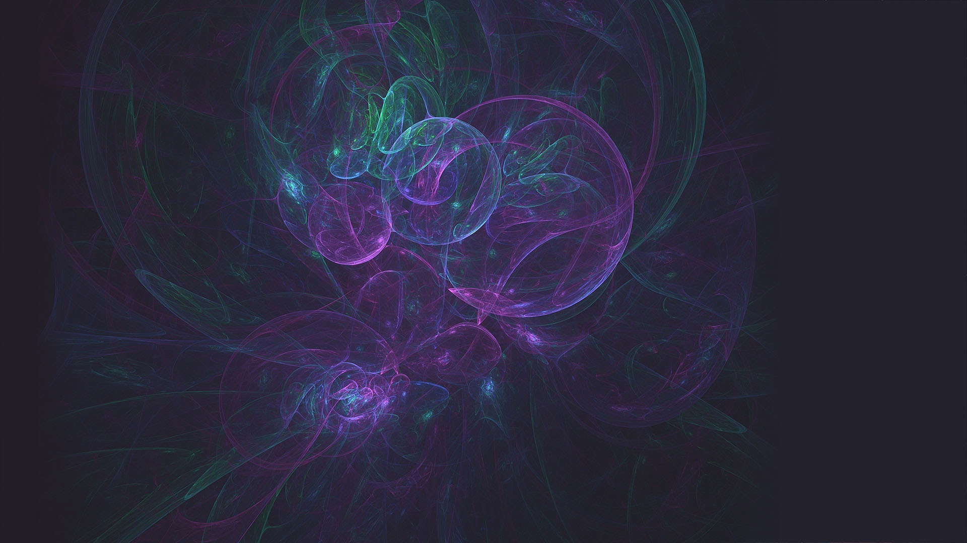
Fundamental
Physics
Notes:
23. Roman Science—Fundamental physics-intro
How does the universe work? New discoveries lead to new questions—Roman is designed to address the biggest ones facing modern-day astronomers:
Growth of large-scale structure of the universe
Expansion history of the universe
Dark energy
Dark matter
Everything that has been observed in the history of astronomy makes up only 5% of the content of the universe. There is so much more to discover.
It is possible that the solutions to some of these mysteries concern new laws of physics that we are not yet aware of, beyond the current theories of Newton and Einstein.
In-depth/narrative messaging:
Seeing this bigger picture of the universe with Roman will shed light on big mysteries in astrophysics, where currently it is “dark”—it is possible that a big part of the reason dark matter and dark energy are still so mysterious is that we just don’t have enough information to figure them out—a famous example is trying to figure out what an elephant is by only observing its tail or some other small area of the whole: https://undaze.files.wordpress.com/2012/06/blindmenelephant.jpg
Alternative elephant image option: https://image.slidesharecdn.com/armamichigan-130207173513-phpapp02/95/big-data-and-the-challenge-of-extreme-information-36-638.jpg?cb=1360659609
Another analogy is that there only has been a trickle of data from current telescopes. We can’t solve the cosmic mysteries with this trickle. We need an enormous amount of data (faucets on high!) to understand the nature of dark energy and dark matter.
Image credit: Pete Linforth
Illustration. Source: https://pixabay.com/images/id-1101474/

Slide 24
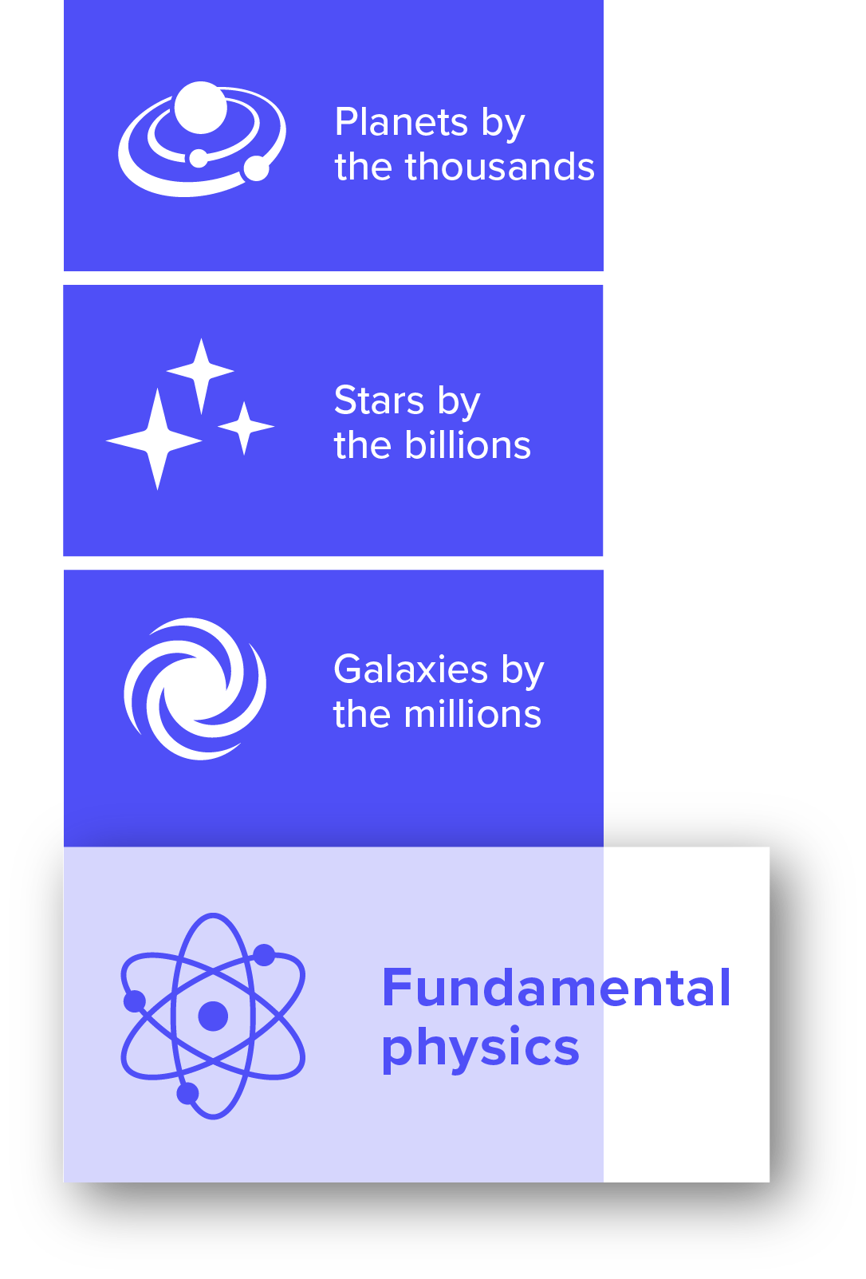
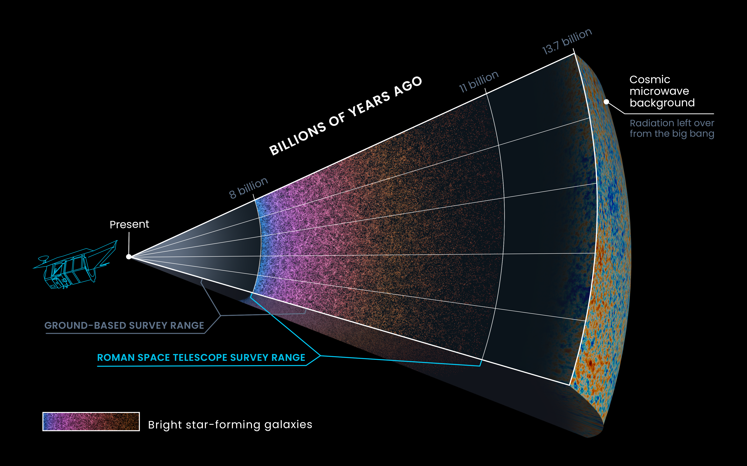
Structure of the Universe
Notes:
24. Roman Science—Fundamental physics—structure of the universe
Key points to discuss:
Structure in the universe is the distribution of dark matter and distribution of galaxies. The structure is the cosmic web of the universe.
How is the growth of structure in the universe influenced by dark energy and dark matter?
Astronomers will use Roman data to map the distribution of galaxies near to far—how has it changed over time?
Roman will be much wider and deeper than past surveys by space telescopes.
More in-depth/narrative messaging:
The universe is so large that if we ever want to get a glimpse of how the universe changes over time, we need to look far back into the past (which is looking at objects far away), and we need to capture a lot of the sky too. Past, deep surveys have been pencil-beams in the sky compared to what Roman will capture.
Image credits:
Data provided by Z. Zhai and Y. Wang, Caltech/IPAC, and A. Benson, Carnegie Observatories
Data Visualization: J. DePasquale and D. Player, STScI.
Simulated Roman star-forming galaxy distribution data, displaying ~215,000 galaxies of a much larger 5-million galaxy simulated galaxy catalog.
Links to more background info:
“NASA’s Roman Space Telescope to Uncover Echoes of the Universe’s Creation”: https://www.nasa.gov/feature/goddard/2020/nasa-s-roman-space-telescope-to-uncover-echoes-of-the-universe-s-creation

Slide 25
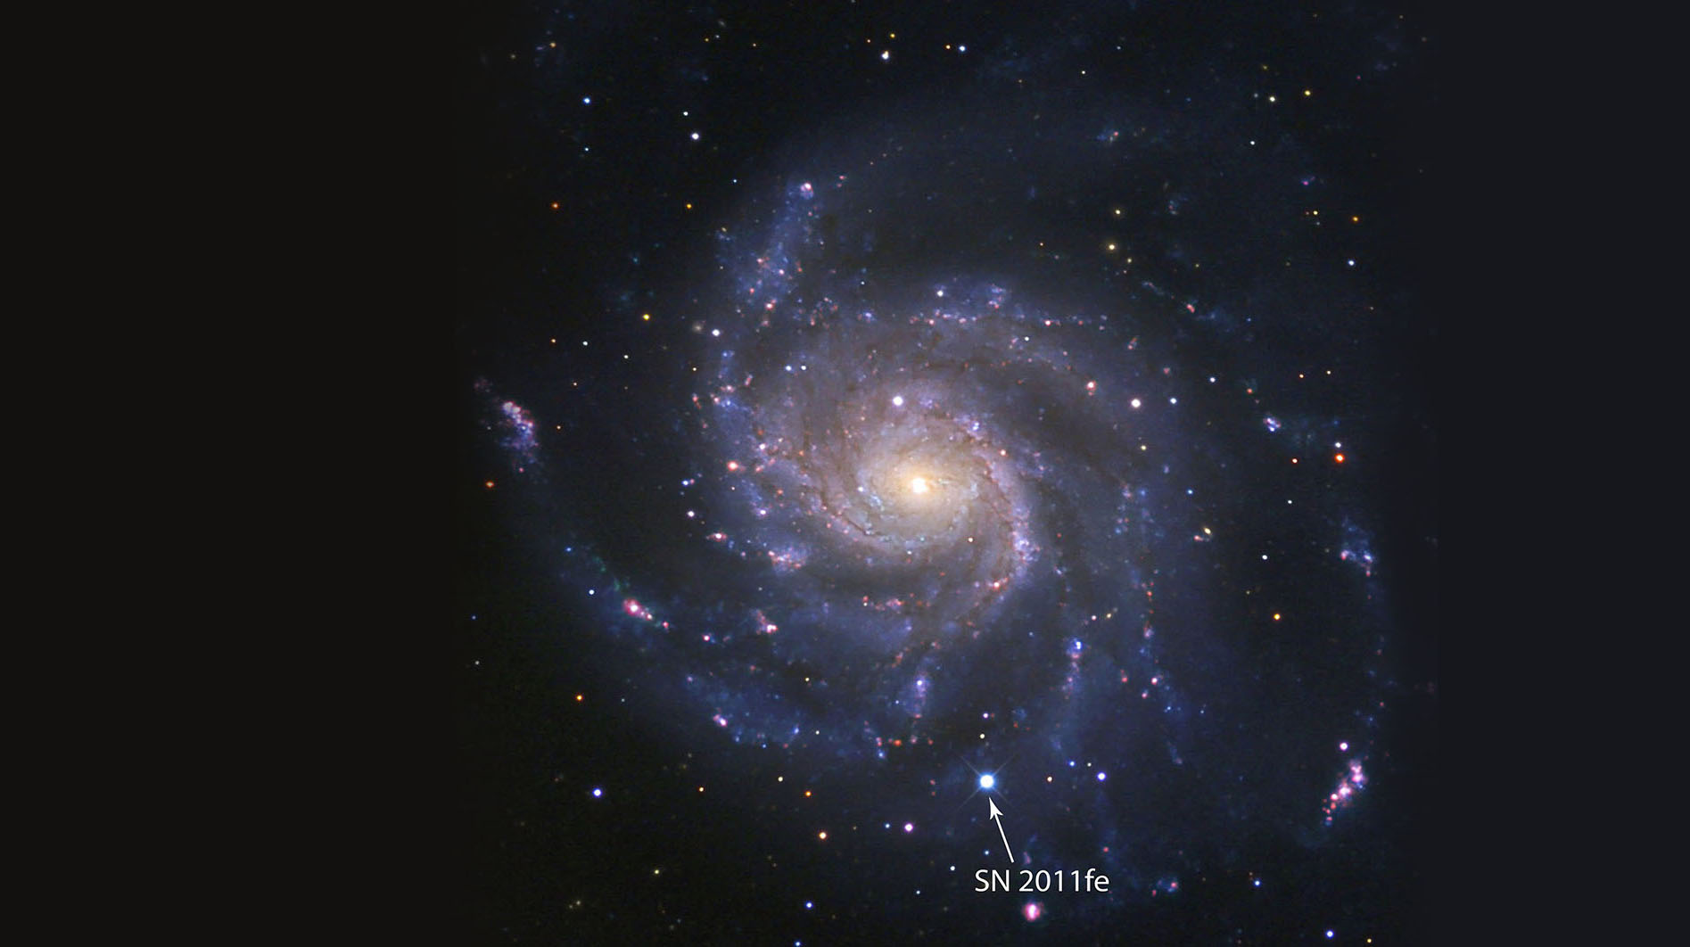
The Mystery of Dark Energy
Notes:
25. Roman Science—Fundamental physics—dark energy
Key points to discuss:
Dark Energy is one of the biggest, and most mysterious, scientific discoveries of modern times.
Previously, science had indicated that the expansion of the universe must be slowing down over time, but it was found to be speeding up instead. The reason is unknown and the phenomena driving it is what is called “dark energy.”
Roman will impact all areas of astronomy, but the investigating dark energy has been a major mission goal from the initial idea during the 2010 decadal survey process.
Astronomers use Type Ia supernovae to measure the universe’s expansion rate—Roman will find many of these throughout time, allowing change over time to be tracked better than ever before.
More in-depth messaging:
The changing rate of the universe’s expansion is a huge question astronomers are trying to answer—detailed studies have led to different results that cannot both be true, which means that there is likely an important piece of the puzzle that is missing from our understanding of the laws of physics.
Type IA supernovae are uncommon, so we need to search the skies often enough to get a chance to find them. Roman plays the numbers games here by observing a big patch of the sky over and over again, and upping the odds of finding these rare objects at very large distances. Then Roman can track the expansion history of the universe farther back in time than we have not been able to do thus far.
Hyperlinks for presentation, i.e., related videos or webpages:
Minute Physics "How do we know the universe is accelerating?” video: https://www.youtube.com/watch?v=tXkBfkeJJ5c&feature=youtu.be
“Behind the headline” video on the Hubble Constant discrepancy: https://viewspace.org/video_library/videos/885-VS-BtH-HubbleConstant-1920x1080-363907575?tags=1639
Video showing expansion and dark energy’s effects on it: https://svs.gsfc.nasa.gov/12433
Image credit: B. J. Fulton/Las Cumbres Observatory Global Telescope Network
Arrow in the image points to a Type IA supernova, which are used to calculate and track the universe’s expansion.
Links to more background info:
Adam Riess's Roman Science Writer's Workshop presentation, "Expansion, Dark Energy, and the Roman Telescope": https://youtu.be/KK9tIMJl13E?t=1949
https://www.stsci.edu/roman/about/science-themes
https://roman.gsfc.nasa.gov/dark_energy.html
https://science.nasa.gov/astrophysics/focus-areas/what-is-dark-energy
https://www.stsci.edu/roman/surveys-and-programs
https://www.nasa.gov/feature/goddard/2022/nasa-s-roman-mission-will-test-competing-cosmic-acceleration-theories

Slide 26
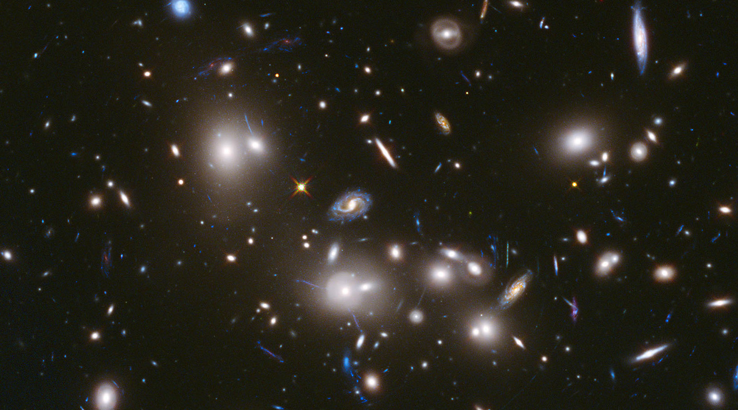
The Nature of Dark Matter
Notes:
26. Roman Science—Fundamental physics—Dark matter
Key points to discuss:
Dark matter cannot be directly observed by telescopes, but its gravitational effects can be seen—the warping of light by something very massive (refer to warped galaxies in slide image).
Roman will observe these effects on large and small scales in clusters of galaxies and map out the distribution of dark matter over cosmic time.
By tracking the positions of stars in galactic halos, Roman can explore the effects of dark matter in galactic environments.
More in-depth/narrative messaging:
Dark matter’s mass warps space and acts as a gravitational lens, redirecting light that passes by it. Uncovering the mysteries about dark matter will require mapping out the curved paths of light and back-tracking to figure out the distribution of dark matter to cause the gravitational lensing. Dark matter can also cause the shape of galaxies to be warped, which requires the high-precision imaging that only Roman can provide for a very large number of very distant galaxies.
Hyperlinks for presentation, i.e., related videos or webpages:
https://viewspace.org/video_library/videos/1042-STScI-H-BeyondTheHeadlines_WarpedLightandDarkMatter-1280x720-459520367?tags=1639
Image credit: NASA, ESA, and J. Lotz, M. Mountain, A. Koekemoer, and the HFF Team (STScI)
Hubble image

Slide 27
Notes:
27. Roman Science—Fundamental physics—New physics
Key points to discuss:
Roman will investigate all the scientific questions we’ve covered and provide so much more detail—but it’s the discoveries we can’t anticipate that are some of the most exciting.
Dark energy was like this for Hubble—no one saw it coming, and now it is a large focus of research and future missions—like Roman!
With its clarity and repeated observations of the sky, Roman will inevitably find unique objects.
Survey missions like Roman are ideal for observing changes in the dynamic universe—how has it changed over time?
Can link back to Nancy Grace Roman quote from earlier in the presentation: "Scientific research and engineering is a continuous series of solving puzzles."
Image credit: NASA, ESA, and J. Olmsted (STScI)
Illustration

Slide 28
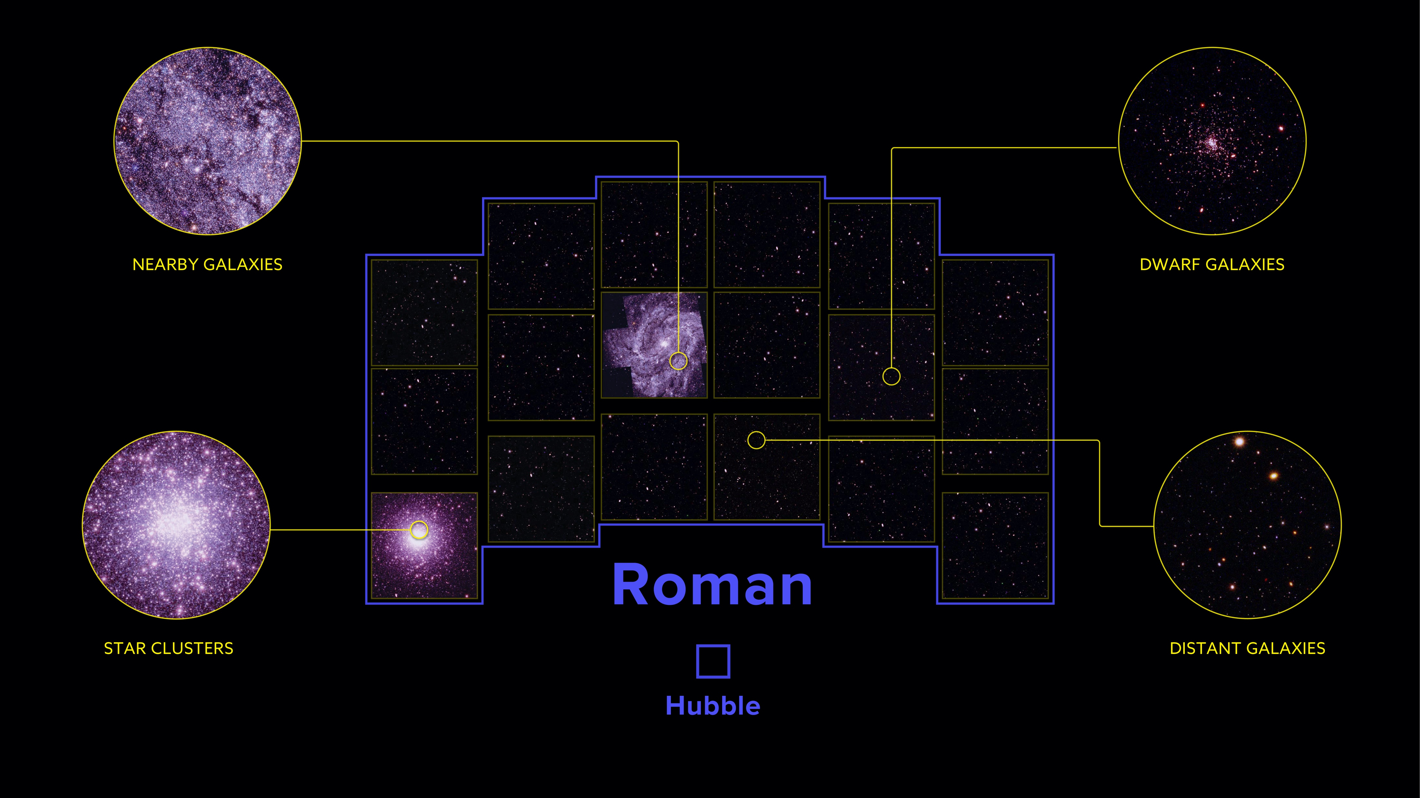
Notes:
28. Roman’s efficiency—more of the sky in less time
Key points to discuss:
Roman's dedicated surveys will be so large that they will image vast quantities of celestial objects from the solar system to the edge of the observable universe.
Roman’s data will immediately be available to anyone with an internet connection, without the traditional period of exclusivity for certain scientists that designed the telescope’s target and settings. This will make more novel discoveries possible more quickly.
More in-depth messaging:
Even Roman’s surveys that are planned for studying distant galaxies will capture a wealth of data on intervening solar system objects, stars, star-forming regions, and nearby galaxies. Given the cadence of the surveys, many areas will be repeatedly covered, providing detailed observations of transient objects, many of which are sure to surprise astronomers.
While the CANDELS program took Hubble nearly 21 days to survey in near-infrared light, Roman’s large field of view and higher efficiency would allow it to survey the same area in less than half an hour.
Top left: This view illustrates a region of the large nearby spiral galaxy M83.
Top right: A hypothetical distant dwarf galaxy appears in this magnified view, demonstrating Roman’s ability to detect small, faint galaxies at large distances.
Bottom left: This magnified view illustrates how Roman will be able to resolve bright stars even in the dense cores of globular star clusters.
Bottom right: A zoom of the CANDELS-based background shows the density of high-redshift galaxies Roman will detect.
All of this wealth of data will immediately be available for free within NASA's Barbara A. Mikulski Archive for Space Telescopes to anyone with an internet connection.
Image credit: Benjamin Williams, David Weinberg, Anil Seth, Eric Bell, Dave Sand, Dominic Benford, and the WINGS Science Investigation Team
Image Composition: Z. Levy (STScI)
This simulated image illustrates the wide range of science enabled by Roman's extremely wide field of view and exquisite resolution. The yellow squares—which all contain background imagery simulated using data from Hubble’s Cosmic Assembly Near-infrared Deep Extragalactic Survey (CANDELS) program—outline the area Roman can capture in a single observation. A blue square shows the field of view of Hubble’s Wide Field Camera 3 for comparison.
Links to more background info:
https://www.stsci.edu/roman/surveys-and-programs
https://www.stsci.edu/roman/science-planning-toolbox
https://roman.ipac.caltech.edu/sims/Simulations_csv.html
Roman “Expanding Our View” brochure: https://www.stsci.edu/files/live/sites/www/files/home/roman/_documents/roman-expanding-our-view.pdf

Slide 29
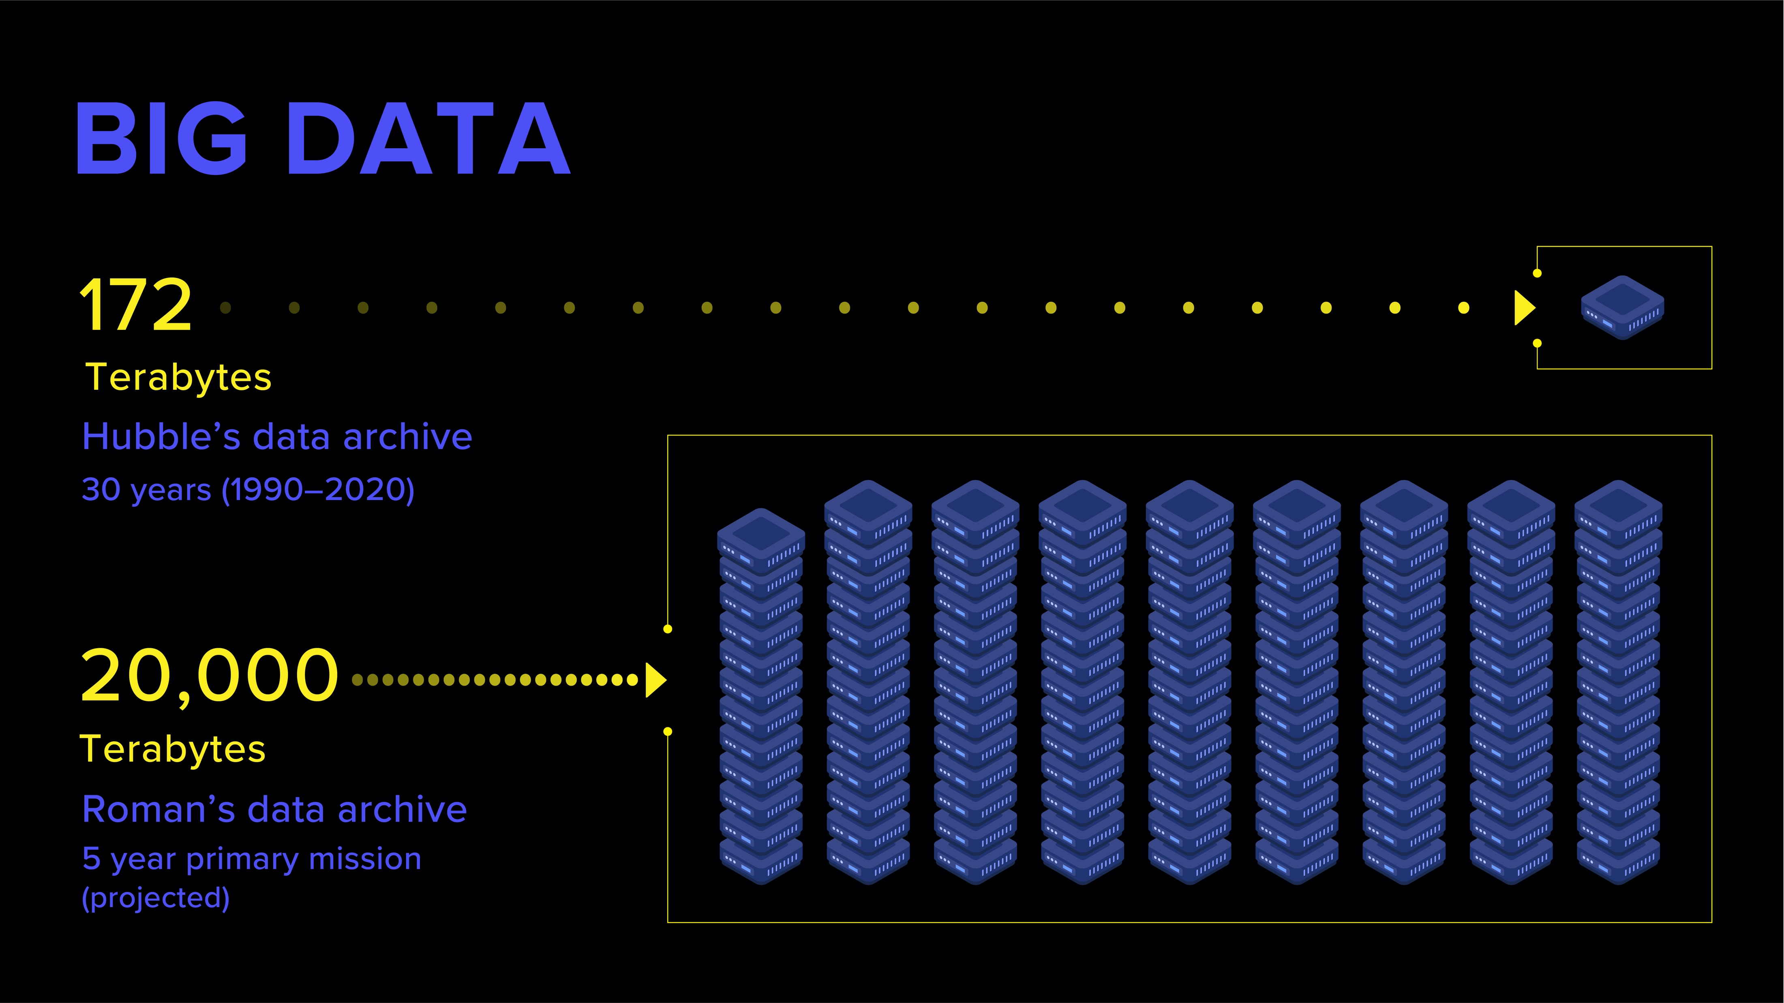
Notes:
29. Roman’s big data visualized—comparison with Hubble
Key points to discuss:
To answer big questions, you need a lot of information. Where are the patterns, and where are important deviations from patterns?
Big data to address big mysteries—Roman’s huge field of view and survey mode provide this.
Roman will collect over 100 times more data in its five-year planned mission than Hubble has in the last 30 years.
All Roman data will be immediately available for research, in contrast to other missions in which data often has a proprietary period of time before becoming public.
More in-depth/narrative messaging:
Many of the biggest questions in astronomy require information about numerous objects at different times in cosmic history.
An Earth-based example: instead of getting a small snapshot of the world by looking around your home, imagine a drone being able to survey the entire city to understand how your neighborhood fits in, or how the city evolved over time, or where structures were built in relation to each other.
All of Roman’s data will be nonproprietary and available to all through the Roman archive. To support data analysis, the mission will release cloud-based data products, including stacks, dithers, and mosaics, in addition to catalogs and other high-level science products. These assets will make it easy to access and analyze parallel, contiguous, homogenous—and huge—data sets. The Roman mission will also partner with the astronomical community to create and release open-source data reduction and analysis tools.
The mission will fund programs to support archival researchers using the survey data to explore all facets of astrophysics. A larger fraction of Roman science funding will go to these archival programs relative to planned observation programs, when compared to other NASA observatories, including Hubble.
Image credit: Z. Levy (STScI)
Illustration
Links to more background info:
https://hubblesite.org/contents/news-releases/2020/news-2020-41

Slide 30
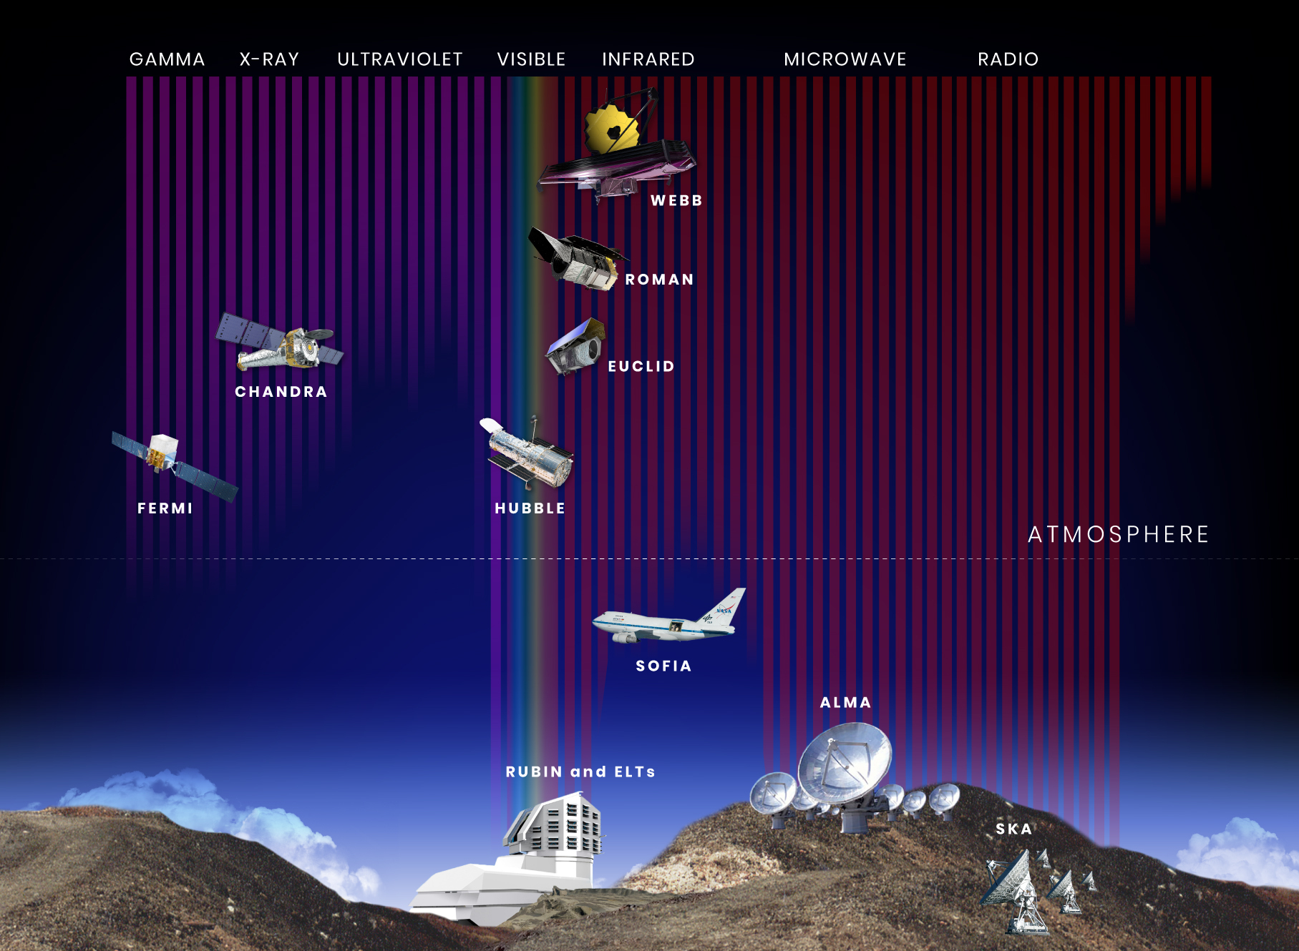

Notes:
30. Roman and other missions
Key points to discuss:
Roman will see a lot, but it won’t see everything. No telescope does.
Because different observatories detect different wavelengths of light and have different observing modes, resolution, precision, and other specialties, they often make the most scientific progress by working together.
Roman’s data will compliment other observatories operating at the same time, as well as those past and future through its data archive.
More in-depth messaging:
Roman’s survey of the very distant universe with Hubble-like resolution will complement future ground-based missions—including the Vera C. Rubin Observatory—of the more nearby universe which covers more of the sky. Roman will scout the universe for unique objects that can be followed-up on by more targeted telescopes, like Hubble and Webb. We learn the most about the universe when we can study it at many different wavelengths, in different parts of the sky, and at different epochs in the universe.
Future astronomers will be able to look back on Roman’s data to see what the universe looked like when Roman was observing it.
Image credit: A. James (STScI)
Illustration
Links to more background info:
Harry Ferguson's Roman Science Writer's Workshop, "Science Synergies of the 2020's:
https://youtu.be/KK9tIMJl13E?t=3130

Slide 31

The Bigger Picture
with the Roman Space Telescope
Planets by the thousands
Stars by the billions
Galaxies by the millions
Fundamental Physics
The Unexpected
Notes:
31. Conclusion summary slide
Key points to discuss:
Large swaths of the sky with Hubble-like resolution
200 times Hubble’s infrared field of view (Wide Field Camera 3)
Survey mode with imaging and spectra
Sensitivity in the visible and near-infrared wavelengths
Publicly available data
Big data for the big questions: How does the universe work? How did we get here? Are we alone?
More in-depth messaging:
Roman will explore large swaths of the sky with Hubble-like resolution, providing views of the universe, both near and far, gathering a tremendous amount of information on all types of objects, that can answer some of our biggest questions: how does the universe work? How did we get here? Are we alone?
Hyperlinks for presentation, i.e., related videos or webpages:
Zoom out video from Eagle Nebula to the larger Carina Nebula https://hubblesite.org/contents/media/videos/2020/41/1284-Video annotated
https://hubblesite.org/contents/media/videos/2020/41/1282-Video unannotated
Zoom out video from center of Abell 427 field to the fuller cluster field https://hubblesite.org/contents/media/videos/2020/41/1285-Video
Image credits:
Wide view: Composite image of NSF’s 0.9-meter telescope at Kitt Peak National Observatory (Credit: T.A. Rector (NRAO/AUI/NSF and NOIRLab/NSF/AURA) and B.A. Wolpa (NOIRLab/NSF/AURA)
and an image by amateur astronomer Liam Murphy.
Center image: NASA, ESA, and the Hubble Heritage Team (STScI/AURA)
Image composition: by L. Hustak (STScI)
Optical Image Filters: F502N ([O III]), F657N (Hα + [N II]), F673N ([S II])

