Slide 1
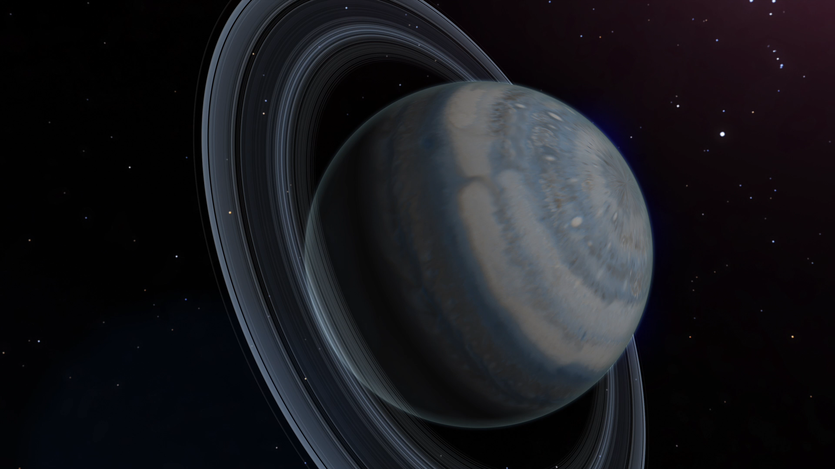
Notes:
A coronagraph works by blocking the bright light of a star to allower dimmer objects, like orbiting exoplanets, to become visible. This in turn allows cameras to directly image the exoplanet.
Direct imaging provides the critical approach to studying the detailed properties of exoplanets. Images and spectra of directly imaged planets provide some of the most powerful information about the structure, composition, and physics of planetary atmospheres. This information can in turn help scientists better understand the origin and evolution of these systems. The direct imaging technique is also naturally applicable to the nearest and brightest, and thus best-characterized, solar systems.
Advancing the technology for direct imaging of exoplanets was the top priority medium-scale space investment recommended by NWNH. Coronagraphy on WFIRST will be a major step towards the long-term goal of a mission that can image habitable Earth-mass planets around nearby stars and measure their spectra for signs of life.

