Slide 1
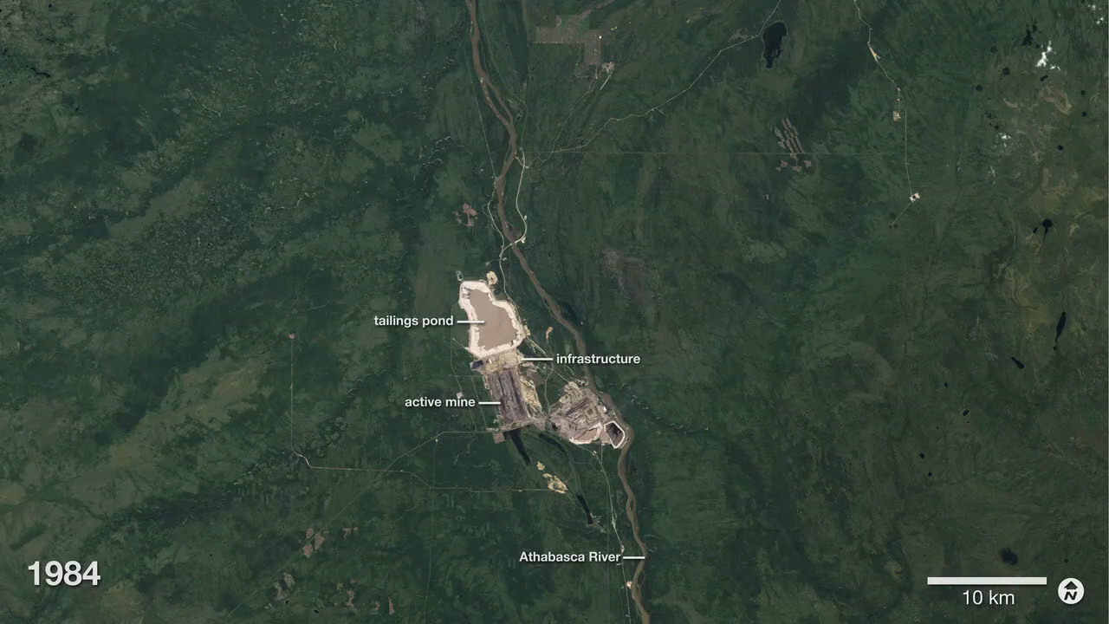
Notes:
Athabasca Oil Sands
Buried under Canada’s boreal forest is one of the world’s largest reserves of oil. Bitumen—a very thick and heavy form of oil (also called asphalt)—coats grains of sand and other minerals in a deposit that covers about 142,200 square kilometers of northwest Alberta.
Only 20 percent of the oil sands lie near the surface where they can easily be mined. The rest of the oil sands are buried more than 75 meters below ground and are extracted by injecting hot water into a well that liquefies the oil for pumping. This series of images from the Landsat satellite shows the growth of surface mines over the Athabasca oil sands between 1984 and 2015.
These images show slow growth between 1984 and 2000, followed by a decade of more rapid development. The first mine (from 1967, now part of the Millennium Mine) is visible near the Athabasca River in the 1984 image. The only new development visible between 1984 and 2000 is the Mildred Lake Mine (west of the river), which began production in 1996.
For more information:
earthobservatory.nasa.gov/Features/WorldOfChange/athabasca.php

