Slide 1
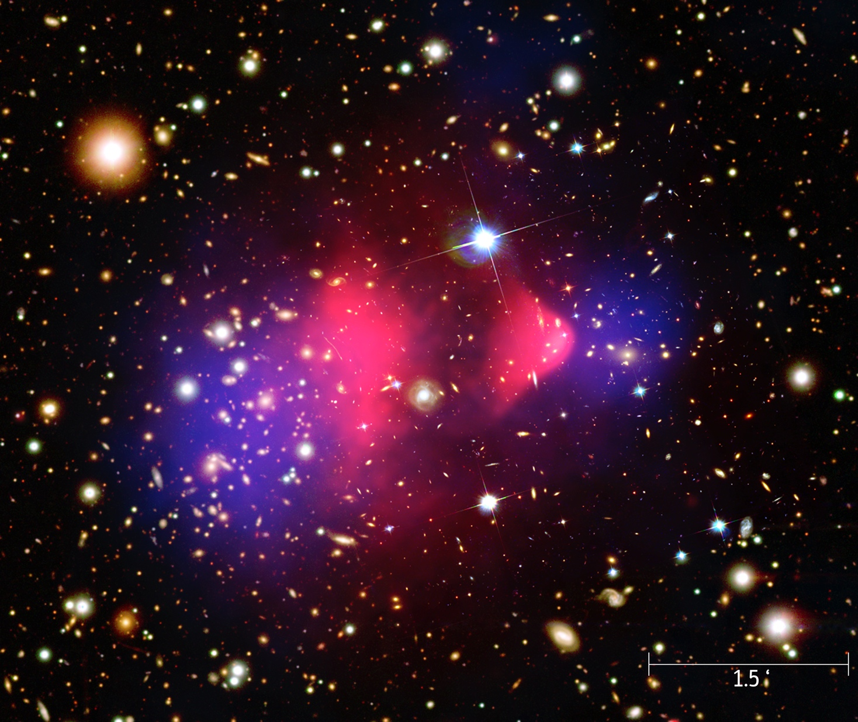
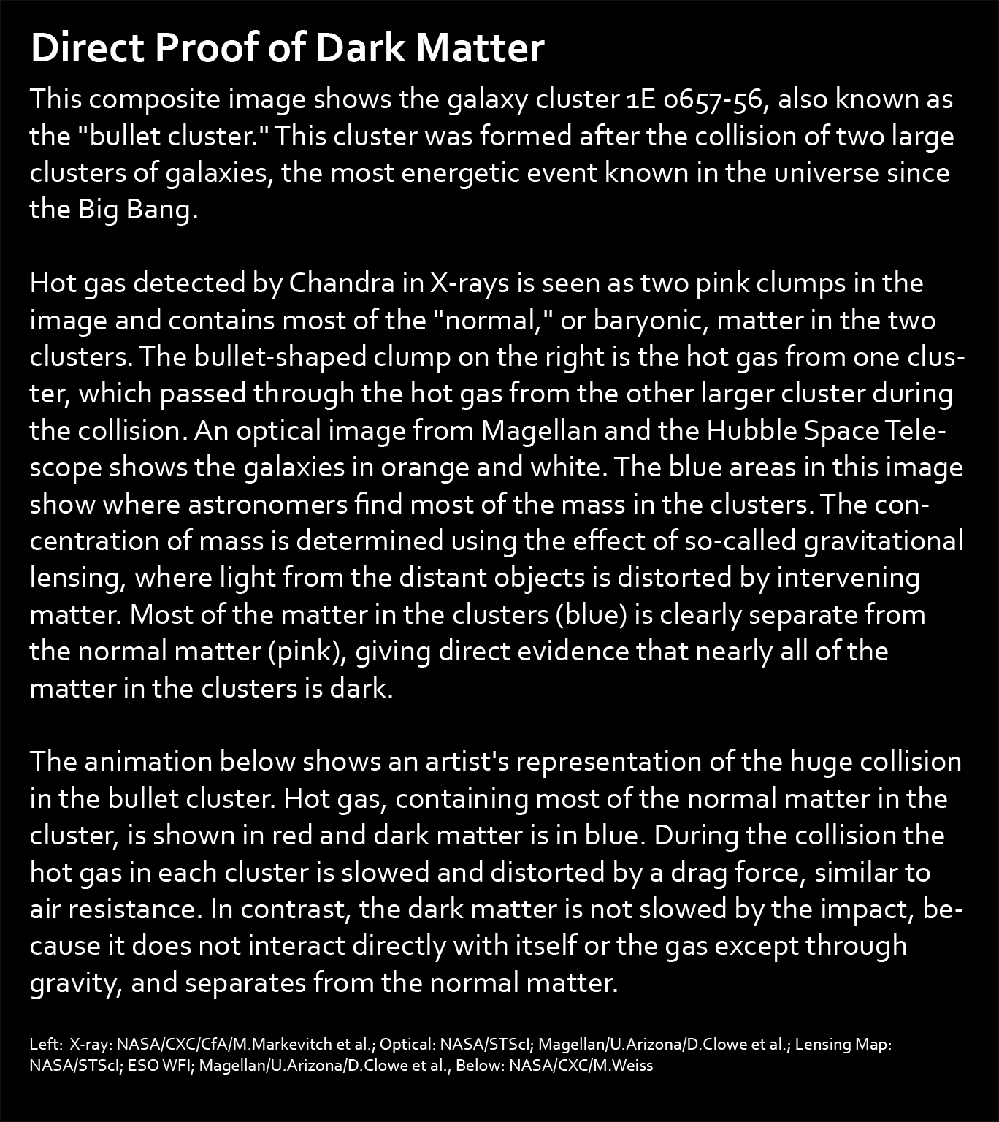
Notes:
Chandra and the Bullett Cluster
This composite image shows the galaxy cluster 1E 0657-56, also known as the "bullet cluster." This cluster was formed after the collision of two large clusters of galaxies, the most energetic event known in the universe since the Big Bang.

