Slide 1
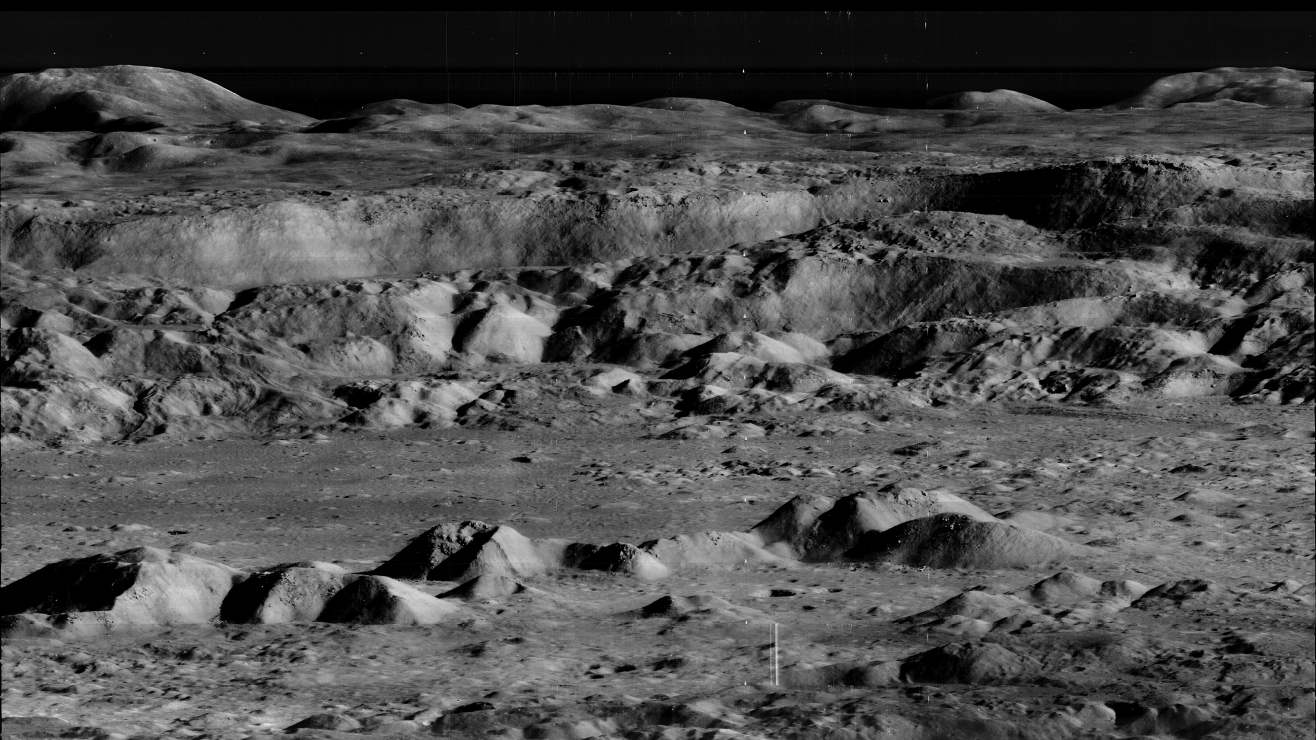
Notes:
Copernicus crater
The Lunar Orbiter Image Recovery Project (LOIRP) has released another iconic image taken during the Lunar Orbiter program in the 1960's. This image, which shows the dramatic landscape within the crater Copernicus was often referred to as the "picture of the century" by many people at the time of its original public release in 1966.
This image was taken by the Lunar Orbiter 2 spacecraft at 7:05 p.m. EST on 24 November 1966 from an altitude of 28.4 miles above the lunar surface, 150 miles due south of Copernicus. At the time this image was originally released most views of the lunar surface involved looking straight down. Little, if any, sense of the true elevation of lunar surface features was usually available. This photo changed that perception by showing the Moon to be a world with tremendous topography - some of it Earth-like, much of it decidedly un-earth-like.
Satellite: Lunar Orbiter

