Slide 1
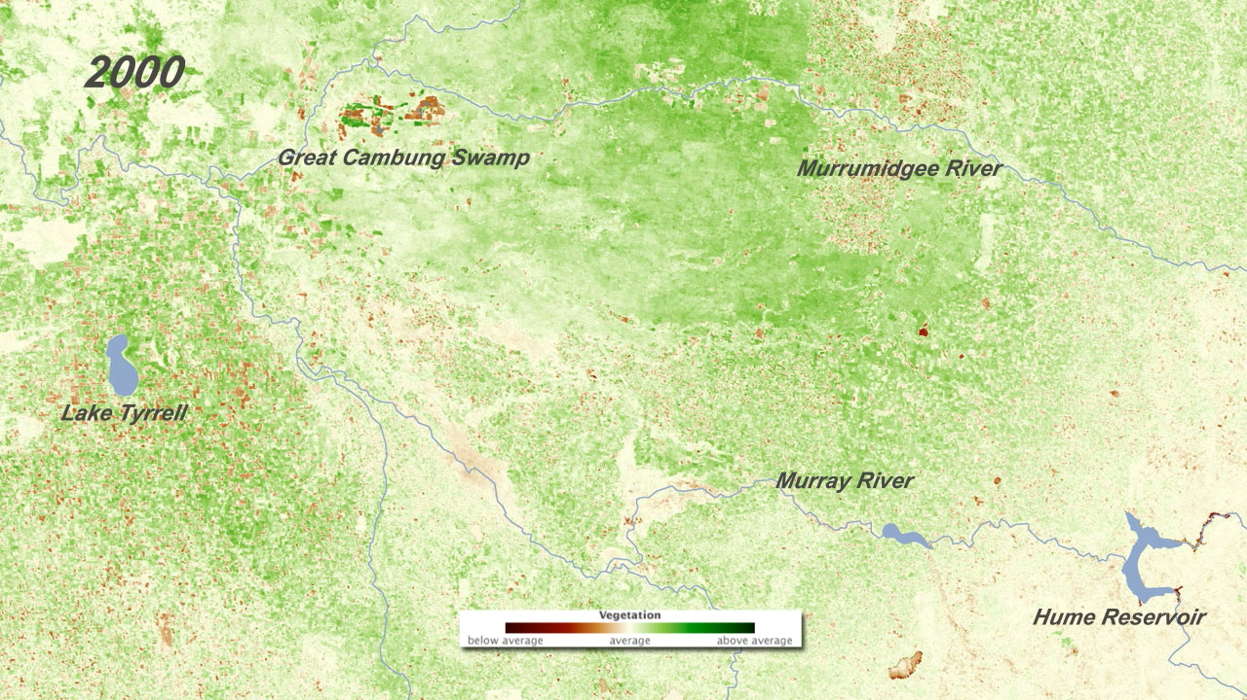
Notes:
Drought is a frequent visitor in Australia. The Australian Bureau of Meteorology describes the typical rainfall over much of the continent as “not only low, but highly erratic.” These satellite-based vegetation images document what farmers and ranchers have had to contend with over the past decade.
The images are centered on the agricultural areas near the Murray River—Australia’s largest river—between Hume Reservoir and Lake Tyrrell. The series shows vegetation growing conditions for a 16-day period in the middle of September each year from 2000 through 2010 compared to the average mid-September conditions over the decade. Places where the amount and/or health of vegetation was above the decadal average are green, average areas are off-white, and places where vegetation growth was below average are brown.
Satellite: Terra
Instrument: MODIS

