Slide 1
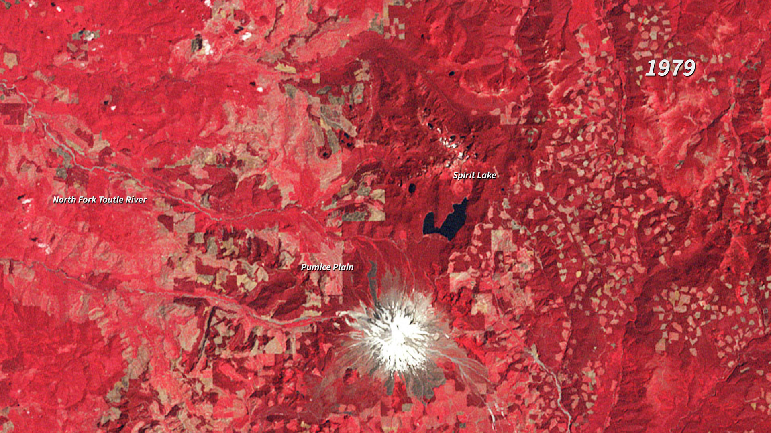
Notes:
Devastation and Recovery at Mt. St. Helens
In the nearly four decades since the eruption (1980), Mt. St. Helens has given scientists an unprecedented opportunity to witness the steps through which life reclaims a devastated landscape. The scale of the eruption and the beginning of reclamation in the Mt. St. Helens blast zone are documented in this series of images between 1979 and 2017. The older images are false-color (vegetation is red).
Not surprisingly, the first noticeable recovery (late 1980s) takes place in the northwestern quadrant of the blast zone, farthest from the volcano. It is another decade (late 1990s) before the terrain east of Spirit Lake is considerably greener. By the end of the series, the only area (beyond the slopes of the mountain itself) that remains conspicuously bare at the scale of these images is the Pumice Plain.
For more information:
earthobservatory.nasa.gov/Features/WorldOfChange/sthelens.php

