Slide 1
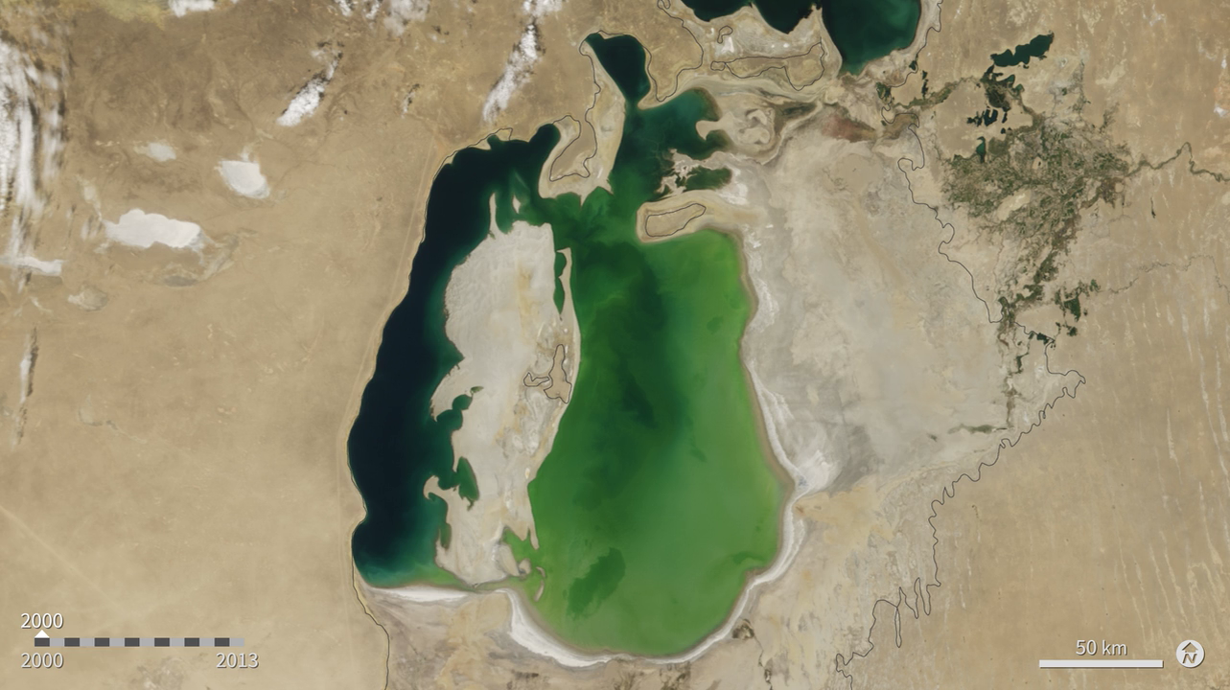
Notes:
The Aral Sea was once the fourth largest lake in the world. In the 1960s however, the Soviet Union undertook a major water diversion project on the arid plains of Kazakhstan, Uzbekistan, and Turkmenistan, diverting the rivers that once fed the Aral Sea. Irrigation transformed desert into farmland, but devastated the sea. This animation shows the visible changes across the region from 2000 to 2013.
At the start of the series in 2000, the lake was already a fraction of its 1960 extent. The Northern Aral Sea (small) had separated from the Southern Aral Sea (large). The Southern Aral Sea had split into an eastern and a western lobe that remained tenuously connected at both ends. By 2001, the southern connection had been severed, and the shallower eastern part retreated rapidly over the next several years. After Kazakhstan built a dam between the northern and southern parts of the Aral Sea, all of the water flowing into the desert basin from the Syr Darya stayed in the Northern Aral Sea. The differences in water color are due to changes in sediment.
Satellite: Terra
INstrument: MODIS

