Slide 1
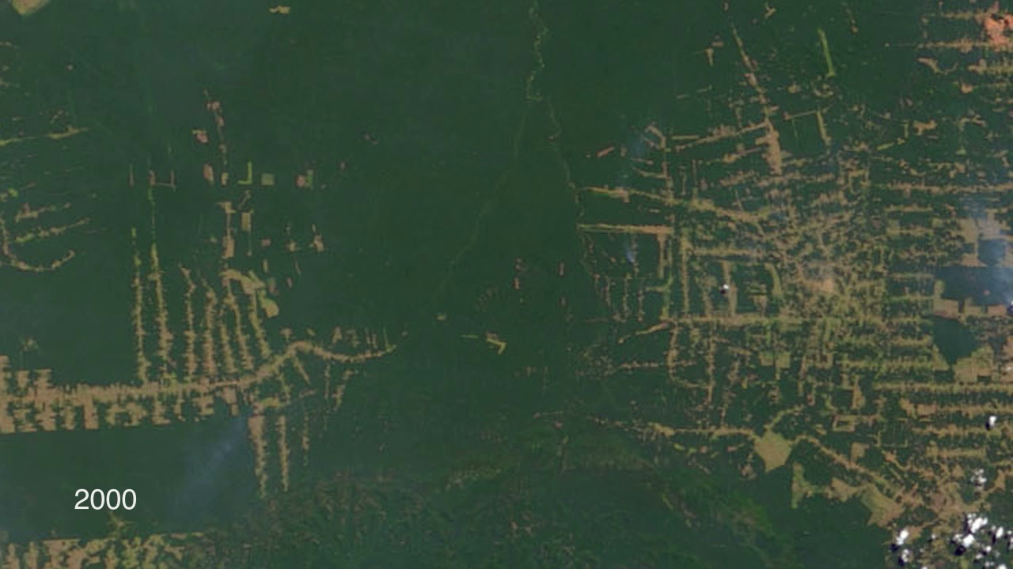
Notes:
The state of Rondônia in western Brazil has become one of the most deforested parts of the Amazon. This image series, created with data from the Moderate Resolution Imaging Spectroradiometer (MODIS) onboard NASA’s Terra satellite, shows the region from 2000 to 2010. By the year 2000, the frontier had reached the remote northwest corner of Rondônia. Intact forest is deep green, while cleared areas are tan (bare ground) or light green (crops, pastures). Deforestation follows a predictable pattern in these images. The first clearings appear in a fishbone pattern, arrayed along the edges of roads. Over time, the fishbones collapse into a mixture of forest remnants, cleared areas, and settlements. This pattern is common in the Amazon. Legal and illegal roads penetrate a remote part of the forest, and small farmers migrate to the area. They claim land along the road and clear some of it for crops. Within a few years, heavy rains and erosion deplete the soil, and crop yields fall. Farmers then convert the degraded land to cattle pasture, and clear more forest for crops.
Satellite: Terra
Instrument: MODIS

