Slide 1
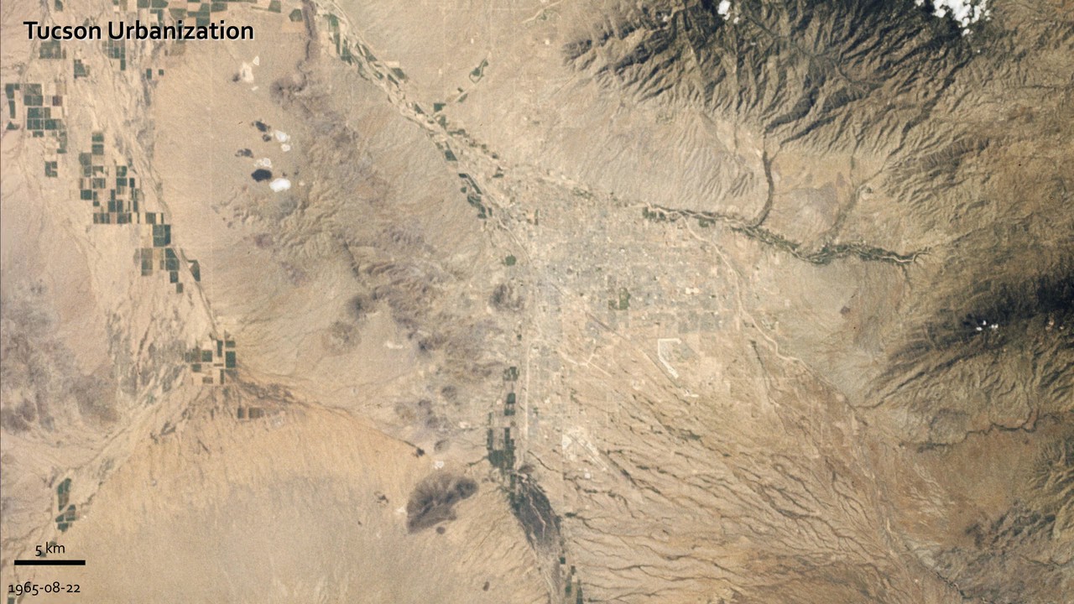
Notes:
Urban Growth in Tucson, Arizona
.Between 1965 and 2011, Tucson's population grew rapidly
The astronauts who snapped photos of Earth during the Mercury and Gemini missions produced more than just pretty pictures. They planted seeds at the USGS and NASA. In the mid-1960s, the director of USGS proposed a satellite program to observe our planet from above, and later described Landsat as “a direct result of the demonstrated utility of the Mercury and Gemini orbital photography to Earth resource studies.”
On a flight in late August 1965, Gemini V astronauts Gordon Cooper and Pete Conrad took photos of the Earth, including a shot showing Tucson, Arizona. A lot changed in the 46 years between that photo and the satellite image acquired in 2011 by the Thematic Mapper on Landsat 5.
A comparison of the images shows more city and less green. The expansion of urbanized areas is readily identifiable by the grid pattern of city streets. Between 1965 and 2011, Tucson’s population grew rapidly. In 1970, the population was 262,933; in 2010, it was 520,116.

