Slide 1
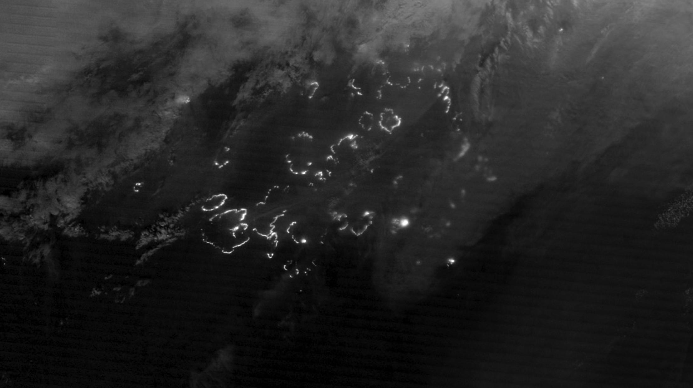
Notes:
Daytime and Nighttime Views of Fires in Siberia
Daytime and nighttime views of fires in Siberia, August 3, 2012.
The vast majority of Russian wildfires occur in Siberia, generally along the southern border. Fires in 2012 followed the typical pattern and occurred primarily east of the Urals. This pair of images from August 3, 2012 shows fires using two different instruments.
The nighttime image on the right was acquired by the Visible Infrared Imaging Radiometer Suite (VIIRS) instrument onboard the Suomi National Polar-orbiting Partnership (NPP) satellite. The VIIRS “day-night band” was designed to be sensitive to such low levels of visible light that it can detect wildfires in the dark of the night. The white outlines are the actively burning perimeters of several fires. The Moderate Resolution Imaging Spectroradiometer (MODIS) instrument on NASA’s Aqua satellite acquired the daytime image on the left, showing the same group of fires several hours earlier during day light.

Slide 2
