Slide 1
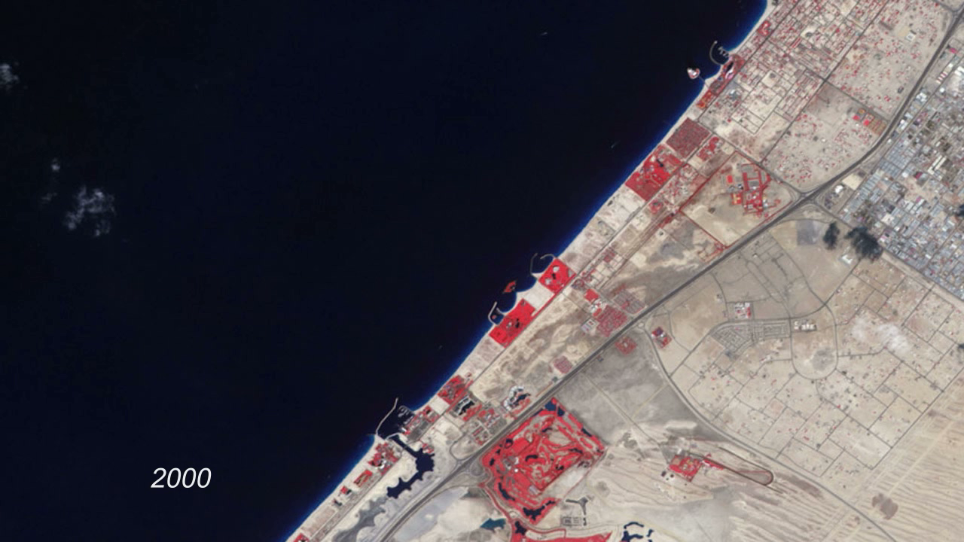
Notes:
Urbanization of Dubai
To expand the possibilities for beachfront tourist development, Dubai, undertook a massive engineering project to create hundreds of artificial islands along its Persian Gulf coastline. This image series shows the progress of the Palm Jumeirah Island from 2000 to 2011.
In these false-color images, bare ground appears brown, vegetation appears red, water appears dark blue, and buildings and paved surfaces appear light blue or gray. The first image shows the area prior to the island’s construction. The final image, acquired in February 2011, shows vegetation on most of the palm fronds, and numerous buildings on the tree trunk. As the years pass, urbanization spreads, and the final image shows the area almost entirely filled by roads, buildings, and irrigated land.
Satellite: Terra
Instrument: ASTER

