Slide 1
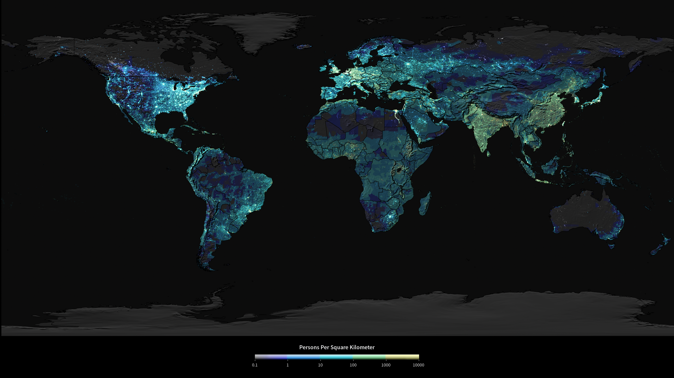
Notes:
Population Density at Night
This image combines the Earth’s Gridded Population of the World, version 3 (GPWv3) data from 2000 with Defense Meteorological Satellite Program (DMSP) night-lights data to show the distribution of human population across the globe, including estimates to 2015. The map is colored to show the number of persons per square kilometer, from dark blue (1 person) to yellow (10,000 people). The blue-to-yellow color scale was desaturated proportional to the amount of night-lights (i.e., the color was made whiter where there were more lights). The brightest areas are generally the most urbanized but not necessarily the most populated. A comparison between the U.S. and India shows a more dense population in India but more lights in the U.S. Other patterns of distribution are also visible. For example, most major cities are along coastlines, near rivers, or near transportation networks. GPWv3 was produced by the Center for International Earth Science Information Network of the Earth Institute at Columbia University using population data from 2000.
^{Satellite: DMSP}
Population Data: GPWv3 was produced by the Center for International Earth Science Information Network of the Earth Institute at Columbia University using
^{population data from 2000}

