Slide 1
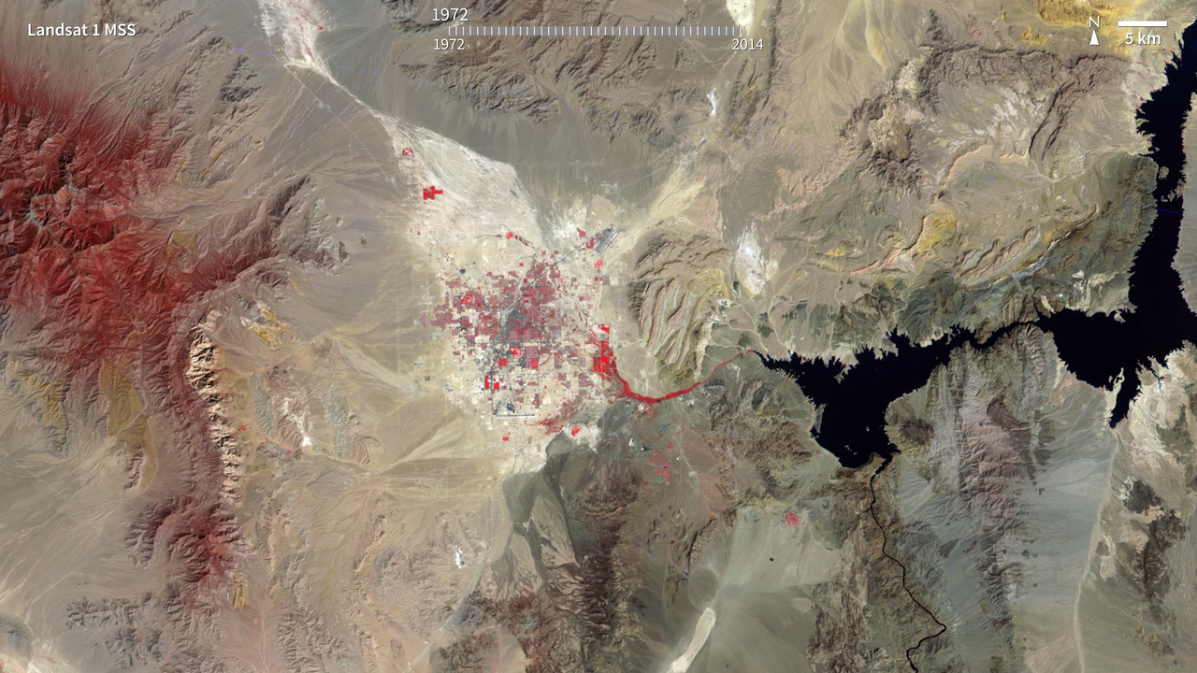
Notes:
Las Vegas Urban Sprawl
The city of Las Vegas—meaning the meadows—was established in 1905. Its grassy meadows and artesian springs attracted settlers traveling across the arid Desert Southwest in the early 1800s. In the 1930s, gambling became legalized and construction of the Hoover Dam began, resulting in the city's first growth spurt. Since then, Las Vegas has not stopped growing. Population has reached nearly two million over the past decade, becoming one of the fastest growing metropolitan areas in the world. These false-color images show the rapid urbanization of Las Vegas between 1984 and 2014. The city streets and other impervious surfaces appear gray, while irrigated vegetation appears red. Over the years, the expansion of irrigated vegetation (e.g., lawns and golf courses) has stretched the city’s desert bounds.
For more information:
science.nasa.gov/science-news/hyperwall/earth-hyperwall

