Slide 1
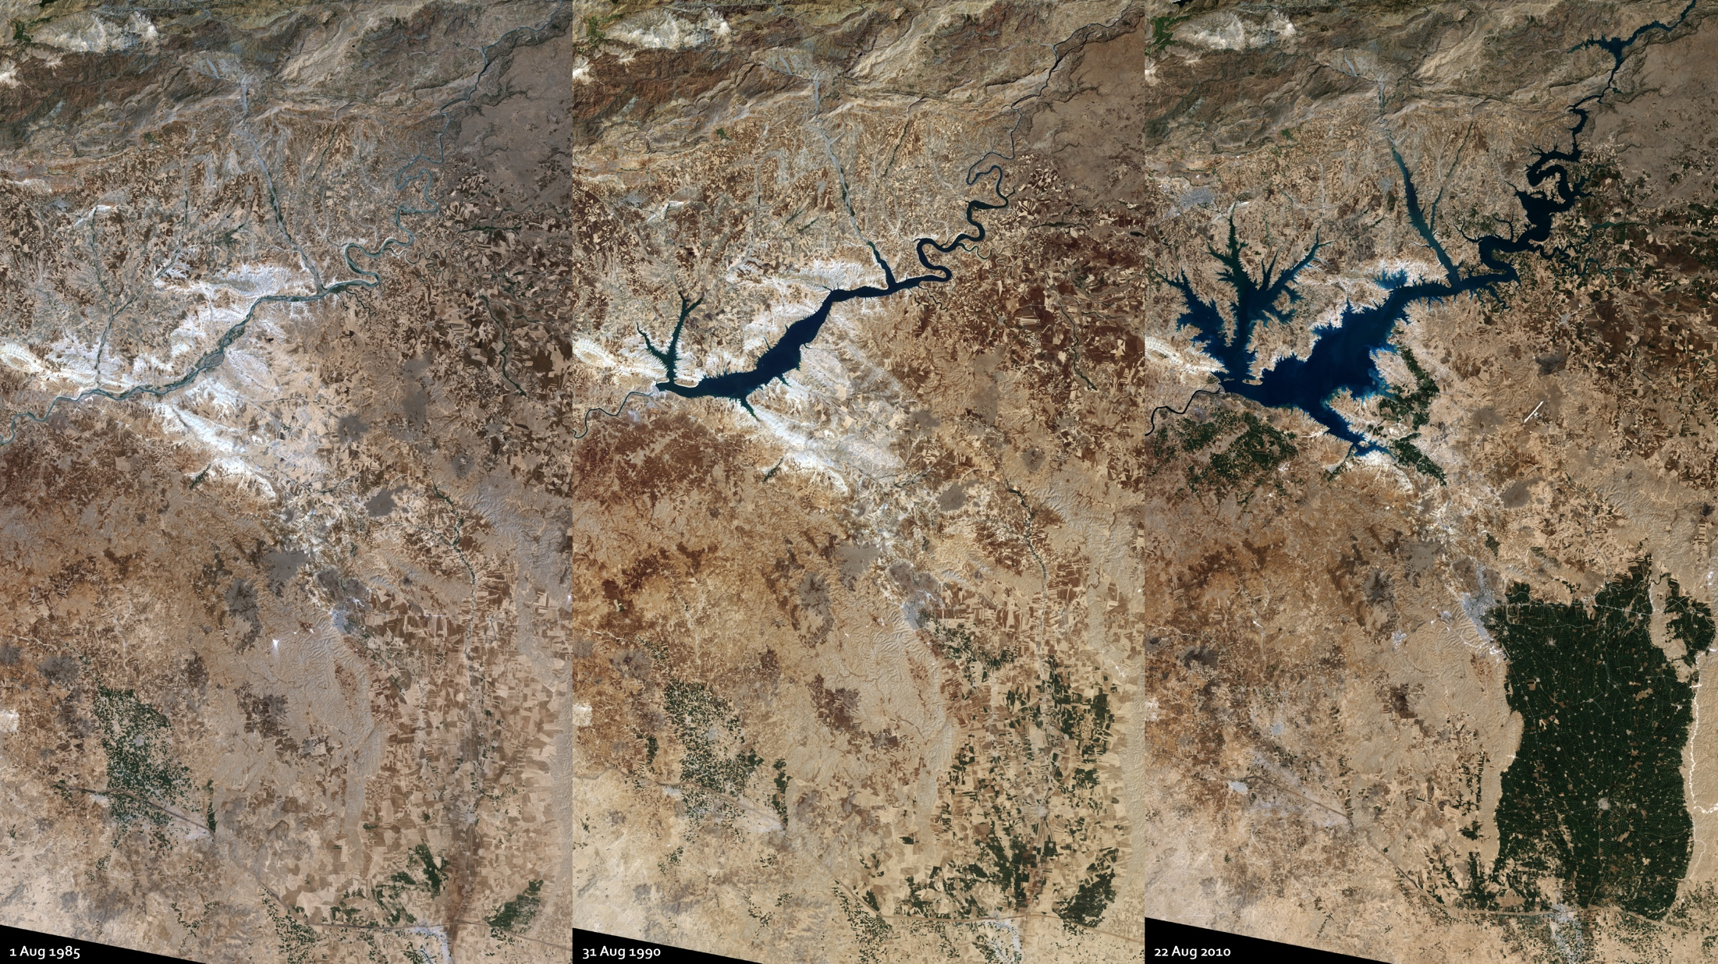
Notes:
Ataturk Dam, Turkey
Turkey’s Ataturk Dam was completed in 1990. It is the largest of a series of dams along the two major rivers of the region, the Tigris and Euphrates, which both have their headwaters in southeastern Turkey. It was built both to generate electricity for the region and to irrigate the plains between the Euphrates and the Tigris.
In this triplet of Landsat images, the dramatic growth of the Ataturk Dam Lake in the space of 19 years is quite apparent. The newly formed lake, sometimes referred to as a sea by locals, covers some 817 square kilometer in total surface area.
When the dam and its associated irrigation channels were finished, agriculture in the Harran Plains expanded. Crops such as cotton could now be grown in the dry season, where previously irrigation was limited to borewater .

