Slide 1
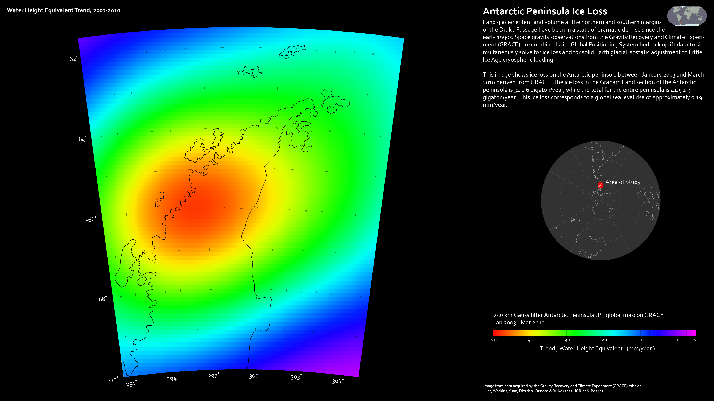
Notes:
Antarctic Peninsula Ice Loss
The Antarctic peninsula is experiencing a high rate of ice loss.
Land glacier extent and volume at the northern and southern margins of the Drake Passage have been in a state of dramatic demise since the early 1990s. Space gravity observations from the Gravity Recovery and Climate Experiment (GRACE) are combined with Global Positioning System bedrock uplift data to simultaneously solve for ice loss and for solid Earth glacial isostatic adjustment to Little Ice Age cryospheric loading.
This image shows ice loss on the Antarctic peninsula between January 2003 and March 2010 derived from GRACE. The ice loss in the Graham Land section of the Antarctic peninsula is 32 ± 6 gigaton/year, while the total for the entire peninsula is 41.5 ± 9 gigaton/year. This ice loss corresponds to a global sea level rise of approximately 0.19 mm/year.

