Slide 1
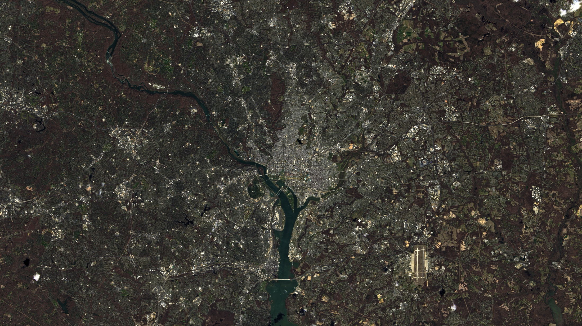
Notes:
On April 2, 2013, the Landsat Data Continuity Mission (LDCM) spacecraft obtained this true-color view of Washington, DC, and the surrounding suburban region. The image was made with 15-meter (49-feet) panchromatic spatial resolution data from the Observational Land Imager (OLI) onboard LDCM. Grey and white shades depict urban areas (e.g., city streets, buildings, sidewalks), while vegetation appears as shades of brown and dark green. In Washington, DC, gridded streets expand from the city’s center and the irrigated lawns of the National Mall, memorial parks, and golf courses appear green.
Landsat satellites provide global coverage of the Earth’s surface every season of the year. Scientists use Landsat images like this one to study how land-cover and land-use change over time. Vegetation for example, appears mostly brown in this image because it was taken in early spring when most vegetation is still dormant following winter months. However, in just a few short weeks, this same scene will look very different (i.e., much “greener”) and LDCM will get a much different view of our Nation’s capital.
Satellite: LandSat 8
Instrument: OLI

