Slide 1
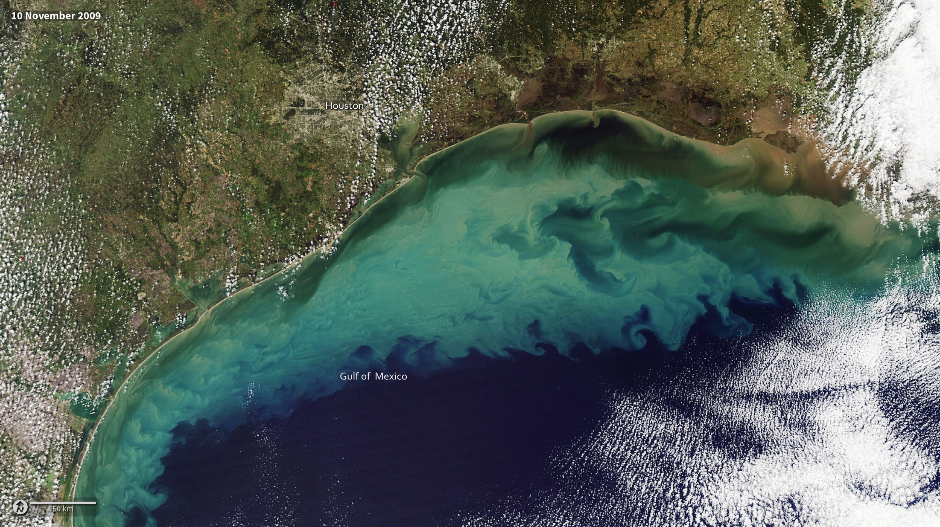
Notes:
Clouds of sediment colored the Gulf of Mexico on November 10, 2009. Much of the color likely comes from resuspended sediment dredged up from the sea floor in shallow waters. The sediment-colored water transitions to clearer dark blue near the edge of the continental shelf, where the water becomes deeper.
The ocean turbulence that brought the sediment to the surface is readily evident in the textured waves and eddies within the tan and green waters. Tropical Storm Ida had come ashore over Alabama and Florida, immediately east of the area shown here, a few hours before the image was acquired. The storm’s wind and waves may have churned up waters farther west.
A second source of sediment is visible along the shore. Many rivers, including the Mississippi River, drain into the Gulf of Mexico in this region. The river plumes are dark brown that fade to tan and green as the sediment dissipates.
Satellite: Aqua
Instrument: MODIS

