Slide 1
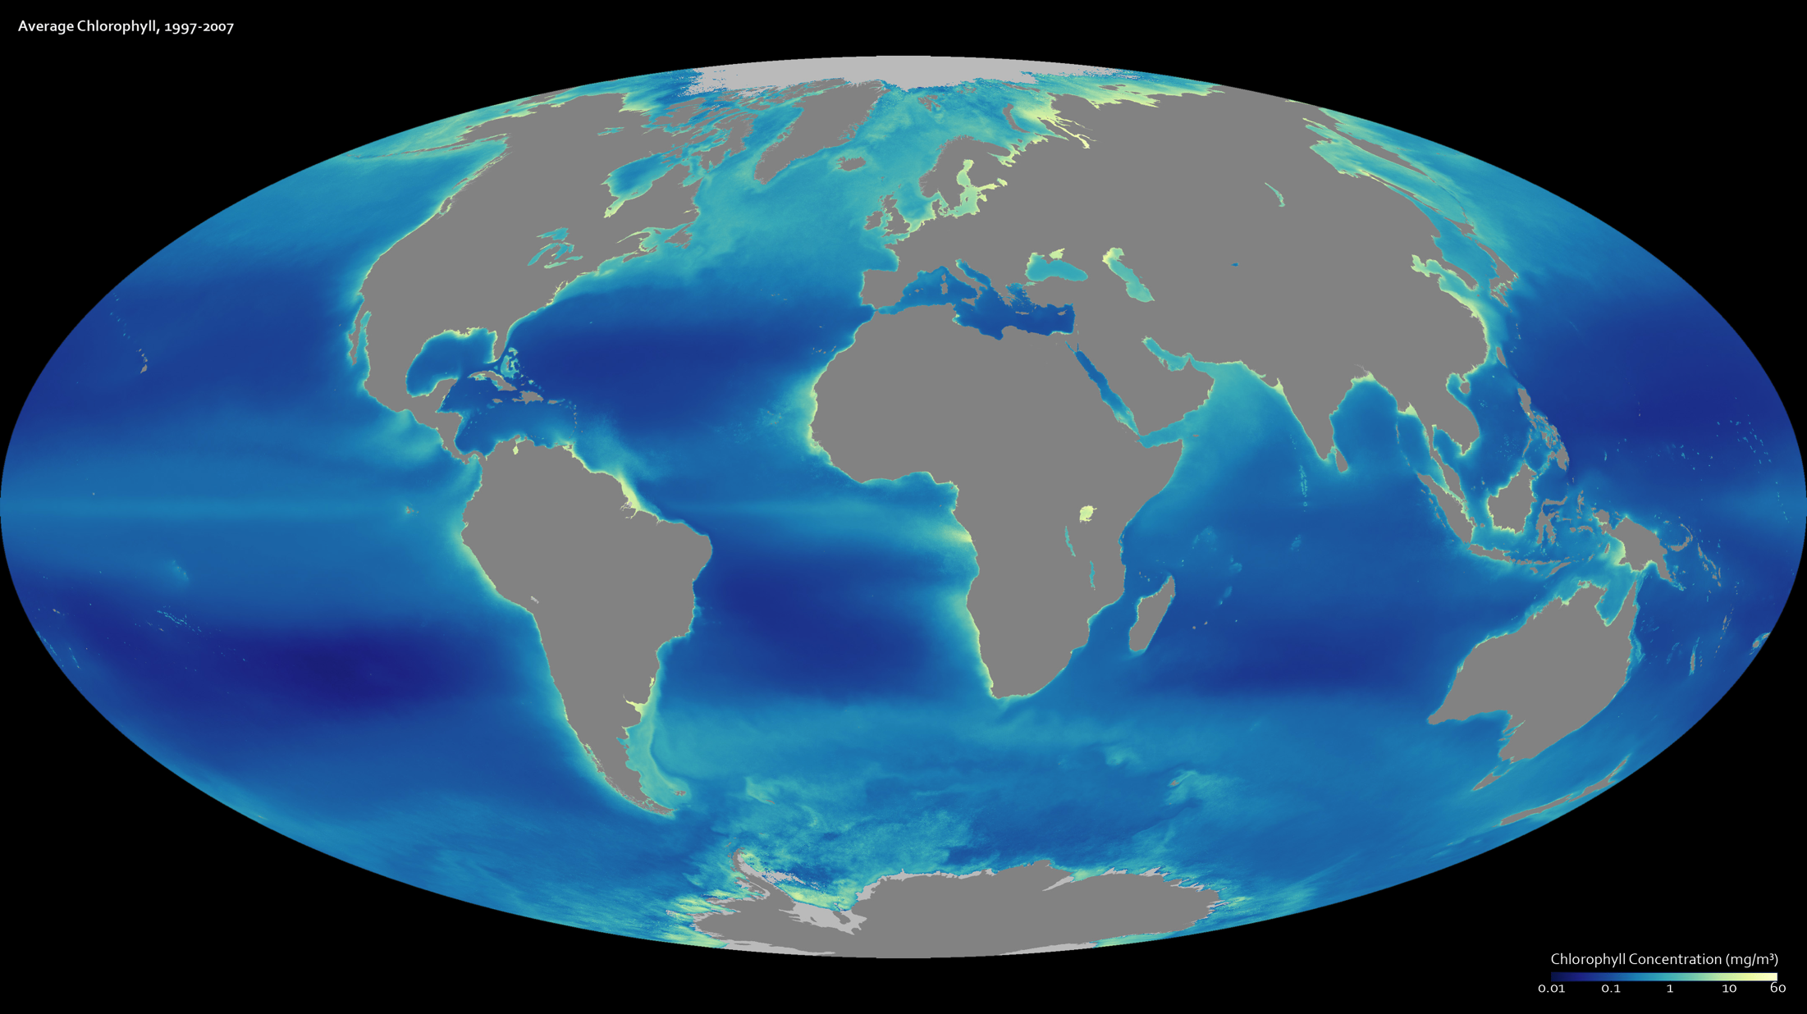
Notes:
A decade of observations from the SeaWiFS satellite are represented in this image, which shows average chlorophyll concentrations in Earth’s oceans from mid-September 1997 through the end of August 2007. Areas where plants thrive are light blue and yellow, while less productive regions are dark blue. The satellite records the amount of light that chlorophyll is soaking up as the plant converts light, water, and carbon dioxide into glucose and oxygen through photosynthesis. In general, high chlorophyll corresponds with a high number of healthy plants.
The global relationship between temperature and productivity was one that scientists first observed in SeaWiFS data. The places with the lowest chlorophyll concentrations are in the tropics, while the cold waters in the Arctic and Antarctic have high chlorophyll concentrations. What the image does not show is that the growth at the poles is seasonal. The plants only flourish during the spring and summer when there is sufficient light to fuel photosynthesis.
Satellite: SeaWIFS

