Slide 1
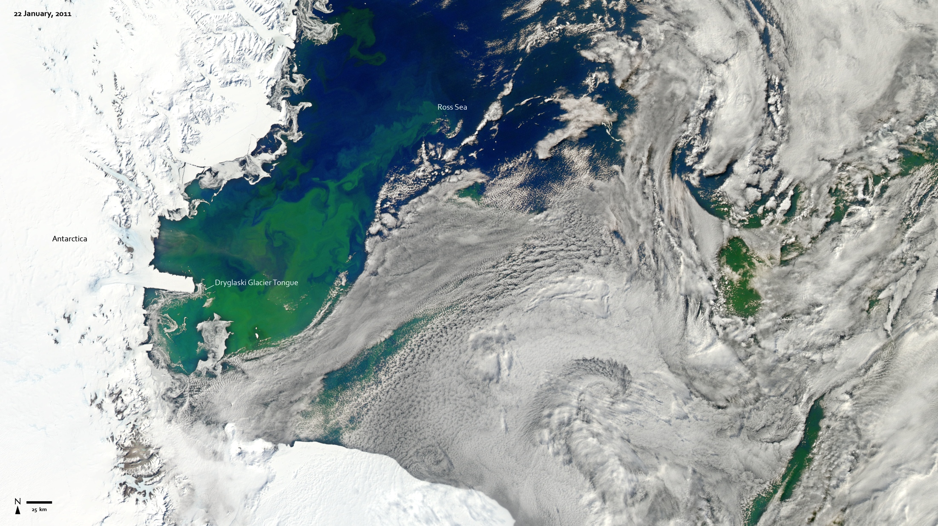
Notes:
Every southern spring and summer the Ross Sea bursts with life. Floating, microscopic plants, known as phytoplankton, soak up the sunlight and the nutrients and grow into prodigious blooms. Those blooms become a great banquet for krill, fish, penguins, whales, and other marine species.
This true-color image captures such a bloom in the Ross Sea on January 22, 2011. Bright greens of plant-life have replaced the deep blues of open ocean water.
The Ross Sea is a relatively shallow bay in the Antarctic coastline and due south from New Zealand. As the spring weather thaws the sea ice around Antarctica, areas of open water surrounded by ice—polynyas—open up on the continental shelf. In this open water, sunlight provides the fuel and various current systems provide nutrients from deeper waters to form blooms that can stretch 100 to 200 kilometers (60 to 120 miles). These blooms are among the largest in extent and abundance in the world.
Satellite: Aqua
Instrument: MODIS

