Slide 1
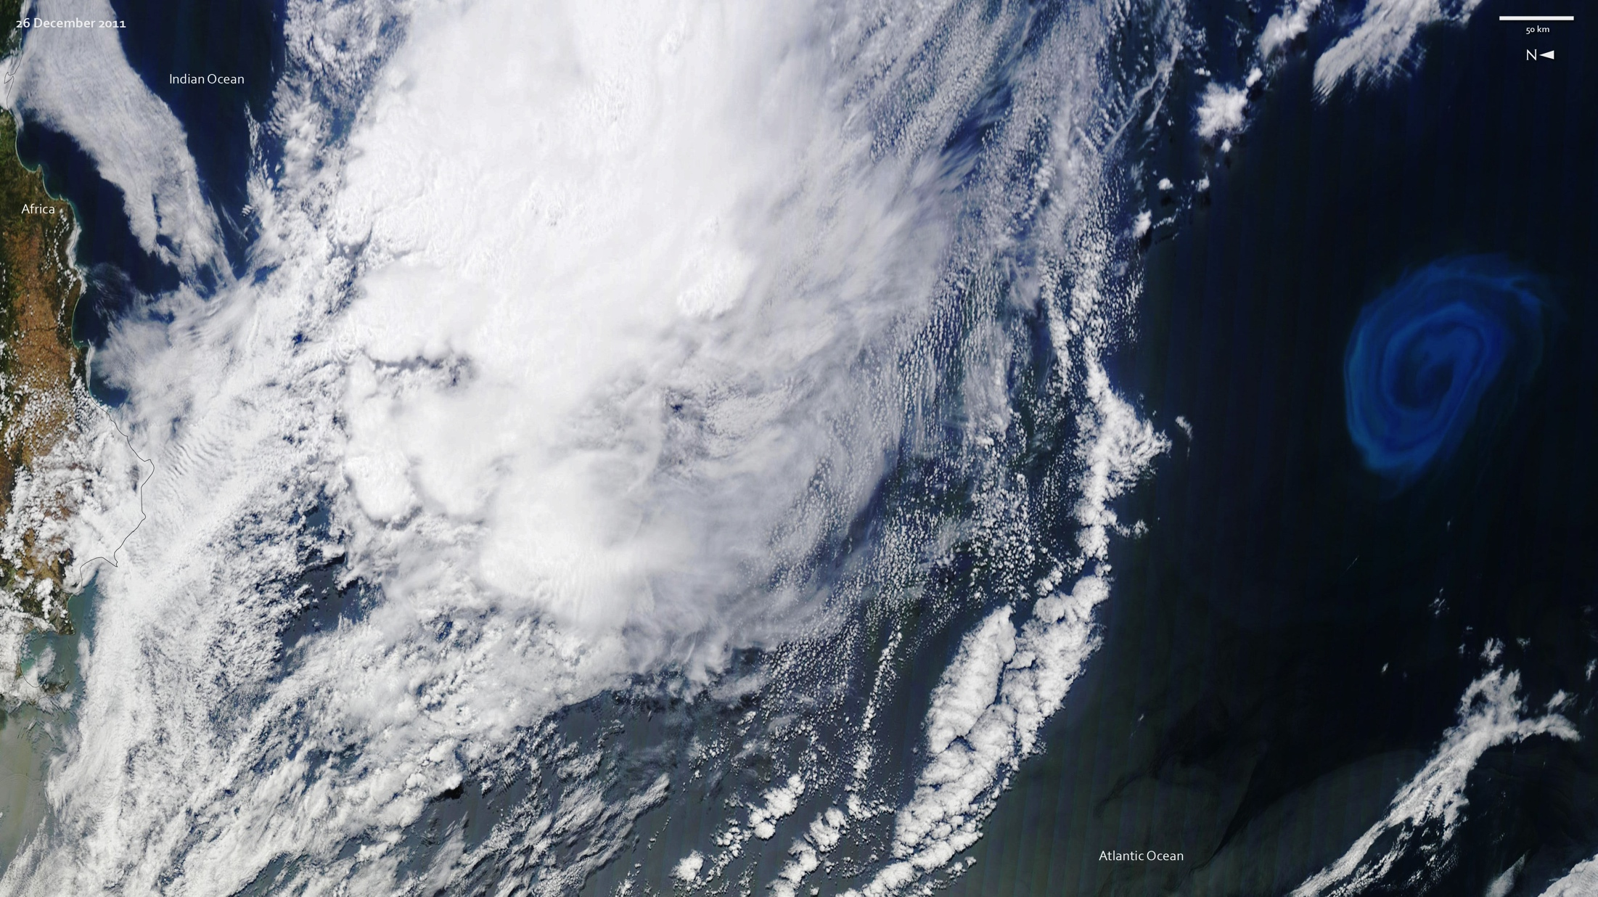
Notes:
This natural-color image of a deep-ocean eddy was acquired on December 26, 2011. The light blue swirls, caused by plankton, reveal the vortex structure of the eddy. The image is rotated 90 degrees (north is to the left) to show the 150-kilometer wide bloom and eddy in context, about 800 kilometers south of South Africa.
This anti-cyclonic (counter-clockwise) eddy likely peeled off from the Agulhas Current, which flows along the southeastern coast of Africa and around the tip of South Africa. Agulhas eddies, or “current rings,” tend to be among the largest in the world, transporting warm, salty water from the Indian Ocean to the South Atlantic. Certain types of eddies can promote blooms of phytoplankton. As these water masses stir the ocean, they draw nutrients up from the deep, fertilizing the surface waters to create blooms of microscopic, plant-like organisms in the open ocean, which is relatively barren compared to coastal waters.
Satellite: Terra
Instrument: MODIS

