Slide 1
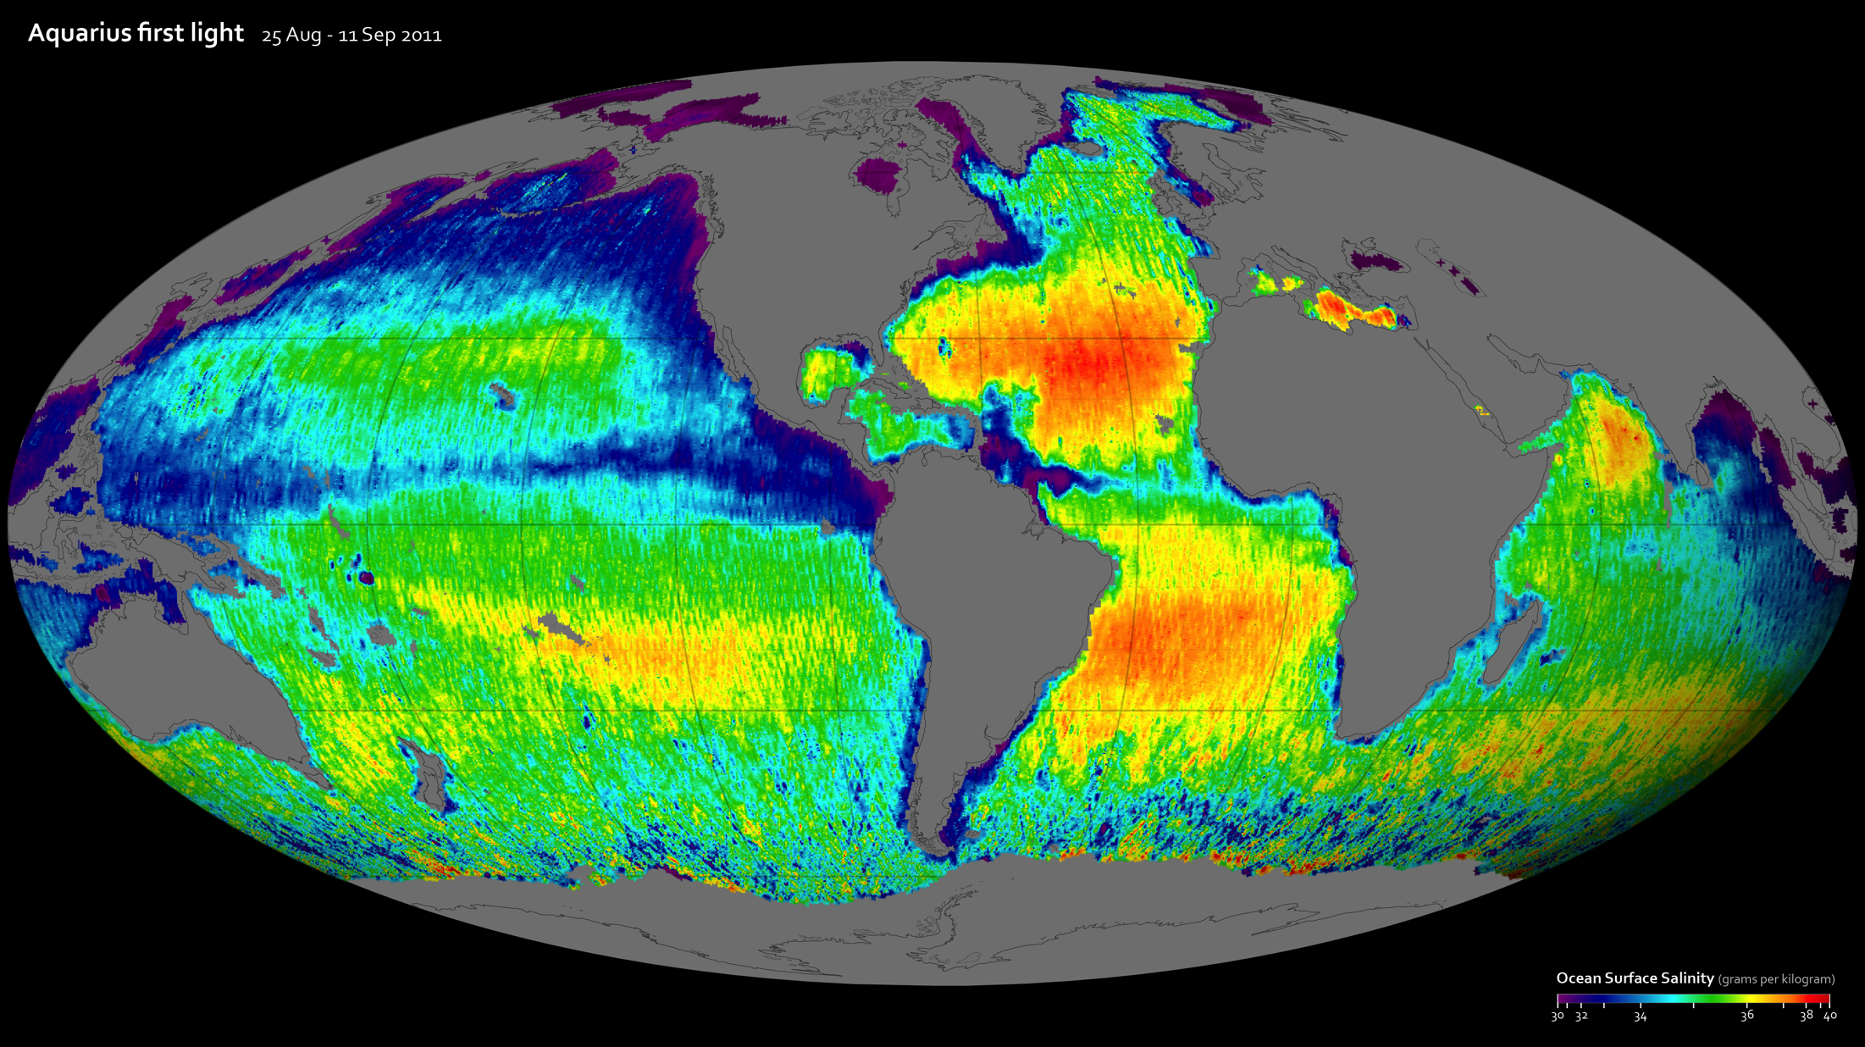
Notes:
NASA's Aquarius instrument produced its first global map of the salinity, or saltiness, of Earth's ocean surface using data from August 25 to September 11, 2013. The numerical values in the map represent salt concentration in parts per thousand (grams of salt per kilogram of sea water). Yellow and red colors represent areas of higher salinity, with blues and purples indicating areas of lower salinity. Areas colored gray and black indicate no data (for example over land or ice covered water). The average salinity on the map is about 35. The map reveals well-known ocean salinity features, such as higher salinity in the subtropics, higher average salinity in the Atlantic Ocean compared to the Pacific and Indian Oceans, and lower salinity in rainy belts near the equator, in the northernmost Pacific Ocean and elsewhere.
Satellite: SAC-D
Instrument: Aquarius

