Slide 1
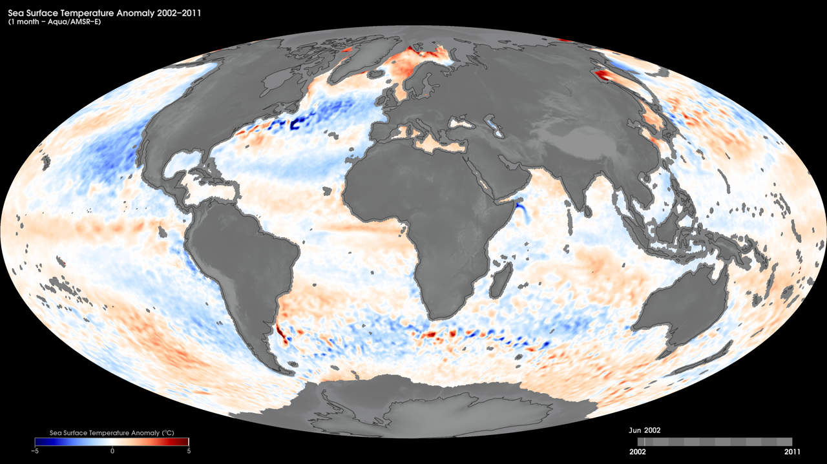
Notes:
Sea-surface temperature is the temperature of the top millimeter of the ocean's surface. An anomaly is when something is different from normal, or average. A sea-surface temperature anomaly is how different the ocean temperature at a particular location at a particular time is from the normal temperatures for that place. Sea surface temperature anomalies can happen as part of normal ocean cycles or they can be a sign of long-term climate change, such as global warming.
These maps show monthly sea-surface temperature anomalies from June 2002 to September 2011, as derived from Aqua’s Advanced Microwave Scanning Radiometer - Earth Observing System (AMSR-E) data. AMSR-E ended data collection in October 2011 due to problems with the rotation of its antenna.
Satillite: Aqua
Instrument: AMSR-E

