Slide 1
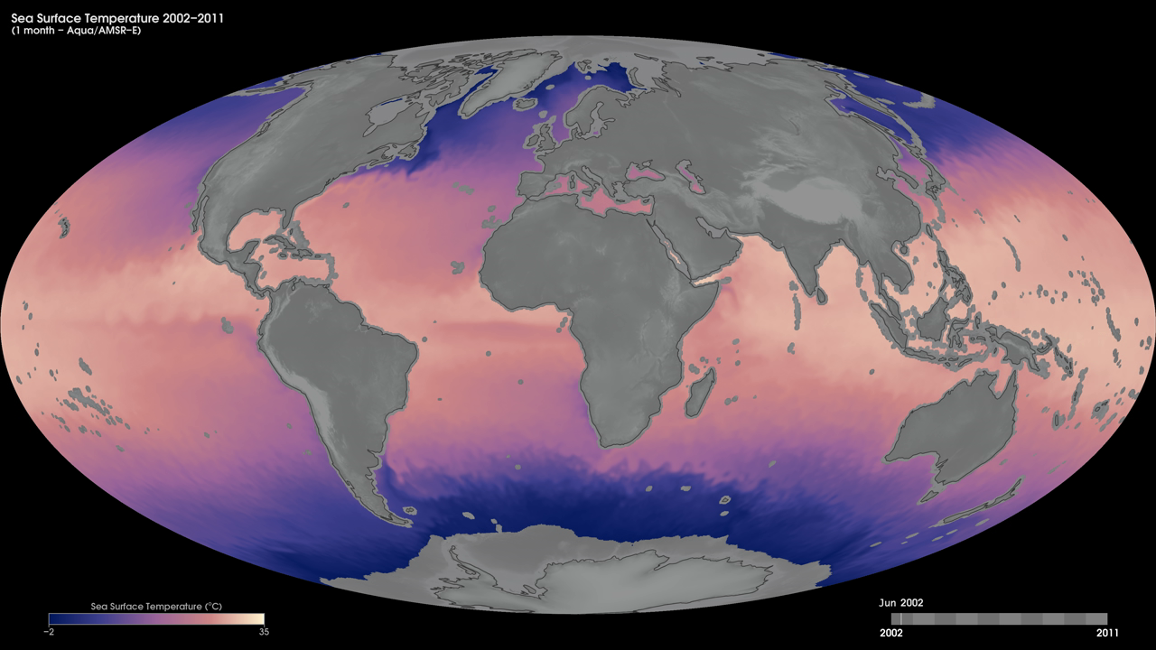
Notes:
Sea-surface temperature is the temperature of the top millimeter of the ocean's surface. Sea-surface temperatures influence weather, including hurricanes, as well as plant and animal life in the ocean. Like Earth's land surface, sea-surface temperatures are warmer near the equator and colder near the poles. Currents like giant rivers move warm and cold water around the world's oceans. Some of these currents flow on the surface, and they are obvious in sea surface temperature images. Special microwave technology allows the Advanced Microwave Scanning Radiometer - Earth Observing System (AMSR-E) sensor on NASA's Aqua satellite to measure sea-surface temperatures through clouds, something no satellite sensor before it was able to do across the whole globe.
These maps show monthly sea-surface temperatures from June 2002 to September 2011, as derived from AMSR-E data. AMSR-E ended data collection in October 2011 due to problems with the rotation of its antenna.
Satellite: Aqua
Instrument: AMSR-E

