Slide 1
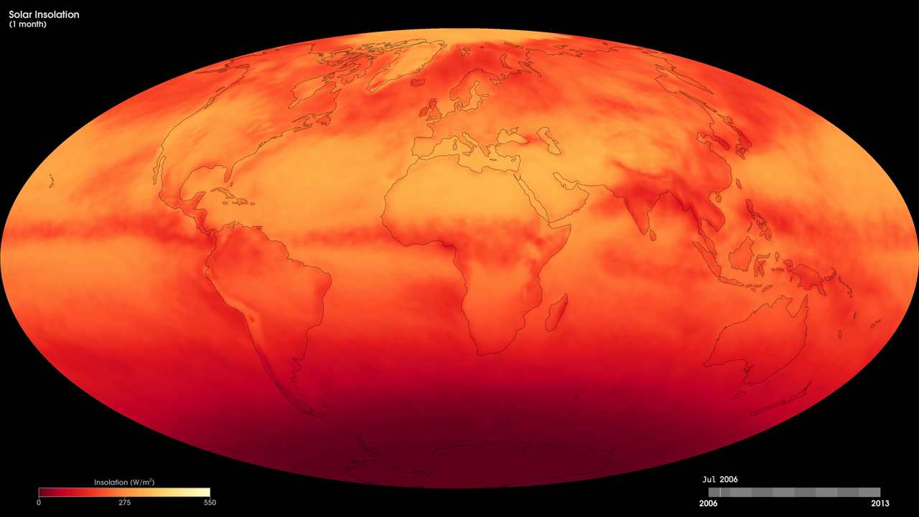
Notes:
These maps show Earth's average monthly solar insolation, or the rate of incoming sunlight reaching the surface, from July 2006 to the present as derived from Clouds and Earth’s Radiant Energy System (CERES) measurements of radiant energy escaping the top of Earth's atmosphere. The CERES instrument flies onboard NASA’s Terra and Aqua satellites and makes these measurements every day on a global scale. The colors represent the kilowatt-hours of sunlight falling on every square meter of the surface per day, averaged over one month.
Energy from the sun warms the surface, creating updrafts of air that carry warmth and moisture up into the atmosphere. Thus, knowing the rate of sunlight reaching the surface helps scientists understand weather and climate patterns. Exposure to sunlight is also a key limit to plant growth, particularly in tropical rainforests. Thus, insolation maps are also useful to scientists studying plant growth patterns in different parts of the world.
Satellite: Aqua, Terra
Instrument: CERES

