Slide 1
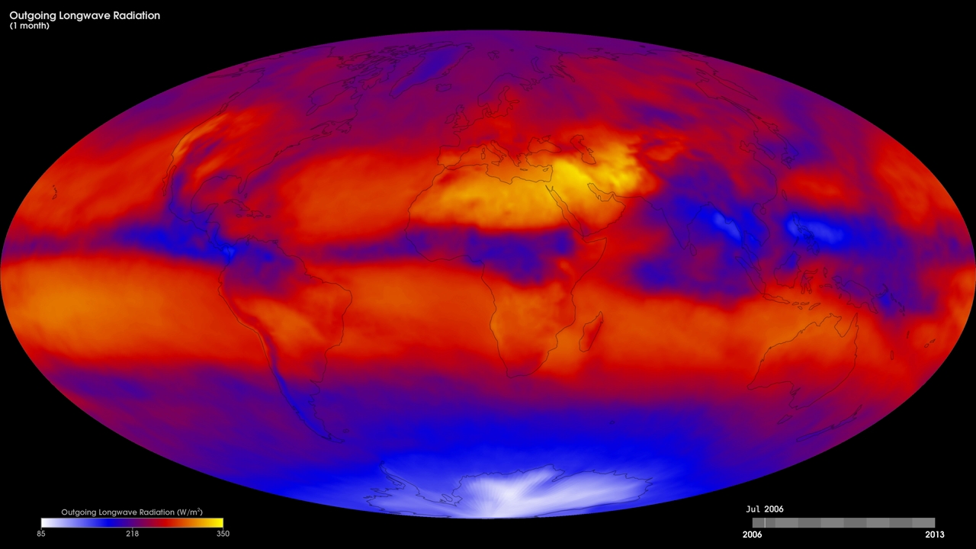
Notes:
Light energy travels in waves, but not all the waves are the same. The kind of light our eyes can see is only a tiny part of the energy that exists in the universe. Other kinds of energy are invisible, like the energy that makes our hands feel warm when we hold them over a fire, or the energy that cooks our food in the microwave. When Earth absorbs sunlight, it heats up. The heat, or "outgoing longwave radiation," radiates back into space. Satellites measure this radiation as it leaves the top of Earth's atmosphere. The hotter a place is, the more energy it radiates. These maps show monthly outgoing longwave radiation from July 2006 to the present, from the Fast Longwave And Shortwave Radiative Fluxes, or FLASHFlux, Time Interpolation and Spatial Averaging (TISA) data product. The product contains daily observations collected by the Clouds and the Earth's Radiant Energy System (CERES) sensors on NASA's Aqua and Terra satellites. The colors show the amount of outgoing longwave radiation leaving Earth's atmosphere (in Watts per square meter). Bright yellow and orange indicate greater heat emission, purple and blue indicate intermediate emissions, and white shows little or no heat emission.
Satellite: Aqua, Terra
Instrument: CERES

