Slide 1
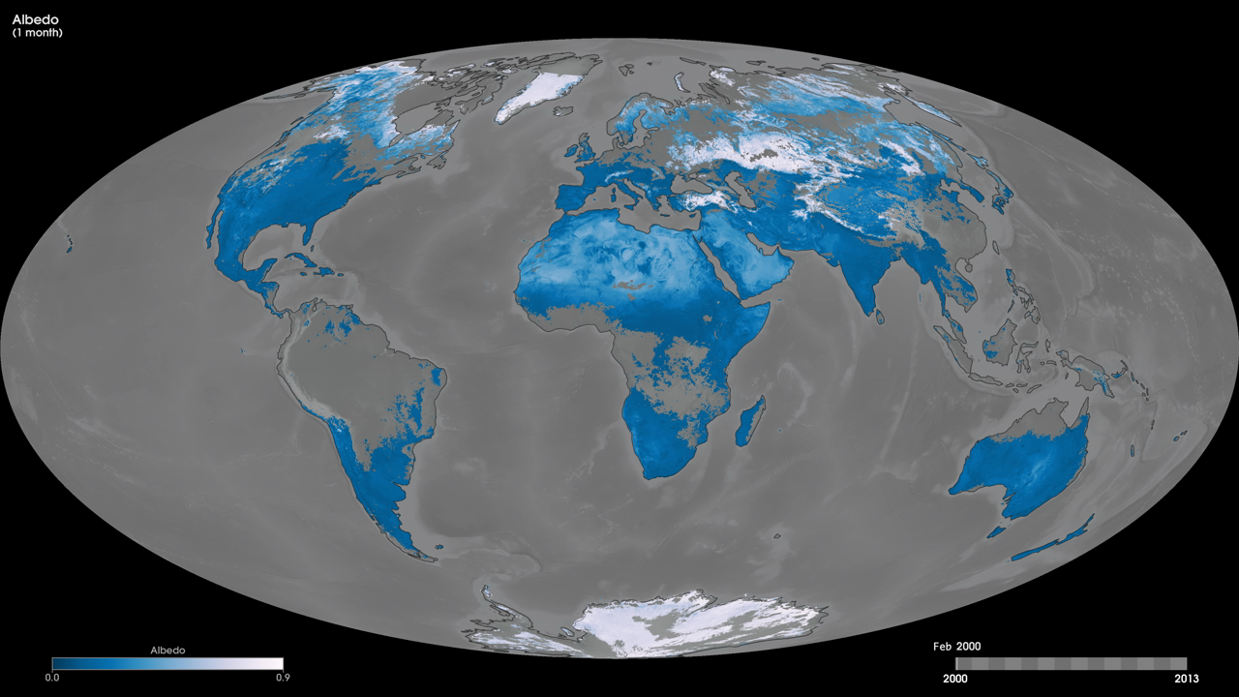
Notes:
When sunlight reaches the Earth’s surface, some of it is absorbed and some is reflected. The relative amount, or ratio, of light that a surface reflects compared to the total incoming sunlight is called albedo. Surfaces with high albedos include sand, snow and ice, and some urban surfaces, such as concrete. Surfaces with low albedos include forests, the ocean, and some urban surfaces, such as asphalt. These maps show monthly albedo from February 2000 to the present, on a scale from 0 (no incoming sunlight being reflected) to 0.9 (nearly all incoming light being reflected). Darker blue colors indicate that the surface is not reflecting much light, while paler blues indicate higher proportions of incoming light are being reflected. Black areas indicate “no data,” either over ocean or because persistent cloudiness prevented enough views of the surface. The observations are based on atmospherically corrected, cloud-cleared reflectance observations from the MODIS sensors on NASA’s Aqua and Terra satellites.
Satellite: Aqua, Terra
Instrument: MODIS

