Slide 1
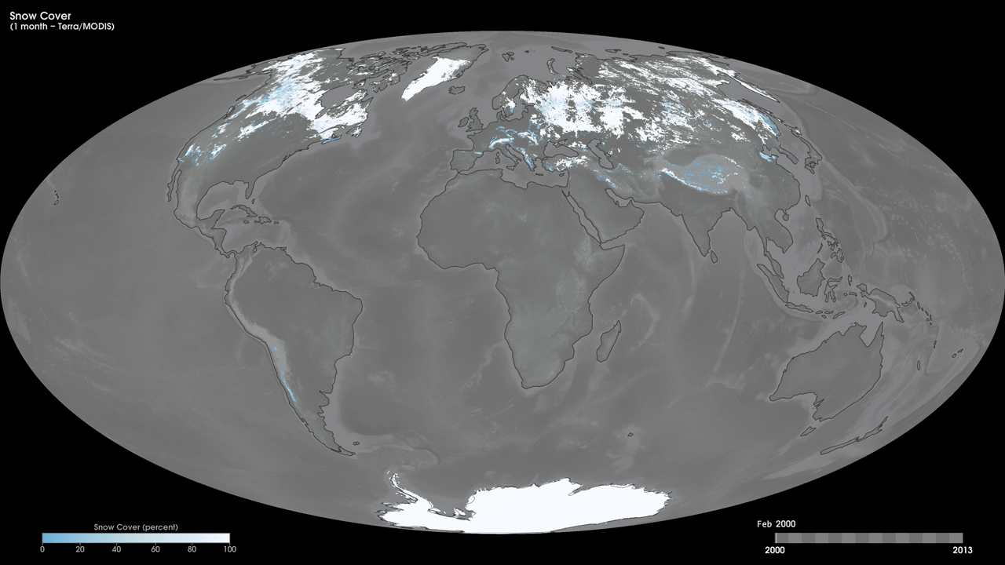
Notes:
Snow and ice cover most of the Earth's polar regions throughout the year, but the coverage at lower latitudes changes with the seasons. Northern Hemisphere snow cover changes dramatically throughout the year, but the only significant snow cover in the Southern Hemisphere is in Antarctica, which has very few snow-free areas at any time of the year. These maps show monthly snow cover data from February 2000 to the present, derived using observations from the Moderate Resolution Imaging Spectroradiometer (MODIS) onboard NASA's Terra satellite. The colors show the percent of land area that is covered with snow. The white areas show lands that were completely snow-covered, while the light blue shades show regions in which there was only partial snow cover.
Satellite: Terra
Instrument: MODIS

