Slide 1
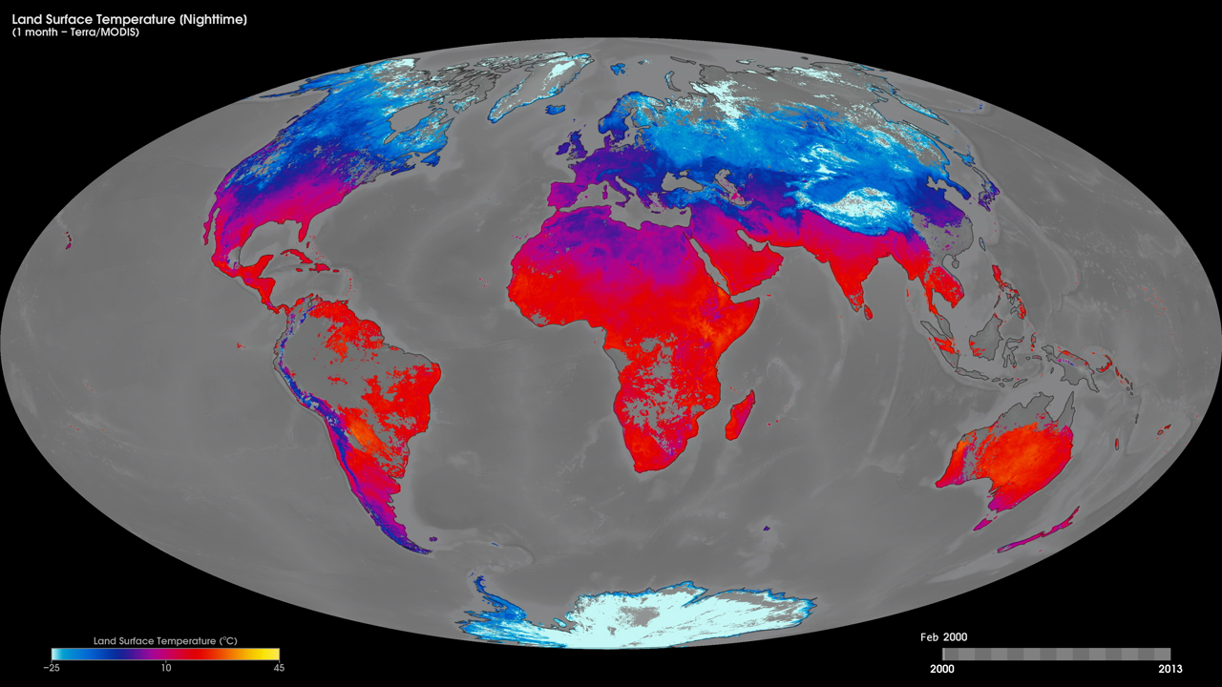
Notes:
Scientists monitor land-surface temperature because the warmth rising off Earth's landscapes influences our world's weather and climate patterns. Likewise, land surface temperature is also influenced by changes in weather and climate patterns.
These maps show monthly nighttime land-surface temperatures from February 2000 to the present using thermal infrared measurements made by the Moderate Resolution Imaging Spectroradiometer (MODIS) instrument onboard NASA's Terra satellite. The measurements shown here represent the temperature of the "skin" (or top 1 millimeter) of the land surface during the nighttime—including bare land, snow or ice cover, and cropland or forest canopy—and should not be confused with surface air temperature measurements that are given in a typical weather reports. Yellow shows the warmest temperatures (up to 45 degrees Celsius) and light blue shows the coldest temperatures (down to -25 degrees Celsius). Black means no data.
Satellite: Terra
Instrument: MODIS

