Slide 1
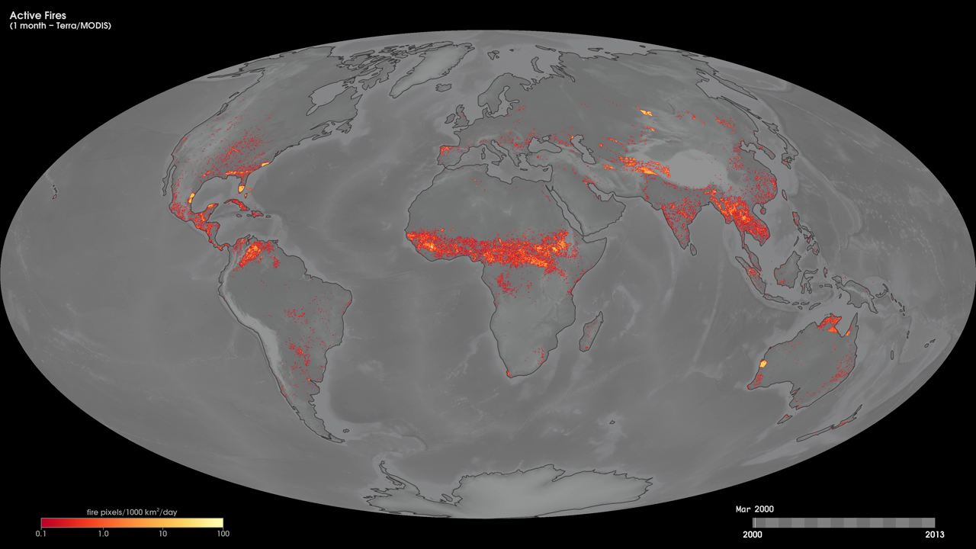
Notes:
Using fire data collected globally every day by the Moderate Resolution Imaging Spectroradiometer (MODIS) instrument onboard NASA's Terra satellite, scientists produce maps like these to show the number and extent of fire around the world each month.
The red, orange, and yellow pixels on these monthly maps from March 2000 to the present show the locations where the MODIS instrument detected actively burning fires. The colors represent a count of the number of fires each month observed within a 1000-square-kilometer (~385-square-mile) area. White pixels show the high end of the count—as many as 100 fires in a 1000-square-kilometer area per day. Yellow pixels show as many as 10 fires, orange shows as many as 5 fires, and red areas as few as 1 fire in a 1000-square-kilometer area per day. Active fire maps such as these are helping scientists to better understand Earth's environment and climate system.
Satellite: Terra
Instrument: MODIS

