Slide 1
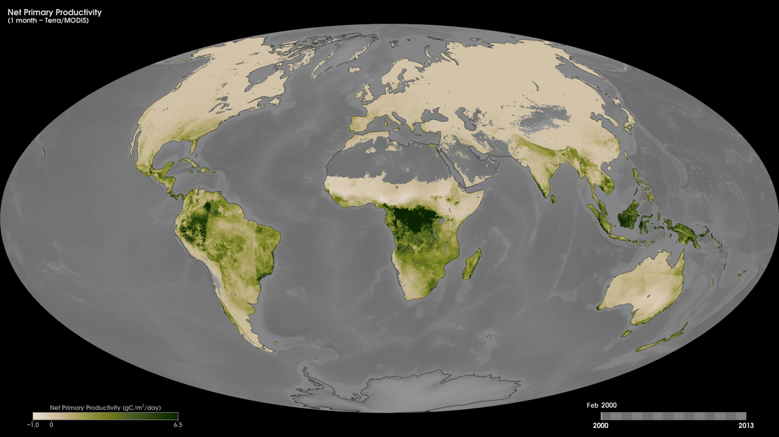
Notes:
Plants play an important role in the movements of carbon dioxide throughout Earth's environment. Living plants both take in carbon dioxide from the air and put out carbon dioxide to the air.
Called net primary productivity, these maps show where and how much carbon dioxide is taken in by vegetation during photosynthesis minus how much carbon dioxide is released when plants respire on a monthly basis, from February 2000 to the present. Created using data from the Moderate Resolutions Imaging Spectroradiometer (MODIS) instrument onboard NASA’s Terra satellite, the colors on these maps indicate how fast carbon was taken in for every square meter of land. Values range from -1.0 grams of carbon per square meter per day (tan) to 6.5 grams per square meter per day (dark green). A negative value means decomposition or respiration overpowered carbon absorption; more carbon was released to the atmosphere than the plants took in. Maps such as these allow scientists to routinely monitor plants' role in the global carbon cycle.
Satellite: Terra
Instrument: MODIS

