Slide 1
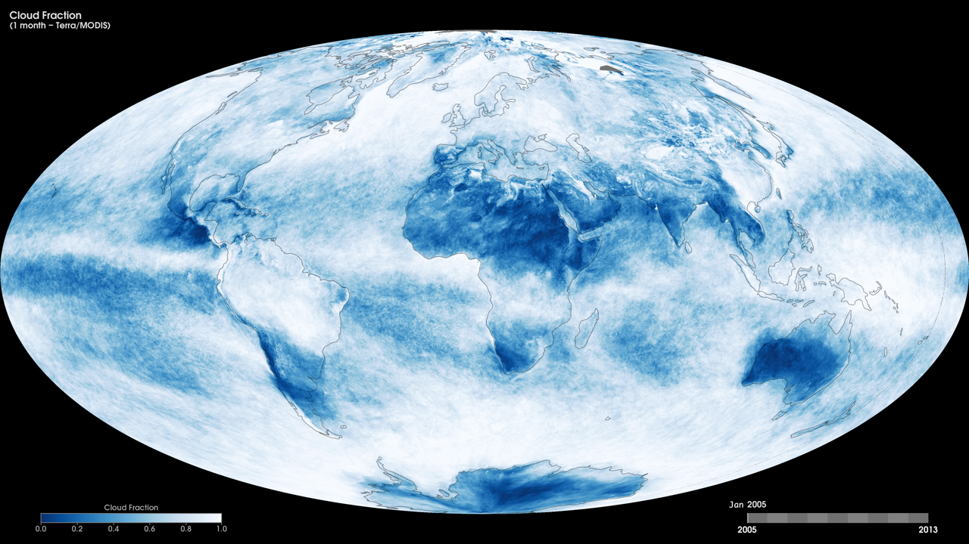
Notes:
Cloud fraction is the measurement scientists use to determine how much of the Earth is covered by clouds. The measurement is important because clouds play a large role in regulating the amount of energy that reaches the Earth from the sun as well as the amount of energy that the Earth reflects and emits back into space.
These maps show monthly cloud fraction from January 2005 to the present, produced using data from the Moderate Resolution Imaging Spectroradiometer (MODIS) instrument onboard NASA’s Terra satellite. Like a digital camera, MODIS collects information in gridded boxes or pixels. Each box covers one square kilometer. Cloud fraction is the portion of each pixel that is covered by clouds. Scientists make this measurement by counting the number of pixels in a 25-square-kilometer box (5 pixels tall by 5 pixels wide) that are cloudy and dividing that number by 25. Scientists use these measurements to better understand how much of the Earth is covered by clouds and how changes in Earth’s climate may alter the amount and types of clouds that form.
Satellite: Terra
Instrument: MODIS

