Slide 1
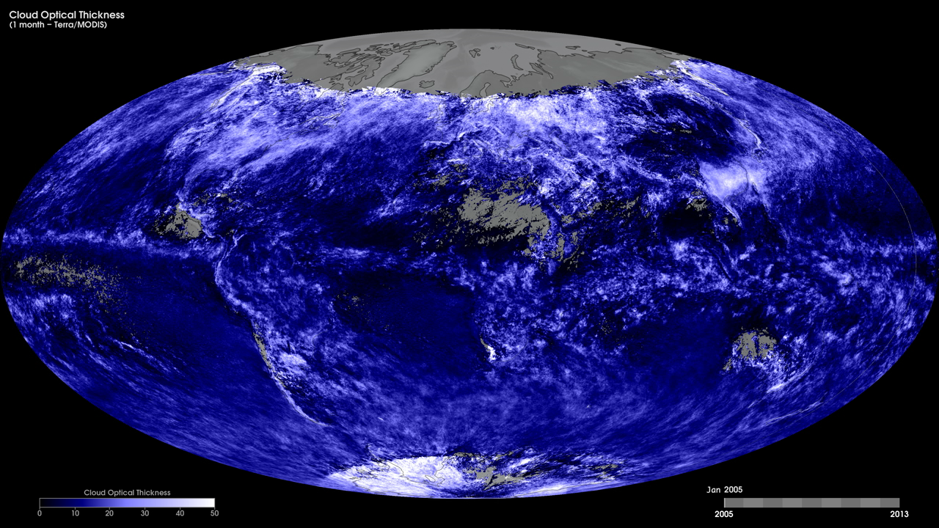
Notes:
To better understand the role of clouds in the Earth's climate system, scientists need two important measurements: cloud optical thickness and cloud particle size. A cloud's optical thickness is a measure of attenuation of the light passing through the atmosphere due to the scattering and absorption by cloud droplets. Clouds do not absorb visible wavelengths of sunlight; rather, clouds scatter and reflect most visible light. The higher a cloud's optical thickness, the more sunlight the cloud is scattering and reflecting.
These maps show monthly cloud optical thickness from January 2005 to the present, produced using data from the Moderate Resolution Imaging Spectroradiometer (MODIS) instrument onboard NASA’s Terra satellite. Dark blue shades indicate areas where there are low cloud-optical-thickness values, while white shades indicate high values (i.e., greater attenuation caused by the scattering and absorption from cloud droplets).
Satellite: Terra
Instrument: MODIS

