Slide 1
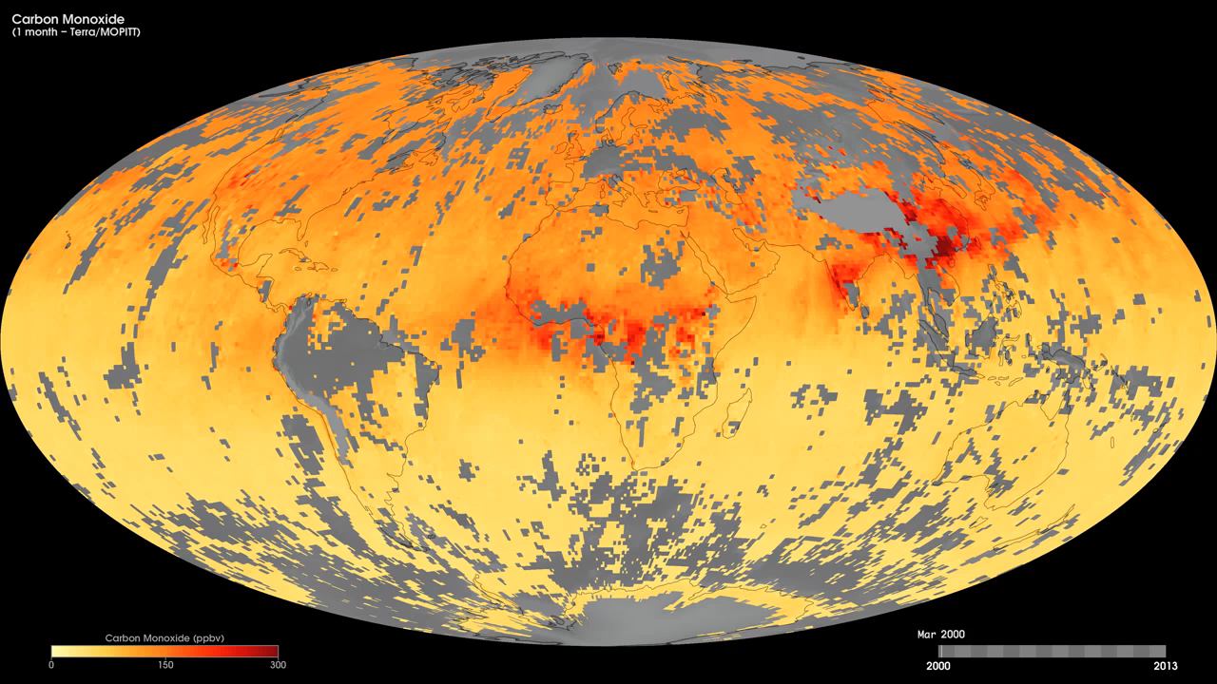
Notes:
Colorless, odorless, and poisonous, carbon monoxide is a major air pollutant regulated in the United States and in many other nations around the world. When carbon-based fuels, such as coal, wood, and oil burn, they produce carbon monoxide.
These maps show monthly averages of carbon monoxide at an altitude of about 12,000 feet from March 2000 to the present, as derived using data from the Measurements Of Pollution In The Troposphere (MOPITT) sensor on NASA's Terra satellite. Concentrations of carbon monoxide are expressed in parts per billion by volume (ppbv). A concentration of 1 ppbv means that for every billion molecules of gas in the measured volume, one of them is a carbon monoxide molecule. In these maps, yellow areas have little or no carbon monoxide, while progressively higher concentrations are shown in orange, red, and dark red. In different parts of the world and in different seasons, the amounts and sources of atmospheric carbon monoxide change. In Africa, for example, the seasonal shifts in carbon monoxide are tied to the widespread agricultural burning that shifts north and south of the equator with the seasons. In the United States, Europe, and eastern Asia, on the other hand, the highest carbon monoxide concentrations occur around urban areas as a result of vehicle and industrial emissions.
Satellite: Terra
Instrument: MOPITT

