Slide 1
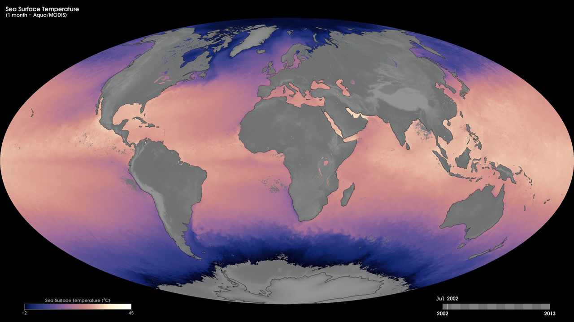
Notes:
Sea-surface temperatures have a large influence on climate and weather. For example, ocean temperatures influence the development of tropical cyclones (hurricanes and typhoons), which draw energy from warm ocean waters to form and intensify.
These maps show monthly sea-surface temperatures from July 2002 to the present, based on observations from the Moderate Resolution Imaging Spectroradiometer (MODIS) onboard NASA’s Aqua satellite. The satellite measures the temperature of the top millimeter of the ocean surface. The coolest waters appear as purple shades (approximately -2 degrees Celsius), while the warmest temperatures appear as yellow shades (45 degrees Celsius). Landmasses and the large area of sea ice around Antarctica appear in shades of gray, indicating no data were collected. The most obvious pattern shown in the time series is the year-round difference in sea surface temperatures between equatorial regions and the poles. Various warm and cool currents stand out even in monthly averages of sea surface temperature. A band of warm waters snakes up the East Coast of the United States and veers across the North Atlantic—known as the Gulf Stream.
Satellite: Aqua
Instrument: MODIS

