Slide 1
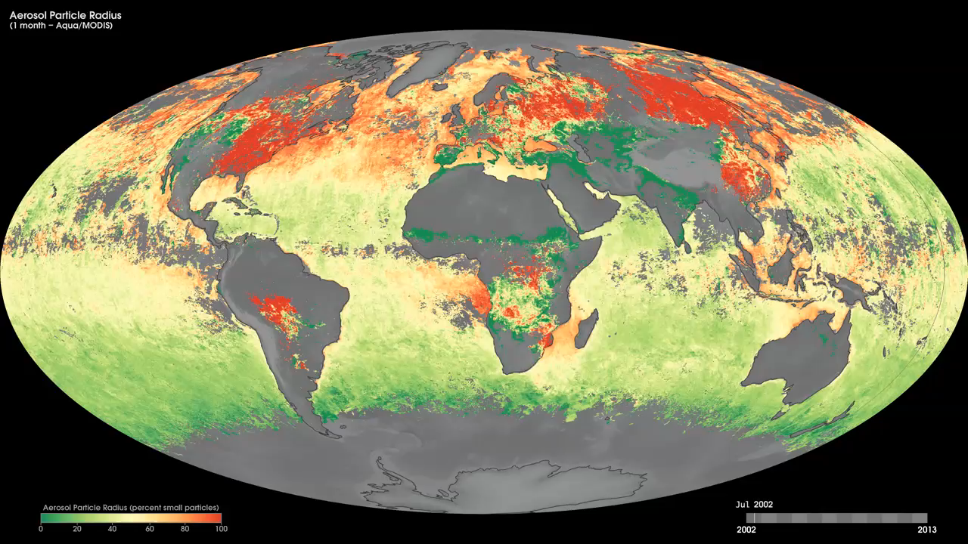
Notes:
Tiny solid and liquid particles suspended in the atmosphere are called aerosols. These particles are important to scientists because they can affect climate, weather, and people's health. Using satellites scientists can tell whether a given plume of aerosols came from a natural source or were produced by human activities. Two important clues about aerosols' sources are particle size and location of the plume. Natural aerosols (such as dust and sea salts) tend to be larger than man-made aerosols (such as smoke and industrial pollution).
These maps show monthly aerosol particle radius from July 2002 to the present, derived using data from the Moderate Resolution Imaging Spectroradiometer (MODIS) sensor onboard NASA’s Aqua satellite. Red areas show aerosol plumes made up of smaller particles. These red-colored plumes are over regions where we know humans produce pollution. Green areas show aerosol plumes made up of larger particles. These green-colored plumes are over regions where we know aerosols occur naturally. Yellow areas show plumes in which large and small aerosol particles are intermingling. Black shows where the satellite could not measure aerosols. Maps such as these allow scientists to estimate the location and size of aerosol particles present in the atmosphere.
Satellite: Aqua
Instrument: MODIS

