Slide 1
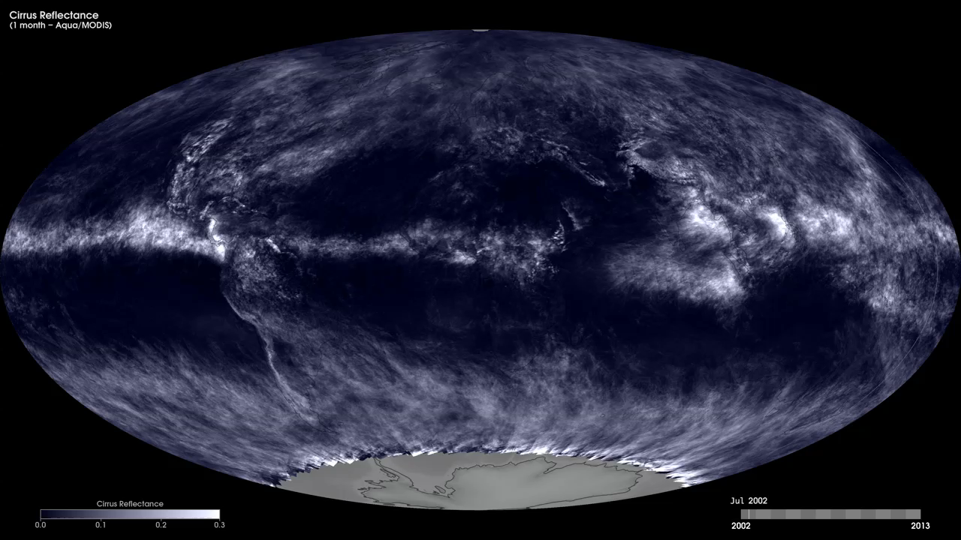
Notes:
Cirrus clouds are thin, wispy clouds high in the sky that can be hard to see with the unaided eye. They typically form at an altitude of 6000 meters (20,000 feet) or higher, where the air temperature is below freezing. Cirrus clouds are composed mostly of tiny ice crystals. They are scientifically interesting because they allow most incoming sunlight to pass through them, but they help to contain heat emitted from the surface. Thus, cirrus clouds exert a warming influence on Earth's surface.
These maps show monthly average cirrus cloud fraction over the Earth from July 2002 to the present, produced using data collected by the Moderate Resolution Imaging Spectroradiometer (MODIS) instrument onboard NASA's Aqua satellite. The MODIS sensor has a unique band for measuring infrared light at a wavelength of 1.38 micrometers—a wavelength that NASA scientists recently found is highly sensitive to cirrus. Bright white pixels indicate regions completely covered by cirrus clouds. Greyish-white pixels show partial cirrus cover and dark pixels indicate little or no cirrus.
Satellite: Aqua
Instrument: MODIS

