Slide 1
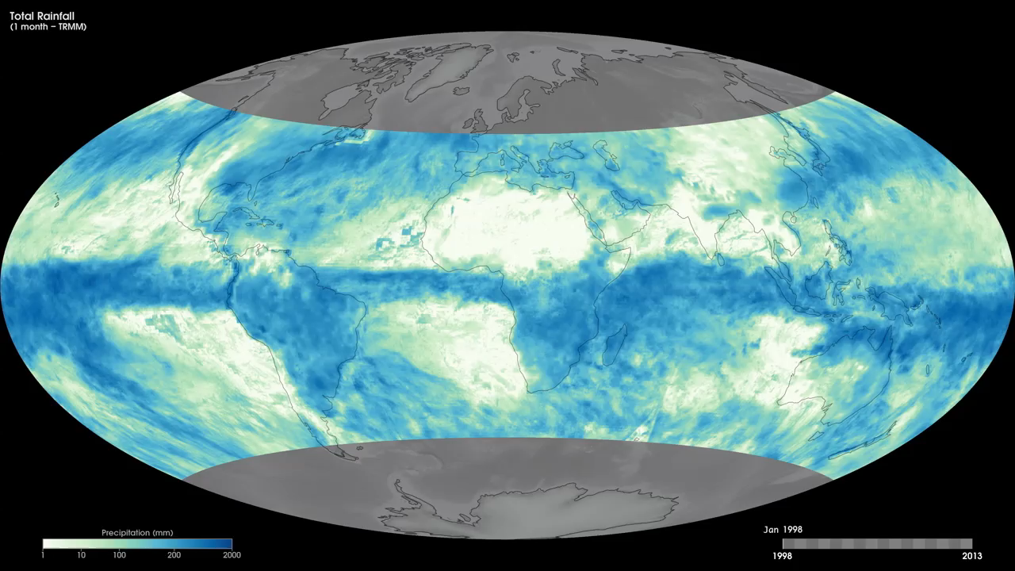
Notes:
Globally, rain is the main source of fresh water for plants and animals. Rainfall is essential for life across Earth's landscapes. In addition to moving tremendous amounts of water through Earth's atmosphere, rain clouds also move tremendous amounts of energy. When water evaporates from the surface and rises as vapor into the atmosphere, it carries heat from the sun-warmed surface with it. Later, when the water vapor condenses to form cloud droplets and rain, the heat is released into the atmosphere. This heating is a major part of Earth's energy budget and climate. These maps show monthly total rainfall amounts in millimeters from January 1998 to the present, derived using data from the Tropical Rainfall Measuring Mission (TRMM) satellite, which is a joint mission between NASA and the Japan Aerospace Exploration Agency. High rain totals are represented as blue shades, while little to no rainfall totals are shown in white. TRMM measures rainfall in the tropics. High-latitude regions, where TRMM does not record rainfall, are gray. The most obvious pattern in these total rainfall maps is seasonal change. A band of heavy rain moves north and south of the Equator seasonally.
Satellite: Aqua
Instrument: MODIS

