Slide 1
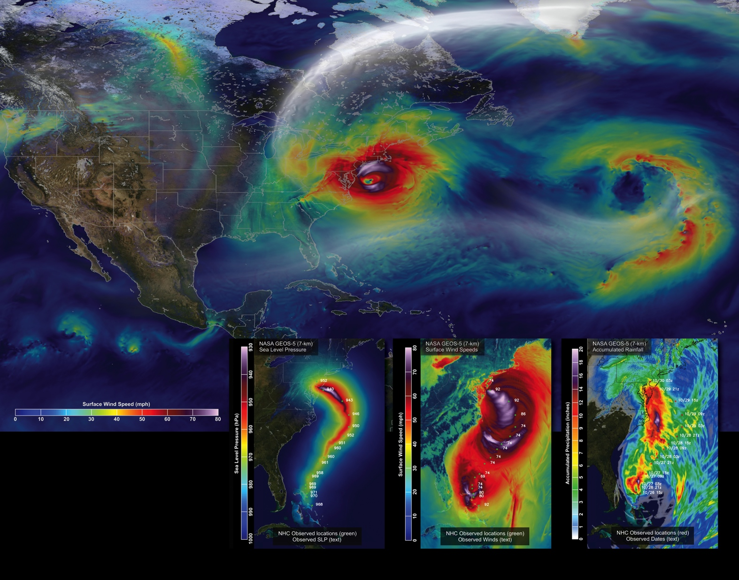
Notes:
A rare convergence of environmental conditions during Hurricane Sandy’s lifecycle led to a storm of unforgettable destruction—hence its nickname, Superstorm Sandy. Scientists can analyze the structure and lifecycle of severe storms like Sandy using weather prediction models and incorporate what they learn into newer models, which hopefully result in even more accurate hurricane forecasts in the future.
Scientists at NASA used the Goddard Earth Observing System Model, Version 5 (GEOS-5) to simulate surface wind speeds across the Atlantic during Sandy’s lifecycle. The large image above shows surface wind speeds on October 29, 2012, as simulated by the GEOS-5 at 7-kilometer (~4.3-mile) resolution just before the storm made landfall near Atlantic City, New Jersey. Wind speeds range from approximately 10 miles per hour (15 kilometers per hour), shown as dark blue, to 80 miles per hour (130 kilometers per hour), shown as very light purple. In the days following landfall, the remnants of Sandy moved inland over Northern New England and Canada before finally dissipating.
The three smaller images show how GEOS-5 simulations of sea level pressure [left], surface wind speeds [center], and accumulated rainfall amounts [right] from October 26, 2012 to October 31, 2012, compare to observations from the National Oceanic and Atmospheric Administration’s National Hurricane Center.

