Slide 1
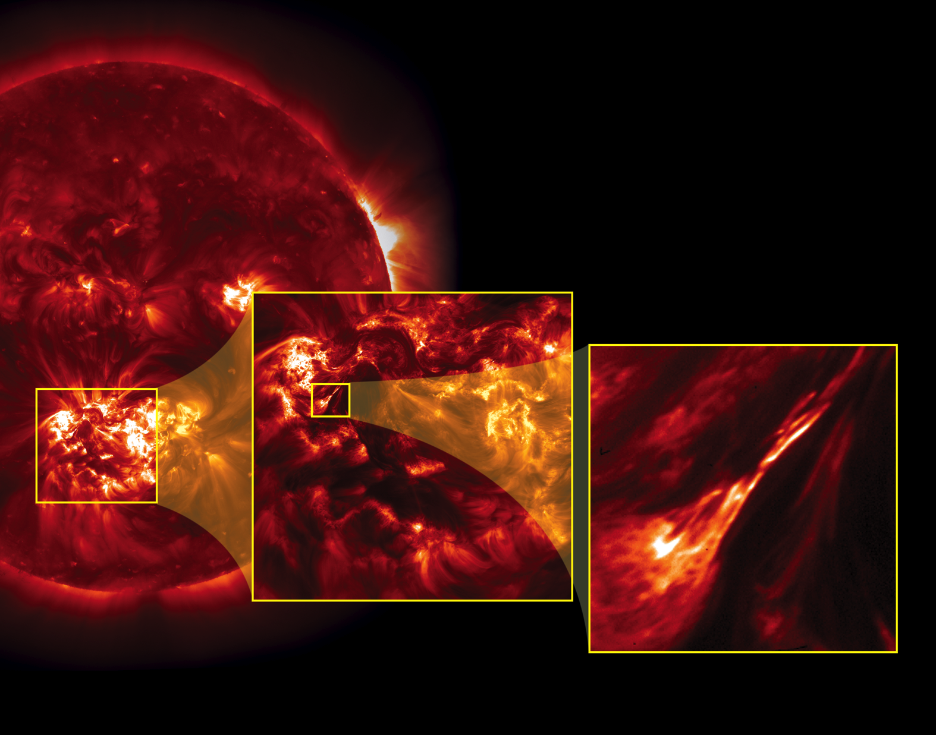
Notes:
In July 2012 NASA's High Resolution Coronal Imager, or Hi-C, telescope launched on a sounding rocket and captured the highest-resolution images ever taken of the sun's million-degree atmosphere, or corona. The square area outlined in yellow in the full disk image of the sun [left], taken by the Atmospheric Imaging Array (AIA) on NASA's Solar Dynamics Observatory (SDO), represents the Hi-C field-of-view.
The Hi-C telescope captured five minutes of data of the solar corona at about five times finer resolution than SDO's AIA. Within the Hi-C field-of-view [center], scientists identified several examples of coronal braiding—structures that appear to be wrapped and woven together. Zoomed in [right], these braided structures appear to be several strands, or magnetic field lines, tangled together, illuminated by hot plasma. This particular braided structure released energy in a small solar flare, shortly after the Hi-C flight.
For decades scientists have sought to understand why the corona is 50 to 100 times hotter than the surface of the sun. Images like these, taken by Hi-C, hint that these braided structures release magnetic energy that likely contributes to the intense heating of the solar corona.

