Slide 1
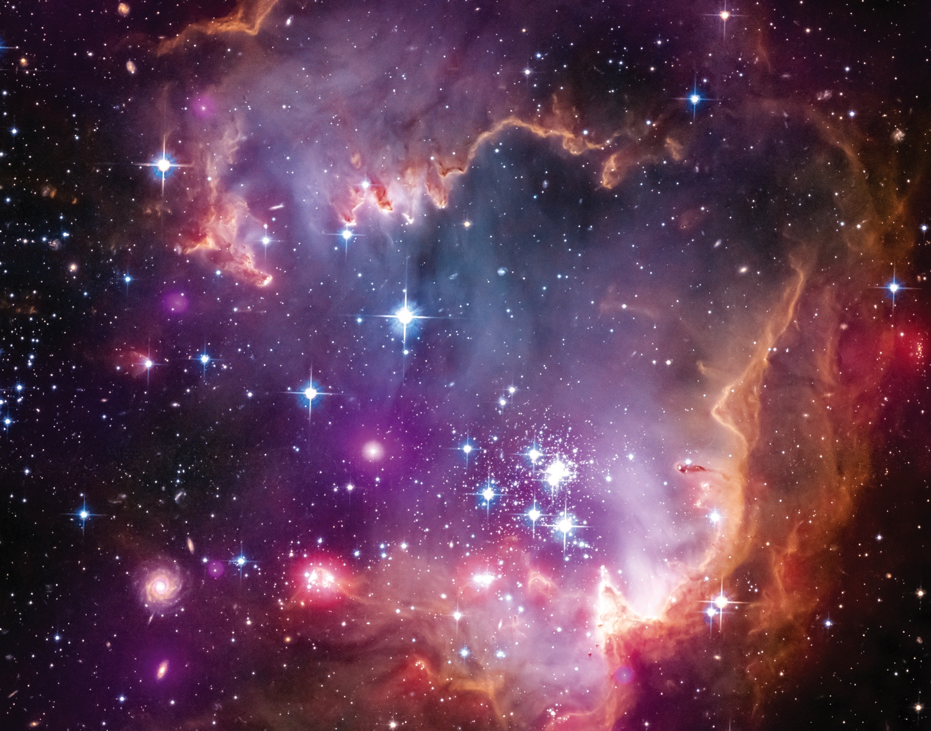
Notes:
The Small Magellanic Cloud (SMC) is one of the Milky Way's closest galactic neighbors. Even though it is a small, or so-called dwarf galaxy, the SMC is so bright that it is visible to the unaided eye from the Southern Hemisphere and near the equator. Many navigators, including Ferdinand Magellan who lends his name to the SMC, used it to help find their way across the oceans.
NASA's Chandra X-ray telescope has made the first detection of X-ray emission from young solar-type stars—stars with characteristics broadly similar to those of our sun—that lie outside our Milky Way galaxy. These stars live in a region known as the "Wing" of the SMC. This image of the Wing is a composite that combines data from three sources into one. X-ray data from Chandra are shown in purple; optical (i.e., visible) light seen by the Hubble Space Telescope is in red, green, and blue; and infrared data from the Spitzer Space Telescope are colored red. X-rays from young stars trace the activity and strength of stellar magnetic fields. Magnetic activity provides clues to a star's convection (the rising and falling of hot gas in the star's interior) and rotation rates. The combined X-ray, optical, and infrared data also reveal, for the first time outside our galaxy, objects that resemble very young, lowmass stars, which scientists call "young stellar objects." These objects have ages of a few thousand years and are still embedded in the pillar of dust and gas from which stars form.

