Slide 1
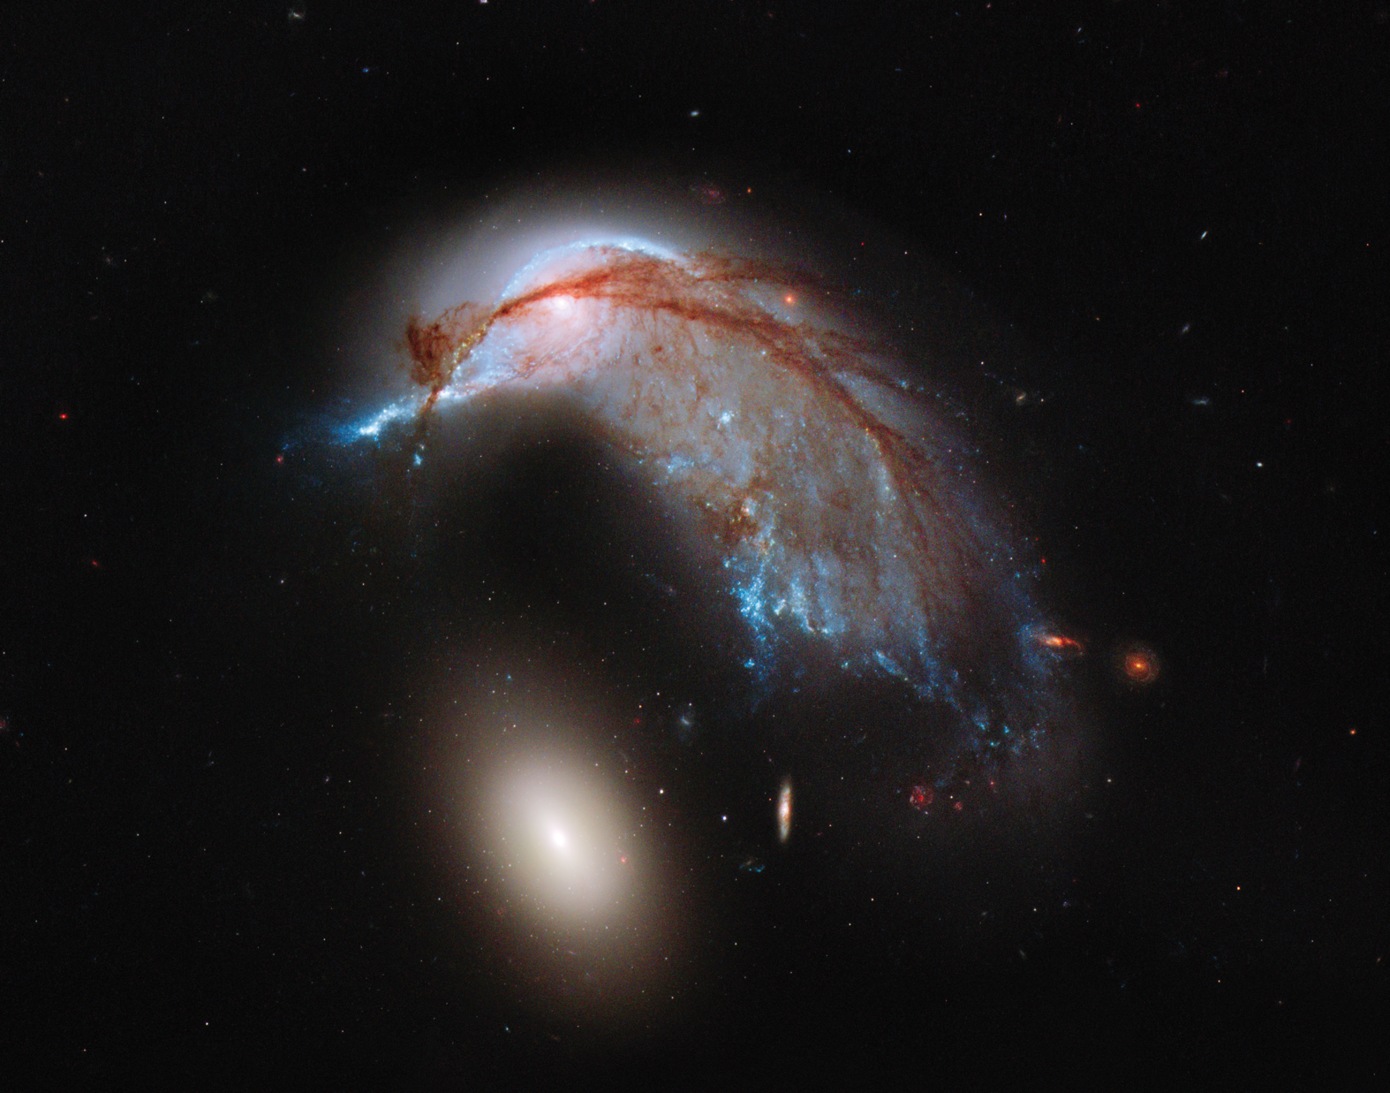
Notes:
This NASA Hubble Space Telescope image illustrates that close encounters between galaxies are messy business. This interacting galaxy duo contains the disturbed, star-forming spiral galaxy NGC 2936—which looks like the profile of a celestial bird—along with its elliptical companion, NGC 2937 at lower left. Once a normal, flat, spiral-disk galaxy, NGC 2936’s appearance and the orbits of its stars have become scrambled due to gravitational tidal interactions with NGC 2937. The interactions have warped and distorted NGC 2936’s spiral shape and interstellar gas has been strewn out into giant tails that look like stretched taffy.
Collectively, these two galaxies are called Arp 142—so named because astronomer Halton C. Arp was the first to observe them in the 1960s. Arp 142 lies 326 million light-years away in the southern constellation Hydra and is a member of the Arp catalog of peculiar galaxies. The image is a composite of photos from the Wide Field Camera 3 taken in blue-green, yellow-red, and near-infrared light.

