Slide 1
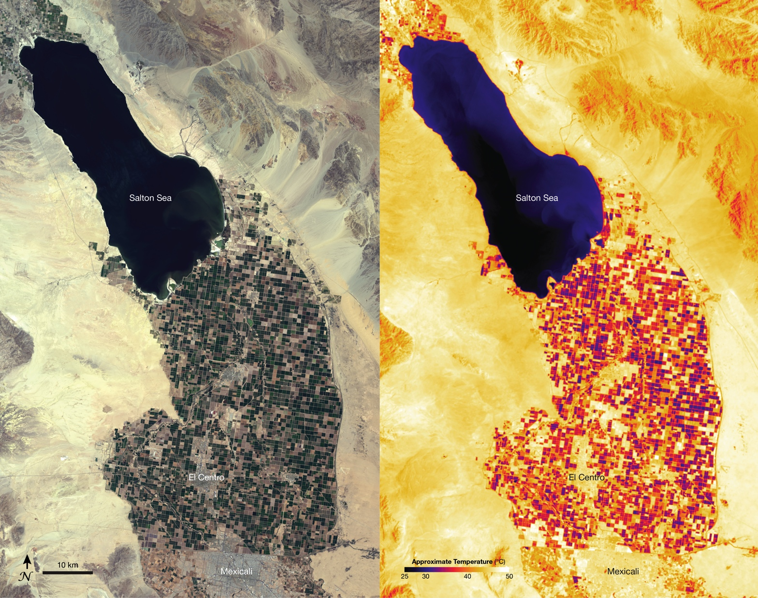
Notes:
In the Western United States between 80 and 90% of freshwater is used for agriculture. In Southern California irrigated farmland stretches southward across the desert from the Salton Sea—an artificial inland sea—to the Mexico border. In the natural-color image [left] acquired on May 15, 2013, by Landsat 8’s Operational Land Imager, blocks of square farmland appear in shades of green and tan, while urban areas such as El Centro, California and Mexicali, Mexico appear in shades of gray. Accurate estimates of total crop area provided by Landsat satellites can be used to help forecast commodities in the United States and the world food market.
On that same day, thermal measurements from Landsat 8’s Thermal Infrared Sensor [right] show different temperatures between crop fields as well as urban and desert areas. Cooler areas (e.g., irrigated crops) appear as dark purple and red shades, while warmer areas (e.g., urban and desert areas) appear as shades of bright yellow and white. Plants cool down when they transpire, so the combination of water evaporating from the plants and the ground (i.e., evapotranspiration) lowers the temperature of the irrigated land. Pixels representing cooler areas in thermal images from TIRS help water-resource managers determine where water is being used for irrigation, allowing them to make management decisions on water distribution to preserve this scarce resource. When an earlier design of Landsat 8 did not include a thermal infrared band, the Western States Water Council advocated for its inclusion.

