Slide 1
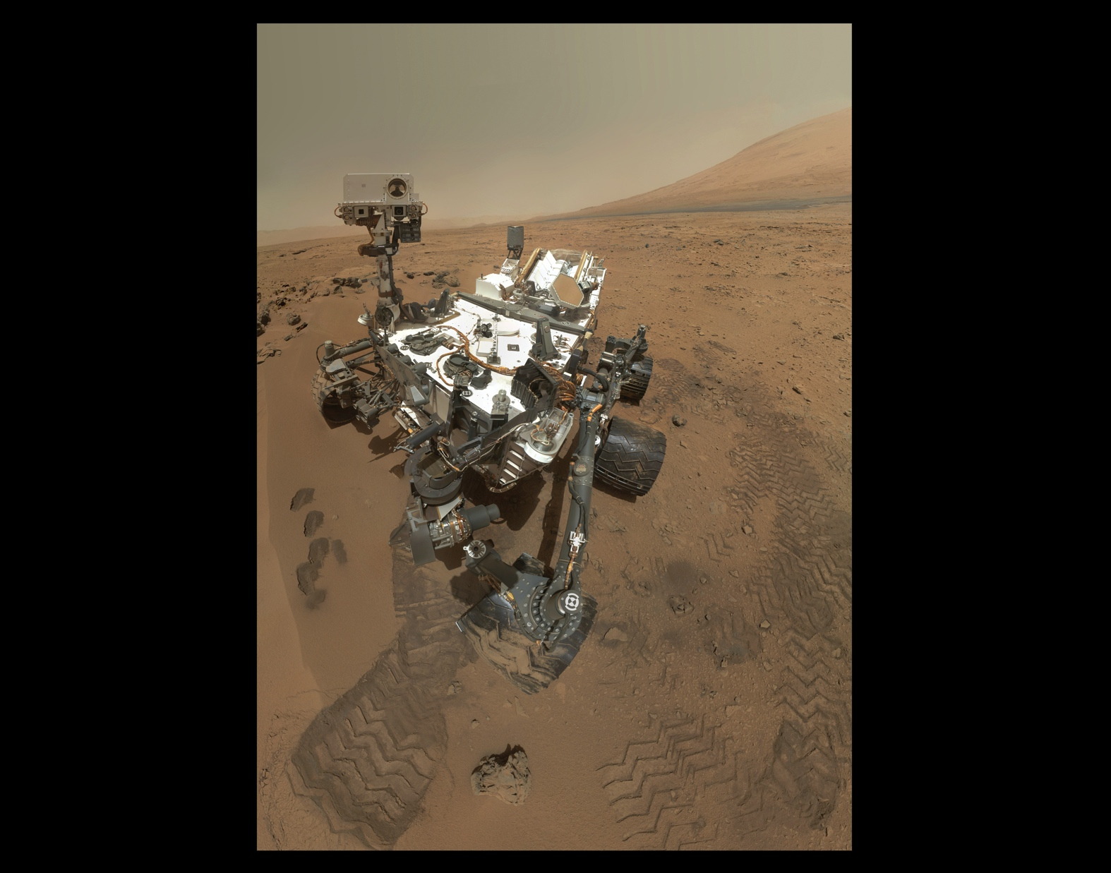
Notes:
On October 31, 2012, the Mars Science Laboratory’s Curiosity rover captured this “self-portrait.” Curiosity used the Mars Hand Lens Imager (MAHLI) located at the end of its robotic arm to capture a set of 55 thumbnail images that were then stitched together to create this full-color mosaic. The rover is located at "Rocknest," the spot in Gale Crater where the mission's first scoop sampling took place. Four scoop scars can be seen in the regolith in front of the rover. A fifth scoop was collected later.
The rover’s robotic arm was positioned out of the shot in the images, or portions of images, used to create the mosaic and therefore, is not visible. Self-portraits like this one document the state of the rover and allow mission engineers to track changes over time, such as dust accumulation and wheel wear. Only MAHLI (among the rover's 17 cameras) is able to image some parts of the craft, including the port-side wheels.
August 5, 2014, is the second Earth-year anniversary of Curiosity’s landing on Mars. After a nearly perfect landing in 2012, the rover has been working its way up the rugged slopes of Mount Sharp, which rise about 3.4 miles (5.5 kilometers) above Gale Crater. Along the way, the rover has been using its 10 instruments to study the composition of the Martian surface and search for any signs that this area could have ever supported life.

