Slide 1
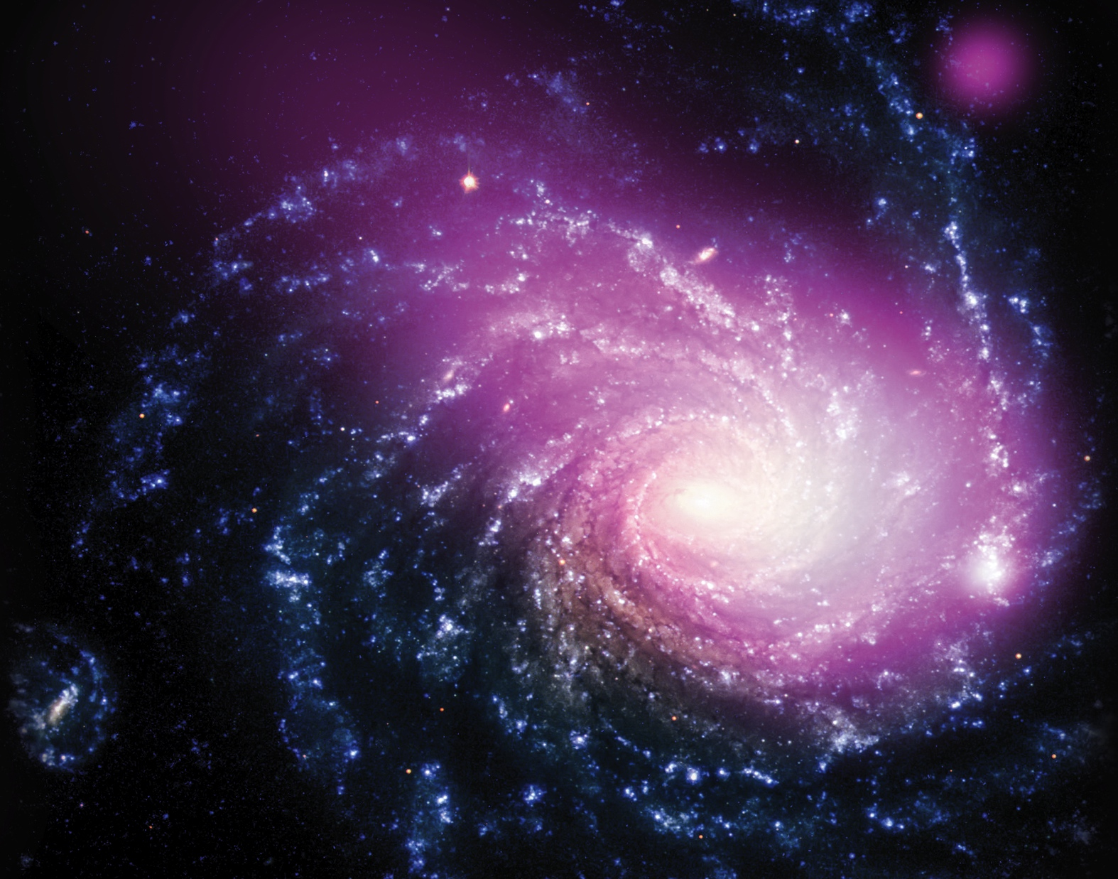
Notes:
Shown here, observations from NASA's Chandra X-ray telescope reveal a massive cloud of multimillion-degree gas in a galaxy about 60 million light years from Earth. The hot gas cloud is likely caused by a collision between a dwarf galaxy [bottom left] and a much larger galaxy called NGC 1232 [center]. The image, which combines X-rays and optical light, shows the scene of the collision. Chandra X-ray data, in purple, show the hot gas has a comet-like appearance, caused by the motion of the dwarf galaxy. Optical data from the European Southern Observatory's Very Large Telescope reveal the spiral galaxy in blue and white. The X-ray emission source at the top right of the image appears to be unrelated to the galaxy collision.
If confirmed, this discovery would mark the first time such a collision has been detected only in X-rays, and could have implications for understanding how galaxies grow through similar collisions. The impact between the dwarf galaxy and the spiral galaxy caused a shock wave—akin to a sonic boom on Earth—that generated the hot gas with a temperature of about 6 million degrees.

