Slide 1
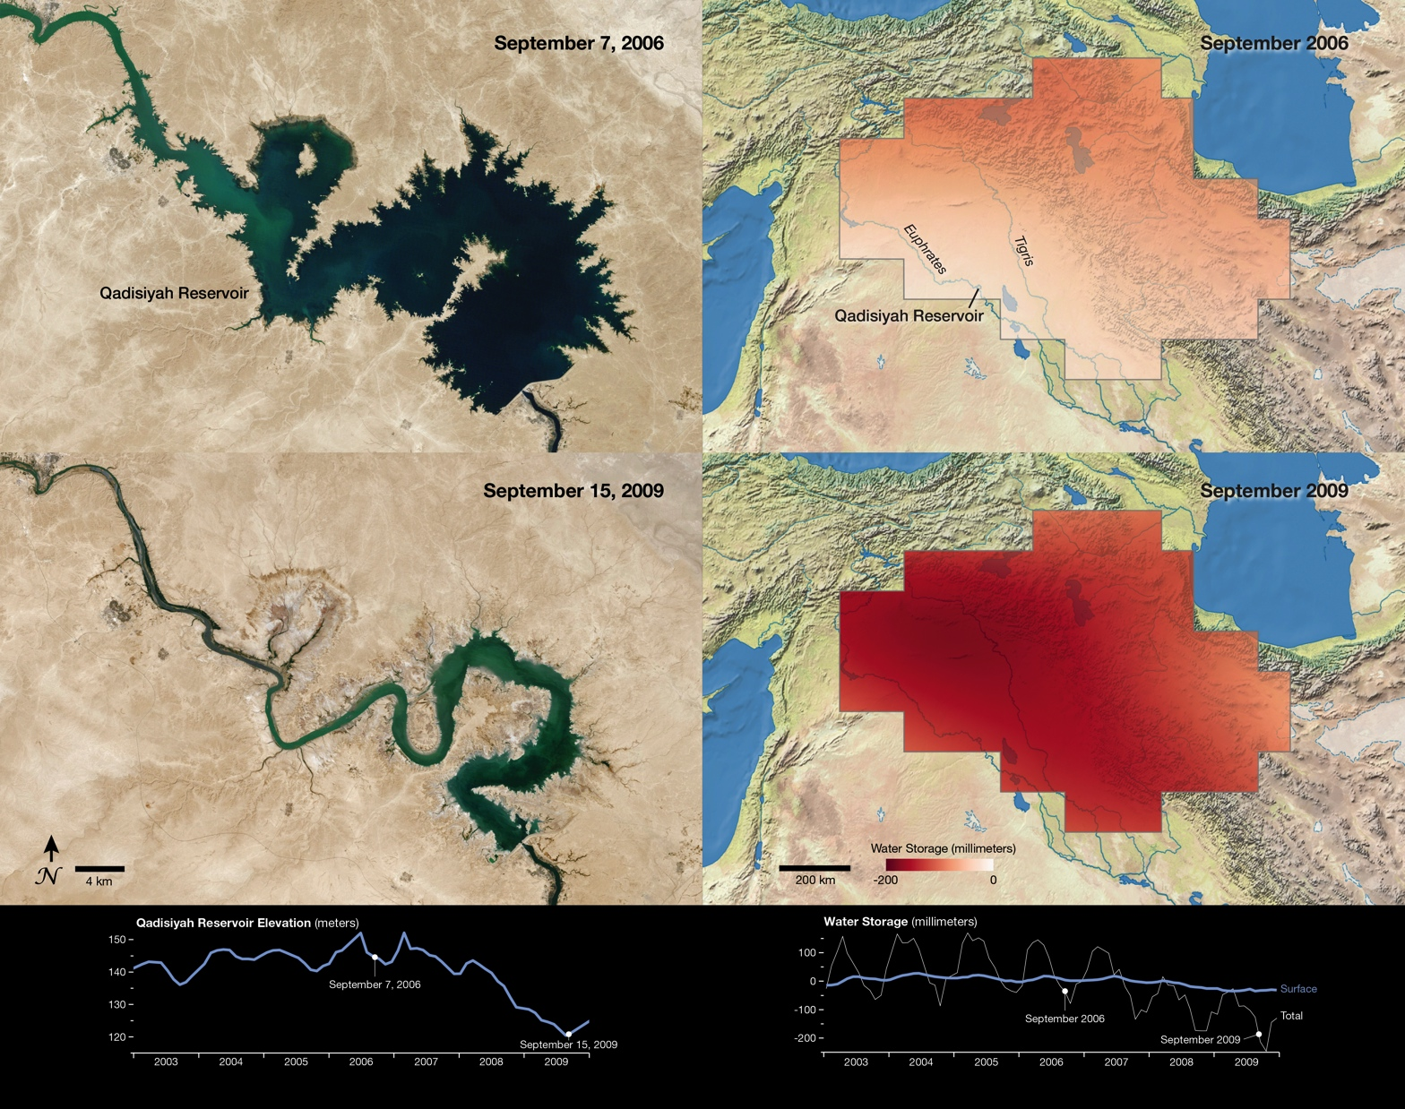
Notes:
A study using data from NASA’s Gravity Recovery and Climate Experiment (GRACE) satellites found that large parts of the arid Middle East region lost freshwater reserves rapidly during the past decade. Meanwhile, demand for freshwater continues to rise. The two natural-color images on the left were acquired by the Landsat 5 satellite and show the shrinking of the Qadisiyah Reservoir in Iraq between September 7, 2006 [top left] and September 15, 2009 [bottom left]. The graph below these two images shows the elevation of the water in that reservoir between January 2003 and December 2009. The elevation is a proxy measurement for the total volume of water stored there.
The two regional images on the right were created with GRACE data and show total water storage in the Tigris and Euphrates river basins for September 2003 [top right] and September 2009 [bottom right]. The graph shows a decrease in water storage for the study area as measured by GRACE from January 2003 to December 2009. The gray line depicts total water storage—groundwater, surface water bodies, and soil moisture—while the green line depicts changes in surface water. The difference between those two lines reflects the change in water stored in underground aquifers. The total water storage shows a seasonal fluctuation, but also an overall downward trend, suggesting that groundwater is being pumped and used faster than natural processes can replenish it. Data from satellites such as GRACE are essential to providing a more complete global picture of water storage trends.

